Slide 1



Slide 2
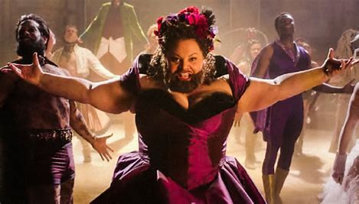
SINGER
Keala Seatle
Profile
・November 5th 1975
・From Hawaii
・Active 2002-present
A musical actress
・the role of Becky in the stage musical “Waitress”
・the role of Lettie Lutz in the musical drama “The Greatest Showman”
A nominated actress
・”Outer Critics Circle Award” ”Drama Desk Award” “Tony Award”

Slide 3
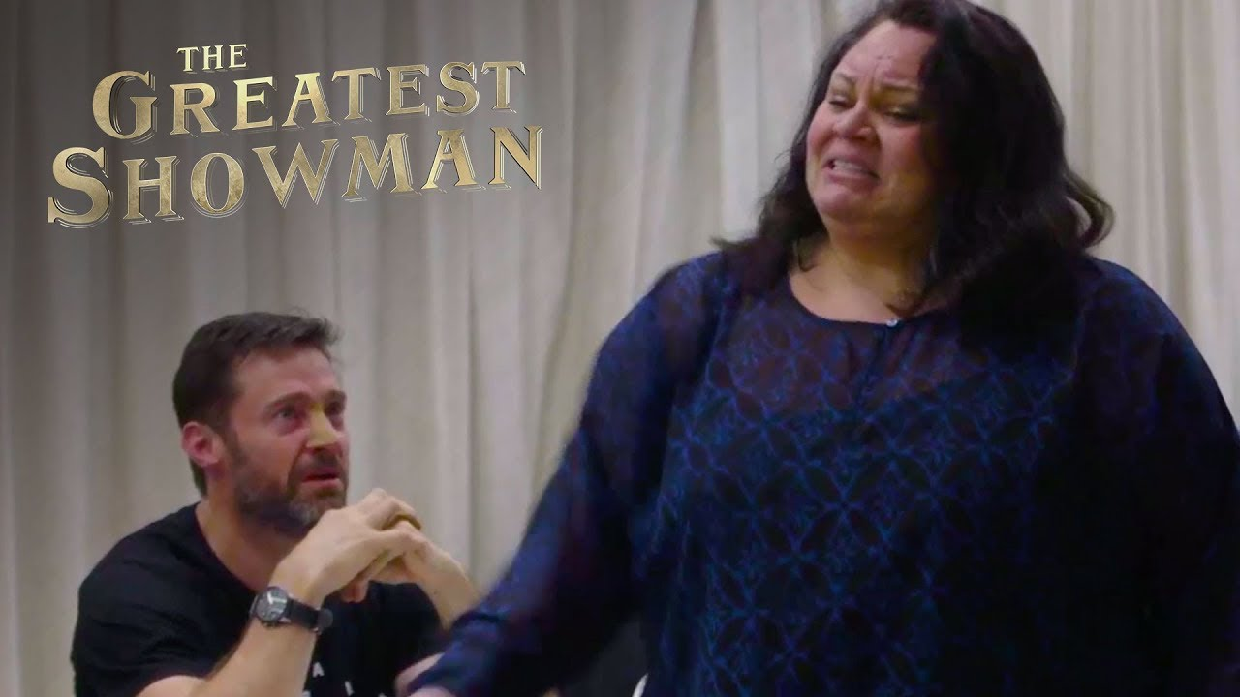
GENRE
・Pop music
・A song which appears in “The Greatest showman”
・A song empowering those who are ostracized by society for being different
・A fight song for the underdog

Slide 4
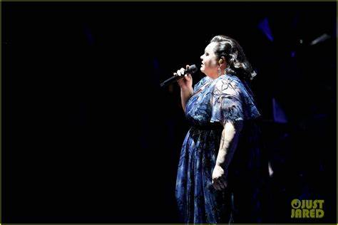
LYRIC
I’m not a stranger to the dark.
→She is always treated harshly by people around her.
But I won’t let them break me down to dust.
→She decided to fight against those who abuse her.
When the sharpest words wanna cut me down, I’m gonna send a flood, gonna drown ‘em out
→When people say nasty things about her, she will make a flood occur and erase the bad words they said.

Slide 5
Listening
https://youtu.be/CjxugyZCfuw

Slide 6
ANSWER
Hide away
bruised
Cause
Look out
learned
bullets
One’ll
sink
break , down
bursting
glorious
worthy
sharpest
drown’em out

Slide 7
Thank you for your listening

