Slide 1

THIS IS ME
Ayuka Yuka Narumi

Slide 2

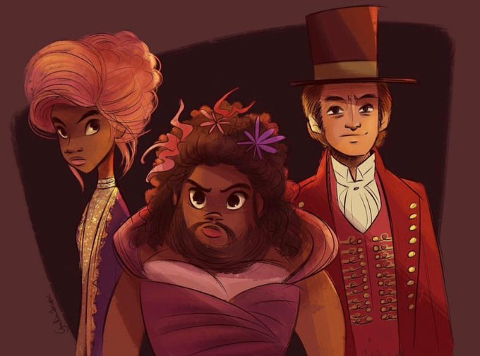

Slide 3

“This is me” won “Best Original Song in Motion Picture" at the 75th Golden Globe Awards.
It was also nominated for “Best Original Song” at the 90th Academy Awards.

Slide 4

This Is Me Keala Settle
[Verse1]
I am not a stranger to the ____
“Hideaway,” they say
““Cause we don’t want your ____ parts”
I’ve learned to be _____of all my ____
“Runaway,” they say
“No one”ll love you as you are”

Slide 5
[Pre-Chorus]
But I won’t let them ___ me down to dust
I know that there’s a place for us
For we are glorious
[Chorus]
When the sharpest words ___ cut me down
I’m ____ send a flood, gonna ____ them out
I am brave, I am bruised
I am who I’m meant to be, this is me
Look out ‘cause here I come
And I’m not scared to be ____
I make no _____, this is me

Slide 6
[Post-Chorus: Ensemble]
Oh-oh-oh-oh,Oh-oh-oh-oh,Oh-oh-oh-oh,Oh-oh-oh-oh,Oh-oh-oh, oh-oh-oh, oh-oh-oh, oh, oh
[Verse2: Lettie Lutz, Ensemble]
Another round of bullets ___ my skin
Well, ___ away 'cause today, I won't let the _____ sink in
We are bursting through the barricades
And reaching for the ___
(We are warriors!)
Yeah, that's what we've become
(Yeah, that's what we've become)

Slide 7
[Pre-Chorus]
[Chorus]
[Post- Chorus:]This is me
[Bridge: Lettie Lutz, Ensemble]
Oh-oh-oh-oh
And I know that I _____ your love
Oh-oh-oh-oh
There's nothing I'm not worthy of
Oh-oh-oh, oh-oh-oh, oh-oh-oh, oh, oh
[Pre-Chorus]
[Chorus]

Slide 8

Let’s listen and correct the answer!!

Slide 9
● ● ● ●
When the sharpest words wanna cut me down
I‘m gonna send a flood, gonna drown them out
I am brave, I am bruised
I am who I’m meant to be,
this is me
Look out 'cause here I come
And I’m marching on to the beat I drum
I’m not scared to be seen
I make no apologies, this is me

Slide 10

Quiz TIME!!!
Which is correct answer?
Remember, guess, and aim for correct answers to all questions!
Let’s count how many questions you answered correctly!

Slide 11
“THIS IS ME” is the theme song of
“The Greatest Showman”
YES
NO

Slide 12
What is the purpose of “THIS IS ME” ?a
To encourage
To feel sad
c. For Love
d. For peace

Slide 13
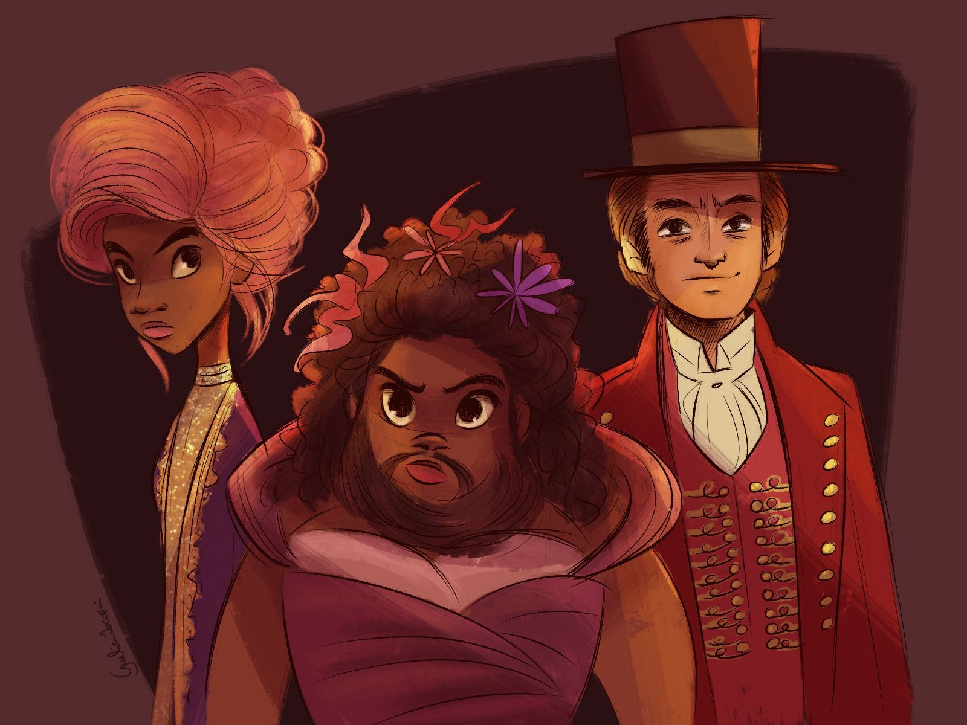
Who sings “THIS IS ME”?
a
c
b

Slide 14
Thank you for listening!
Please enjoy this song!!

