Slide 1
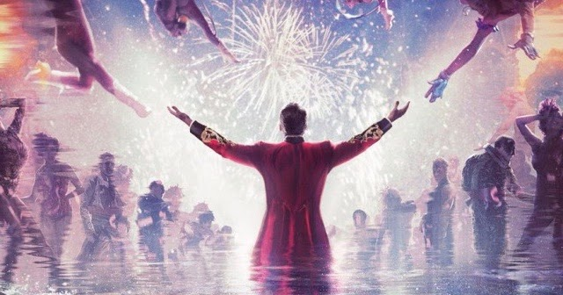
Do you have
confidence to yourself？
https://www.youtube.com/watch?v=CjxugyZCfuw

Slide 2
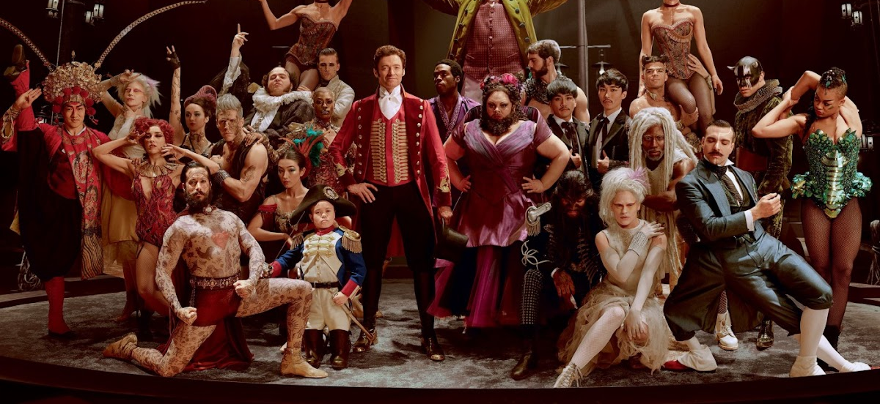
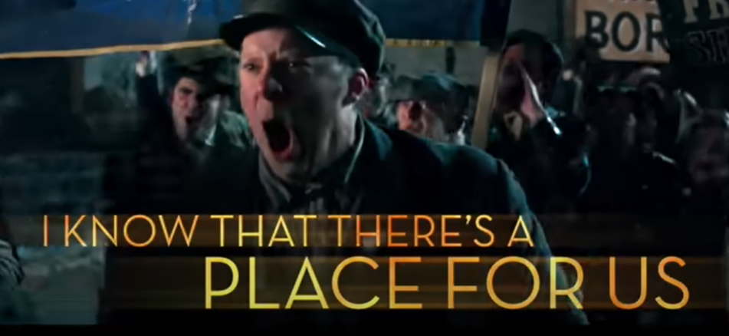
What we see in this video
Freak or Strange People fight with social stereotype
https://www.youtube.com/watch?v=CjxugyZCfuw
この写真 の作成者 不明な作成者 は CC BY-NC-ND のライセンスを許諾されています
Notes:
In this part of the presentation, I’ll talk about the key visual elements we noticed in the video.
1.Freak or Strange People
In the video, there are characters who are different from social stereotipe. They might be seen as freaks or strange people because of some person's height is small and other person wear a beard on her jaw in spite of women. In the middle of seane, there is dancing seane that strange people are dancing outcide.
And we can watch the people having Frag or touch are protesting with stranger people.From this, I could guess the local people are scared of them.

Slide 3
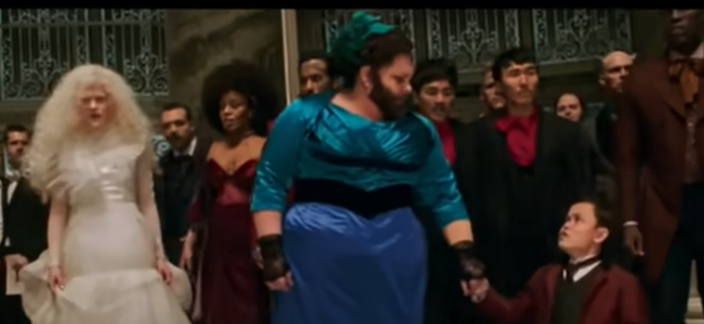
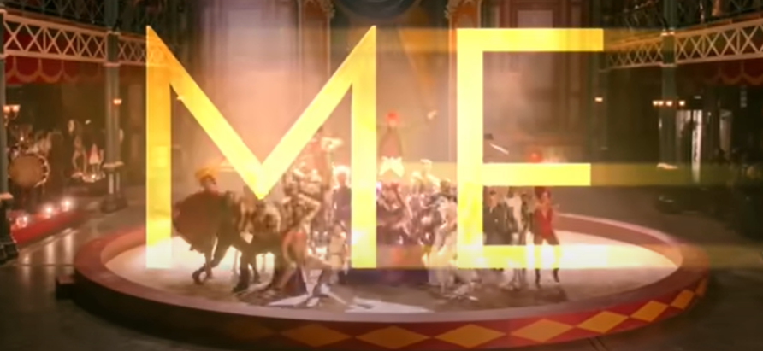
The woman and her’s mate have strong confident
https://www.youtube.com/watch?v=CjxugyZCfuw

Slide 4
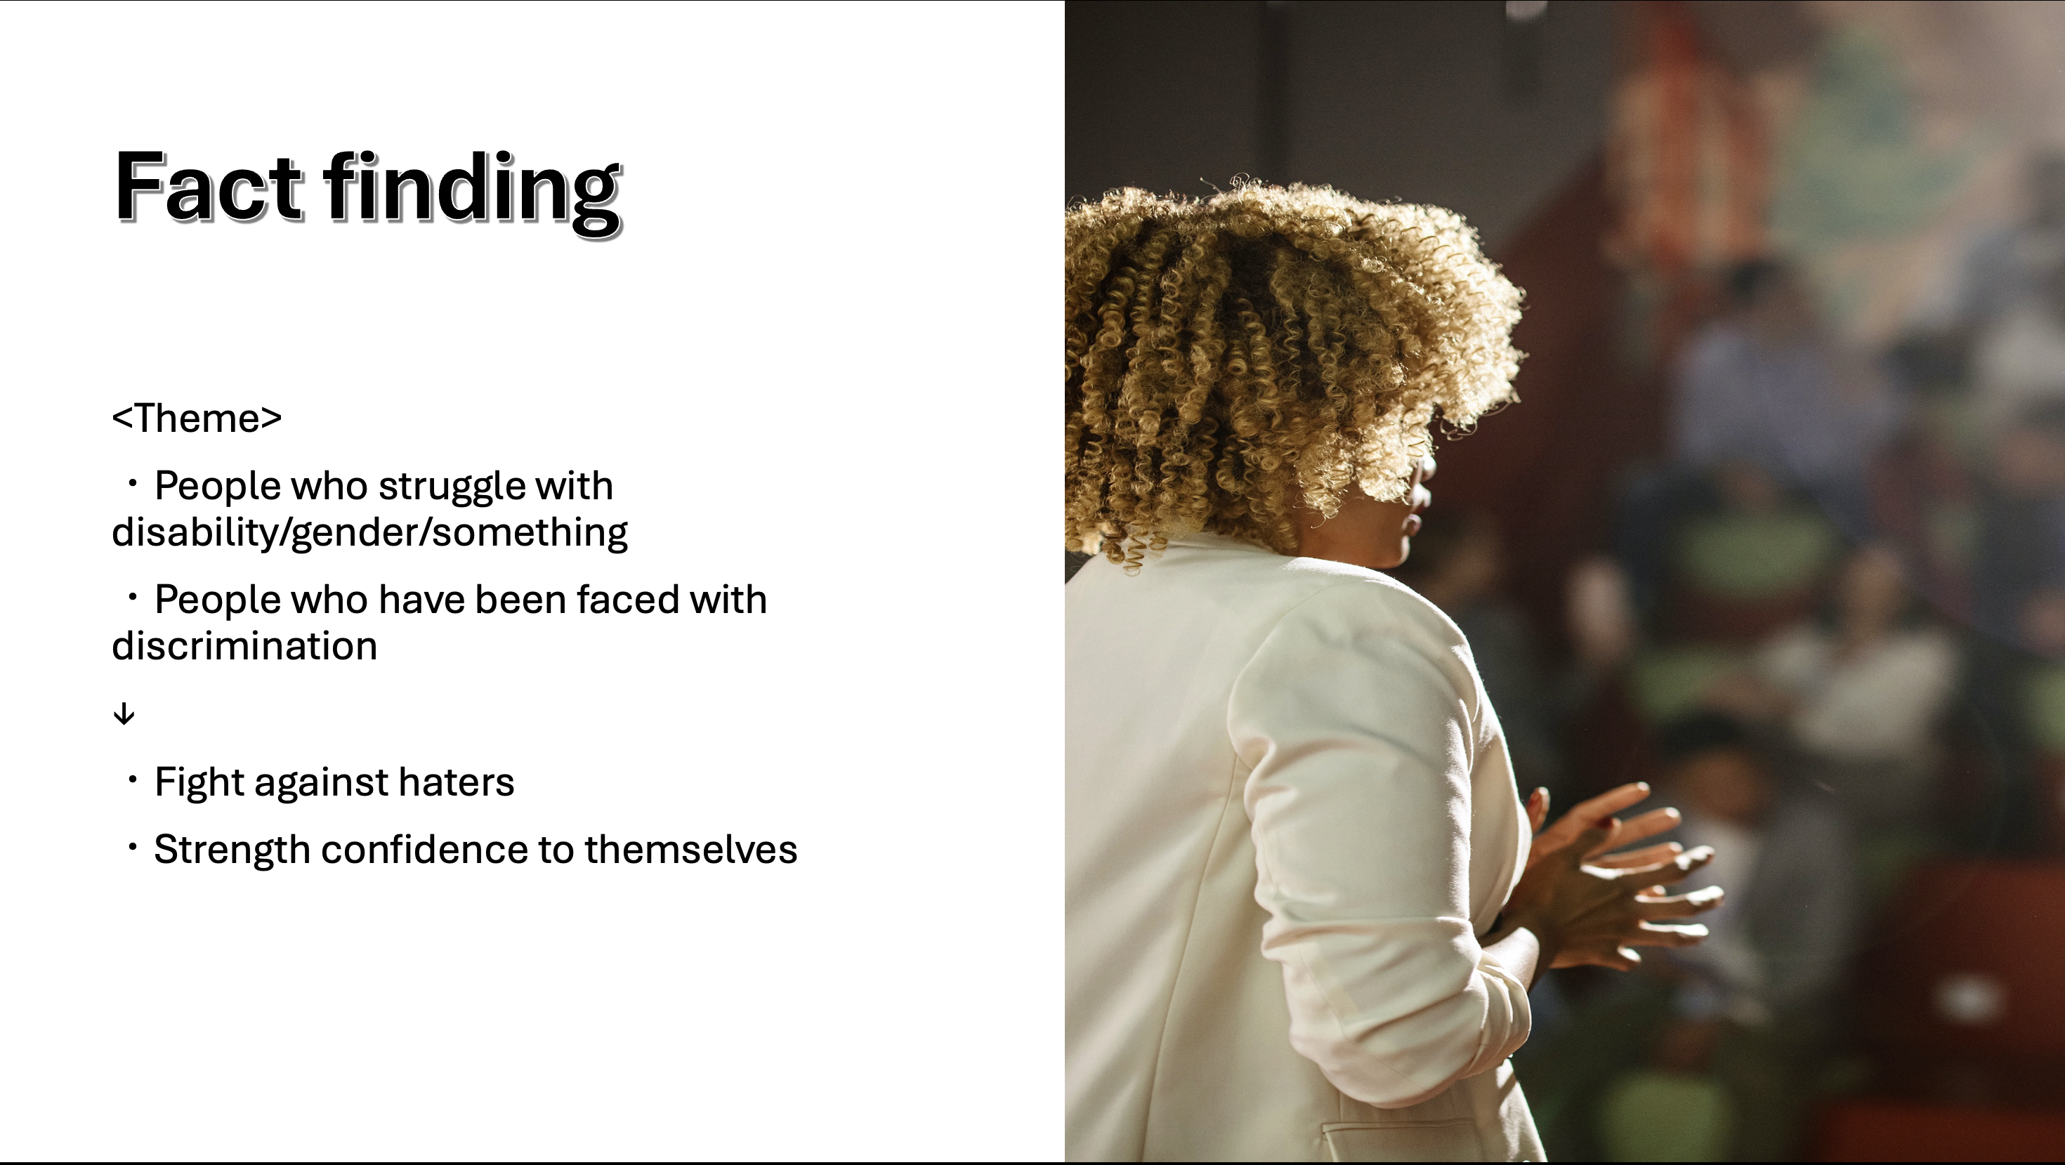
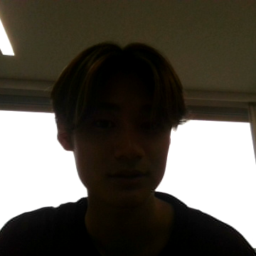
https://www.youtube.com/watch?v=CjxugyZCfuw

Slide 5
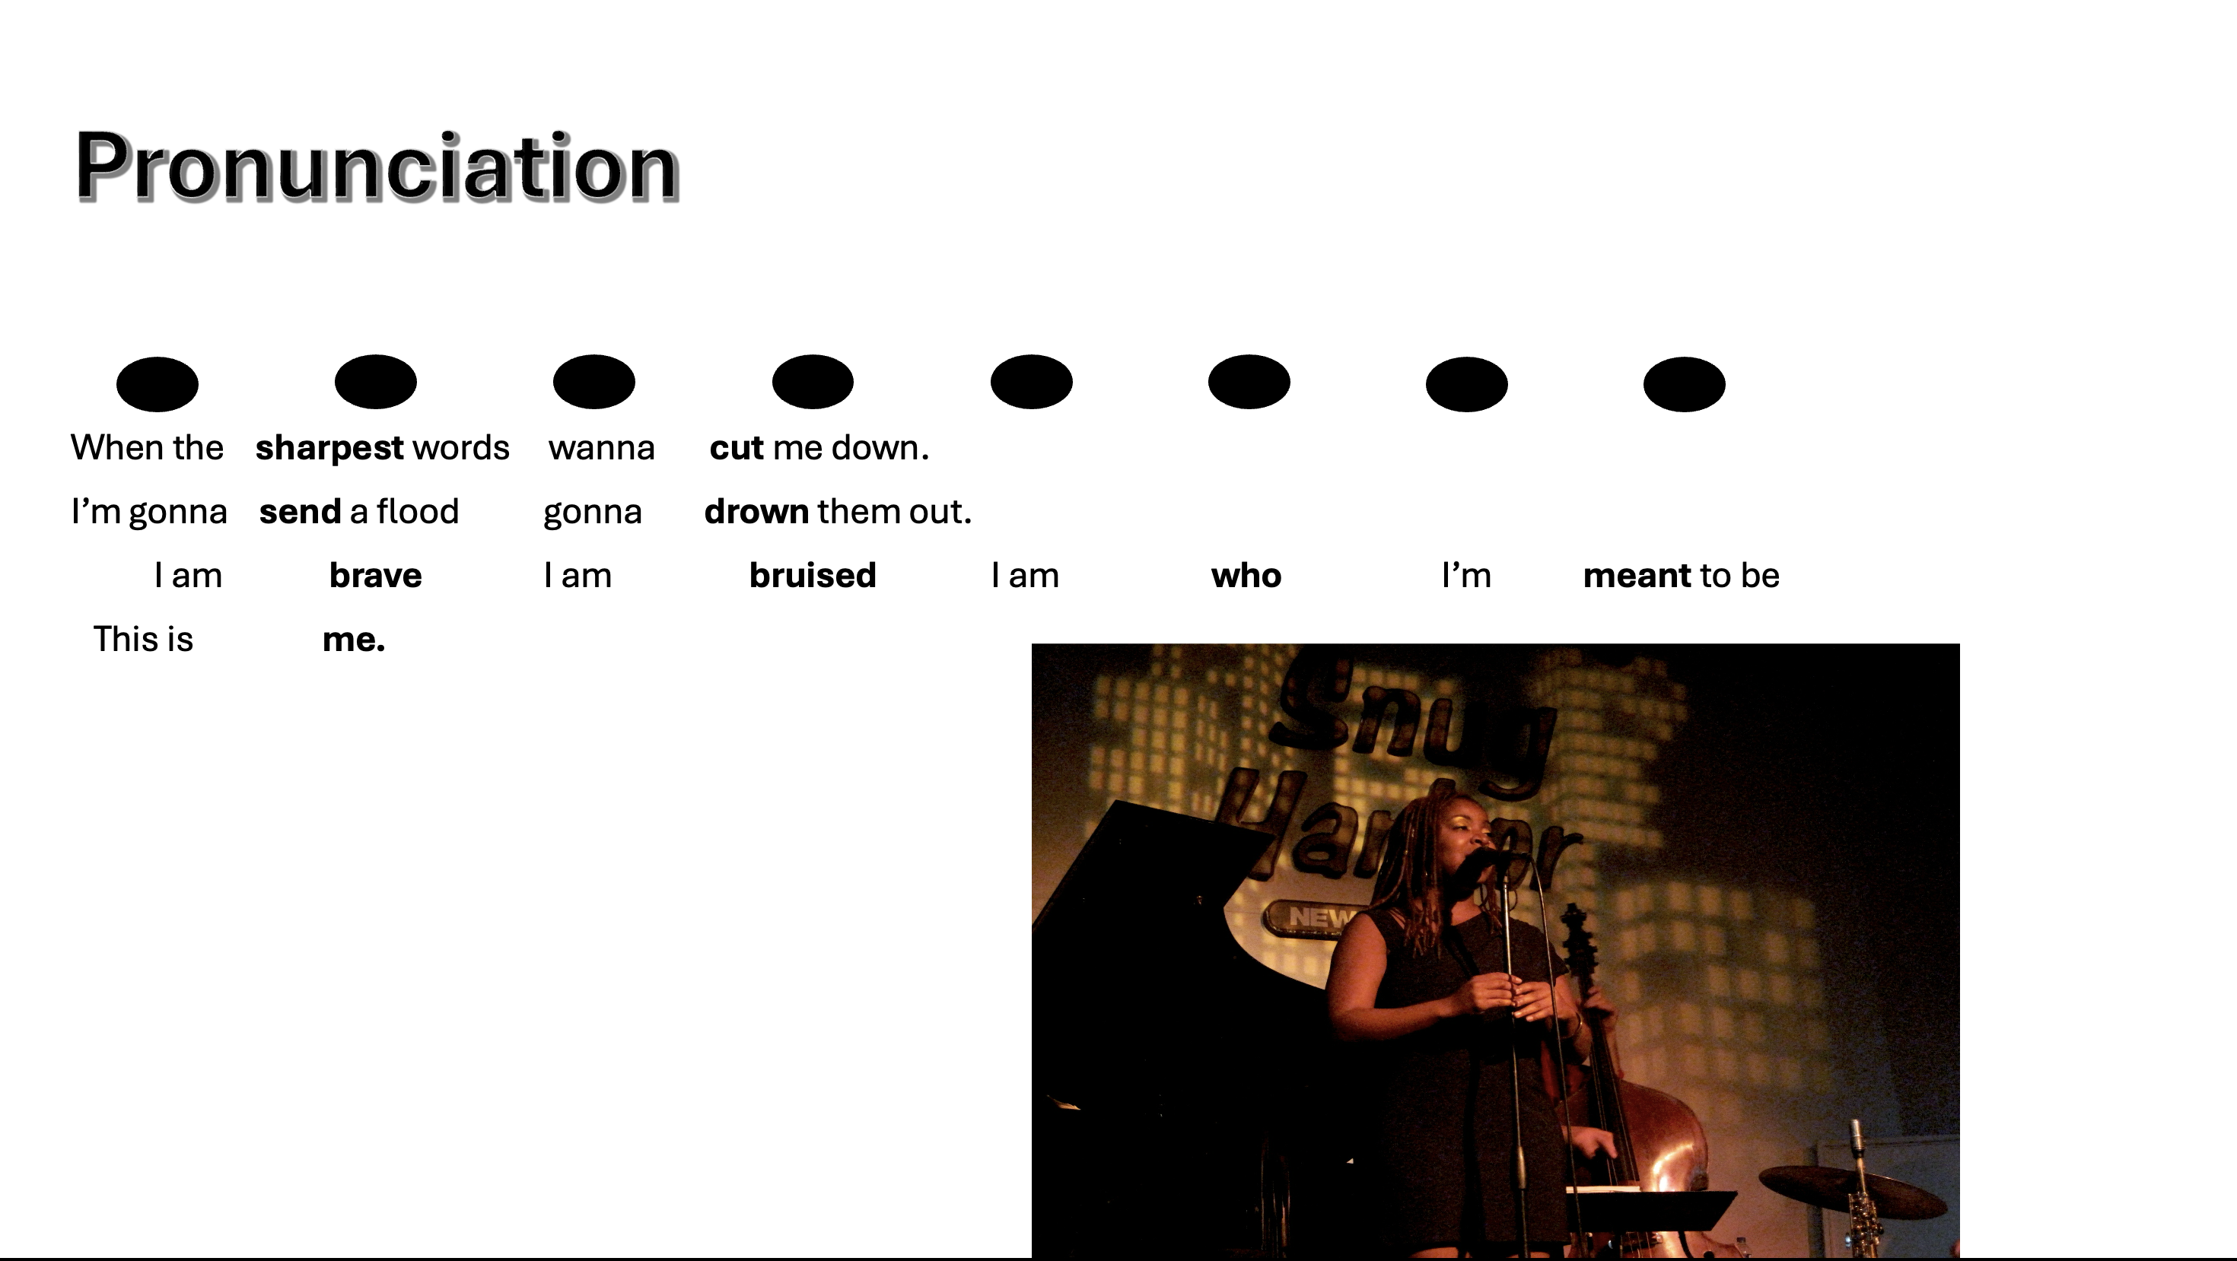
https://www.youtube.com/watch?v=CjxugyZCfuw

Slide 6
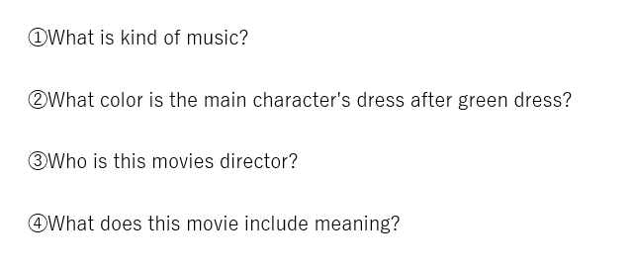
Question
https://www.youtube.com/watch?v=CjxugyZCfuw

Slide 7
Answer of the question
https://www.youtube.com/watch?v=CjxugyZCfuw
①What is kind of music?
⇒It’s pops.
②What color is the main character's dress after green dress?
⇒It's pink.
③Who is this movies director?
⇒Michel Gracey.
④What does this movie include meaning?
⇒ No matter who you are, you​ deserves to​ be respected, and
You should behave as you are.

