Slide 1
The history of human emotions by Tiffany Watt Smith

Slide 2
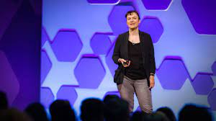
About the Content
Link: https://www.ted.com/talks/tiffany_watt_smith_the_history_of_human_emotions?subtitle=ja
Speaker: Tiffany Watt Smith (cultural historian)
Related Tags: Culture, History, Communication,
Language, Humanity, Society, Emotions…

Slide 3

Reason Why I Chose This Presentation
In the class where we talked about the rhetoric of RuPaul, I confirmed that many of us rely most on our emotions when communicating.
However, how well do we understand and consciously confront ourselves with regard to those emotions?
I think it would be very useful for us to know how we perceive our emotions through different languages and cultures, and how we have changed and adapted our awareness of them.

Slide 4
Vocabulary & Grammar
exhilaration: the feeling close to joy or excitement, “Hwyl” in Welsh
delirium: mental state of being unable to think or speak clearly because of extreme excitement
troubadours: a singer or poet active in the Middle Ages
dismay: worried, sad, shocked or disappointed
lethargy: the feeling of having little energy or of being unable or unwilling to do anything
smug: too pleased or satisfied about something you have achieved

Slide 5

Engaging questions
Which of the examples presented in the presentation impressed you the most?
What emotional words do you prefer/not prefer?
How would you translate or explain the word “Amae” in English?
Through your foreign (language) studies or cross-cultural interactions, have you ever noticed that a particular emotion was perceived differently in another region or language?

Slide 6
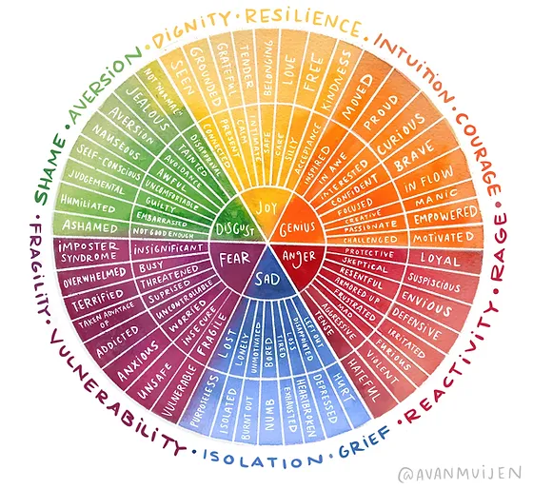
Fun Activity
Choose one word that describes a unique emotion in your native or major language!
Translate it into English or explain its meaning in your own way.
Then, discuss (with multiple variations if possible) the reason/background for the recognition of the word and emotion, and how the perception of that has changed over time.

