Slide 1
THE MARTIAN

Slide 2
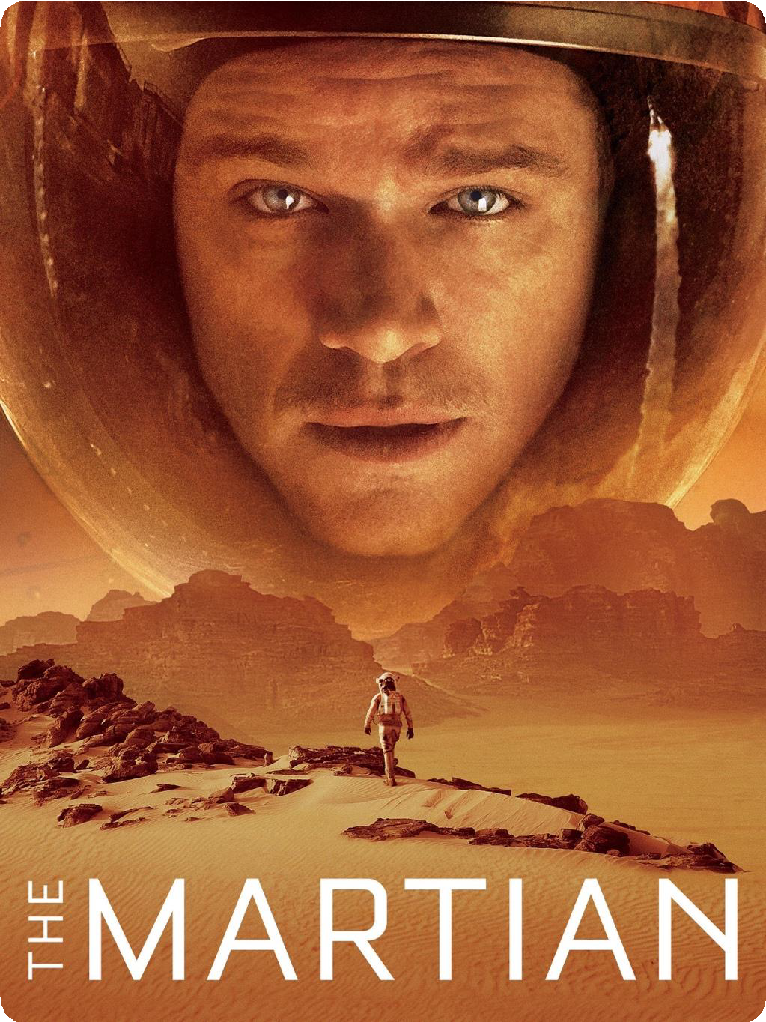

https://youtu.be/DKd6- ugozkA?si=aisgdcou6QC6dbi9
Background
An astronaut becomes stranded on Mars after his team assume him dead, and must rely on his ingenuity to find a way to signal to Earth that he is alive and can survive until a potential rescue.
To obtain food to survive, he tries to plant potatoes using his knowledge as a botanist.

Slide 3
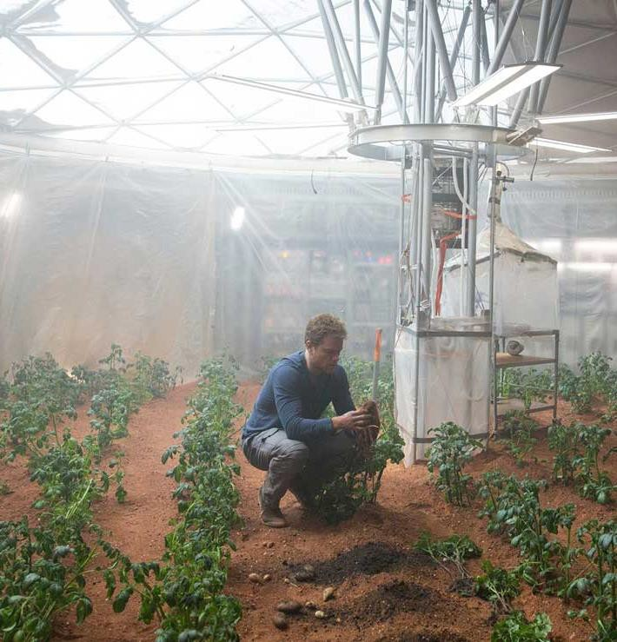
Transcript
Surprise. I did not die on Sol 18. If the oxygenator breaks, I'll suffocate. If the water reclaimer breaks, I'll die of thirst. If the Hab breaches, I'll just sort of... implode. And if, by some miracle, none of that happens... eventually I'm going to run out of food.
I’m not going to die here.
Our surface mission here was supposed to last 31 sols. For redundancy, they sent 68 sols worth of food. That's
for 6 people. So for just me, that's gonna last 300 sols... which I figure I can stretch to 400 if I ration. So I got to figure out a way to grow three years' worth of food here. On a planet where nothing grows. Luckily... I'm a botanist.
The problem is water... I've created one-hundred and twenty-six square meters of soil. But each cubic meter needs 40 liters of water to be farmable. So, I gonna make a lot of water. Fortunately, I know the recipe. Take hydrogen. Add oxygen. Burn. Unfortunately... burn. I have hundreds of liters of unused Hydrazine from the MDV. If I run the Hydrazine over an iridium catalyst, it'll separate into N2 and H2.. Then I just need to direct the hydrogen into a small area and burn it. Luckily, in the history of humanity, nothing bad has ever happened from lighting hydrogen on fire. NASA hates fire. Because of the whole "fire makes everyone die in space" thing.
Okay…
It's been 48 sols since I planted the potatoes, so now its time to reap and re- sow. They grew even better than I expected. I now have 400 healthy potato plants. I dug them up being careful to leave their plants alive. The smaller ones I'll re-seed. The larger ones are my food supply. All natural, organic, Martian-grown potatoes. You don't hear that every day, do you?

Slide 4

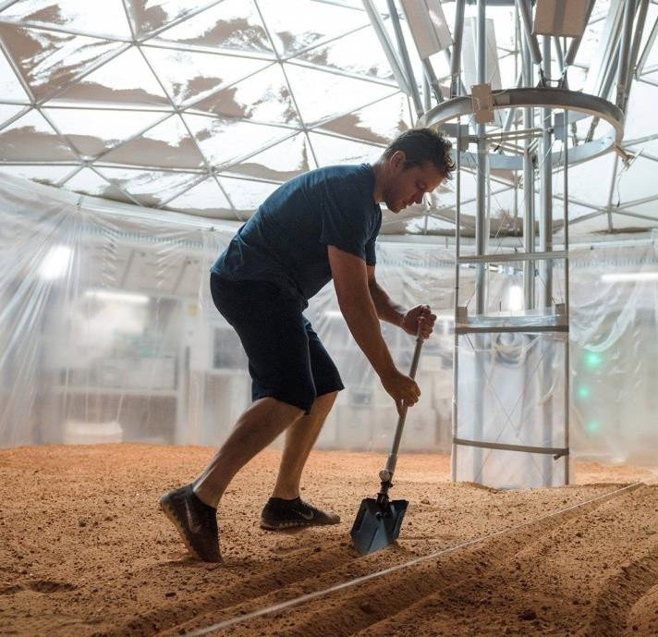
Why chose it
Because I was impressed by the idea of using his botanist wisdom to grow potatoes in the critical situation of being stranded on Mars.
I like this scene, which is fictional but very realistic.

Slide 5

Vocabulary
suffocate
to die because there is no air to breathe
implode
to collapse into the center
redundancy
the state of not being necessary or useful
catalyst
a substance that makes a chemical reaction happen faster without being changed itself
reap
to cut and collect a crop from a field
breach
To make a hole in a wall, fence, etc.
run out of
to use up or finish a supply of something
ration
a fixed amount of food, fuel, etc. that you are officially allowed to have when there is not enough for everyone to have as much as they want, for example during a war

Slide 6


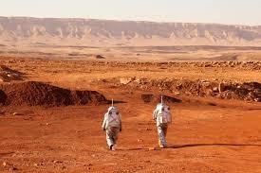
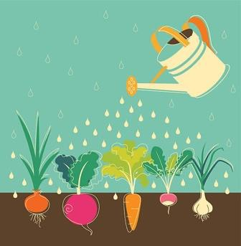
Questions
If you were stranded on Mars, what would you do to survive?
Have you ever grown vegetables?
If yes, what knowledge did you use to grow the vegetables?
If no, what vegetables would you like to grow in the future and how?

Slide 7
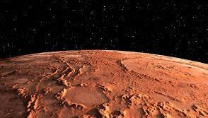
Fun activity
General Knowledge Quiz about Mars!
What is the number of the planet Mars from the sun?
①1 ②7 ③4
How many moons does Mars have?
①2 ②3 ③10
Why does Mars look red?
①Because it‘s burning. ②Because it’s hot.
③Because it's covered with red soil.

Slide 8
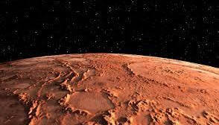
Fun activity ~Answers~
General Knowledge Quiz about Mars!
What is the number of the planet Mars from the sun?
①1 ②7 ③4
How many moons does Mars have?
①2 ②3 ③10
Why does Mars look red?
①Because it‘s burning. ②Because it’s hot.
③Because it's covered with red soil.

Slide 9
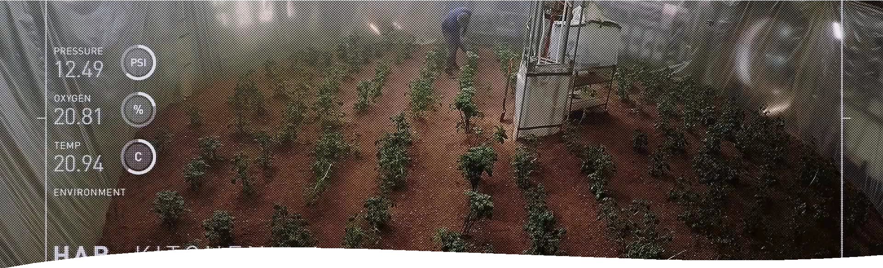
what I learnt from the scene
I learnt a mind that attempts to use the knowledge it has to deal with any situation.
I tried to overcome the problem of miscommunication by watching the film while imagining the words that come next.

Slide 10

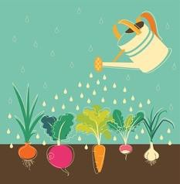
Answers to the Questions
If you were stranded on Mars, what would you do to survive?
I would look for anything on Mars that might be food. If nothing else, I would somehow survive by eating little food I already have.
Have you ever grown vegetables?
If yes, what knowledge did you use to grow the vegetables?
I have grown tomatoes. I put up a support pole so that the vines would grow nicely. I remember being able to grow delicious tomatoes!

