Slide 1
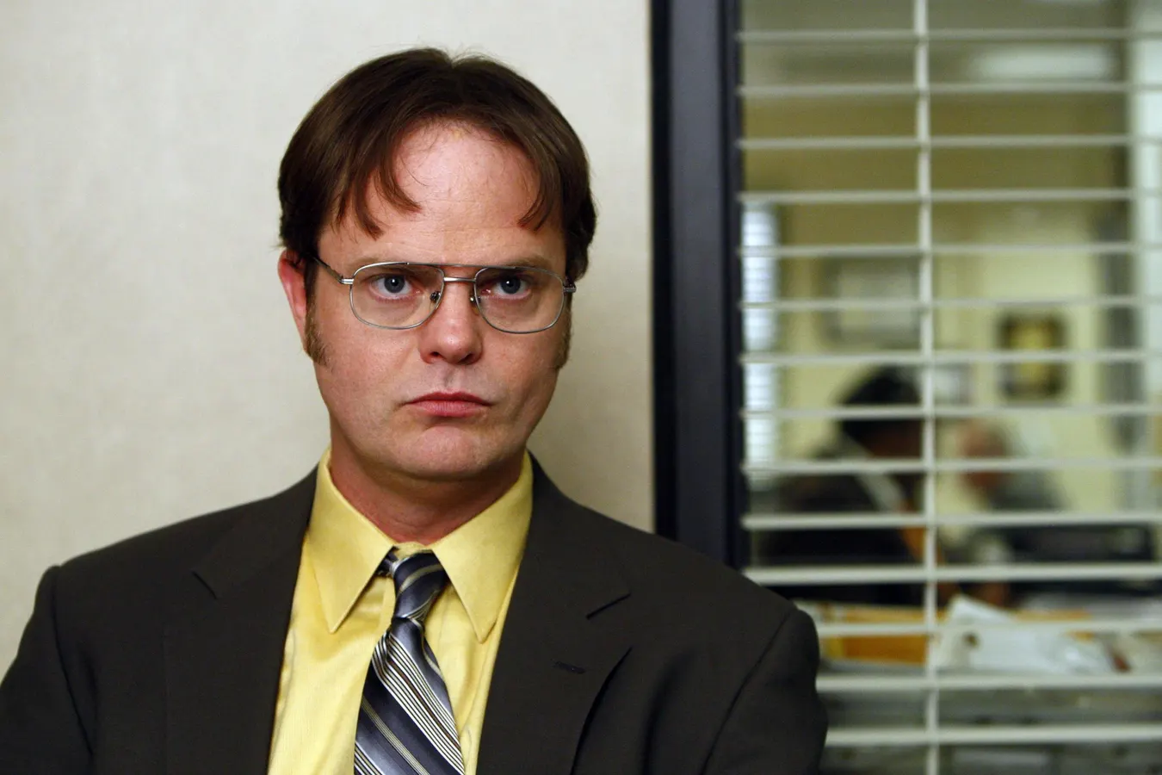
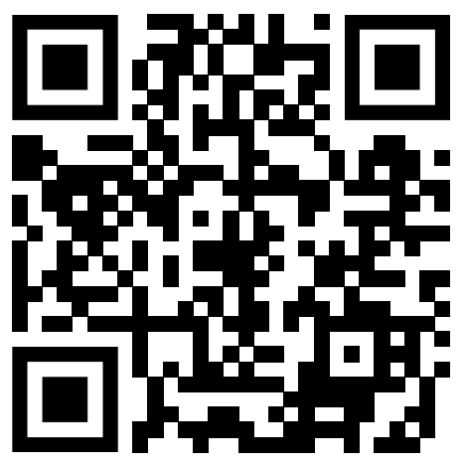
The office
“Dwight’s Drug investigation”
https://youtu.be/b0mOY7OMHh4?si=3Gqzf3gdYgoOCi4D

Slide 2
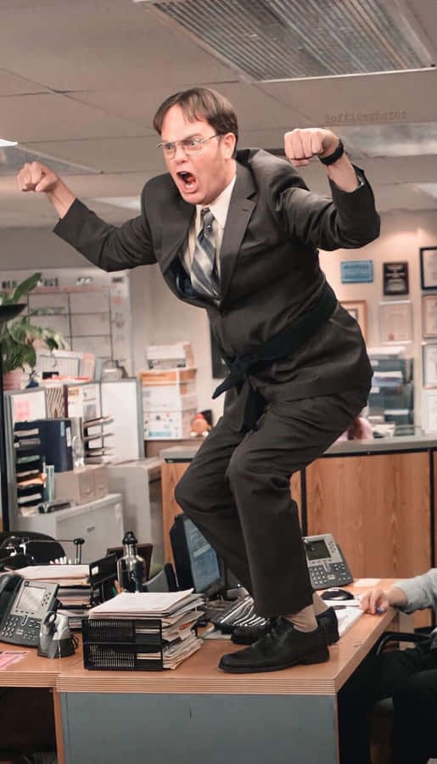
Why I chose this scene
I LOVE The Office!
I used to watch this show all the time with my parents when I used to live with them.
I remember when I saw this scene I couldn't stop laughing!

Slide 3
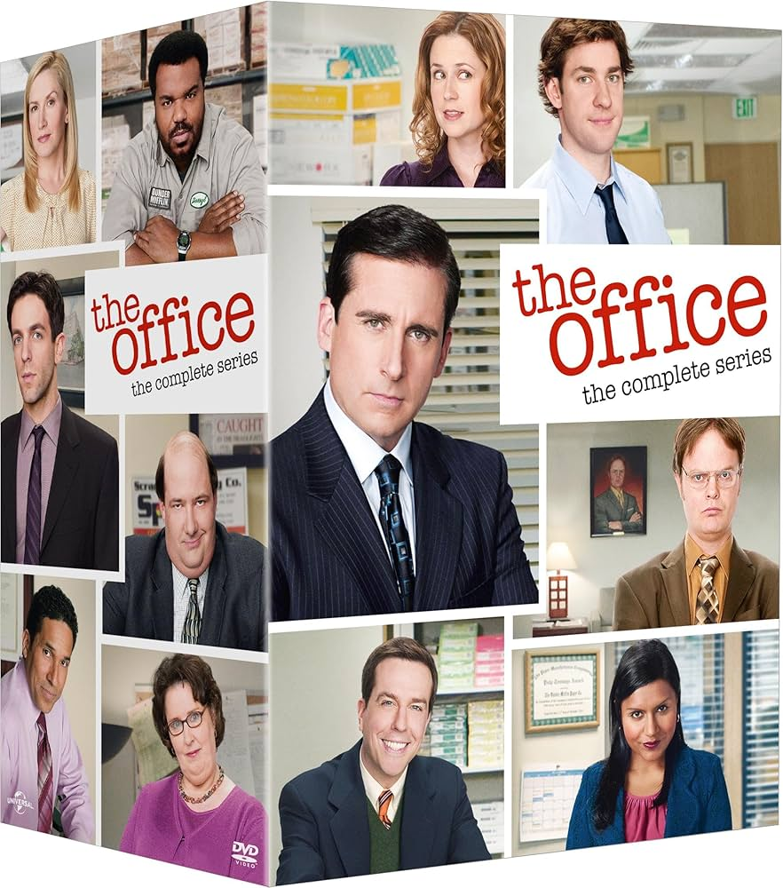
Description of the show/scene
The office is a TV comedy show about a paper company, Dunder Mifflin.
In this scene, drugs were found in the parking lot, and Dwight (a character in The Office) is investigating who’s drug it was.
https://youtu.be/b0mOY7OMHh4?si=3Gqzf3gdYgoOCi4D

Slide 4
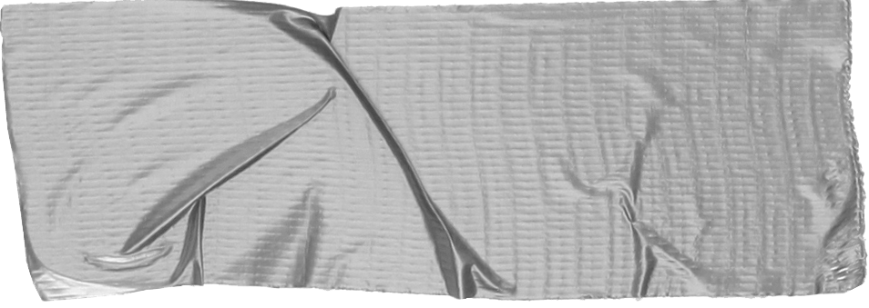

Vocab (words)
Vocab (Phrases)
Drug mule
someone who personally transports illegal drugs
bug
To annoy someone
Nark
1. a police informer (UK)
2. an annoying person or thing (AUS, NZ)
Search warrant
a legal document authorizing a police officer or other official to enter and search premises
I dont wanna blow this.
≒I don’t want to mess this up
Take a chill pill
Calm down
Knock it off!
Stop it!

Slide 5
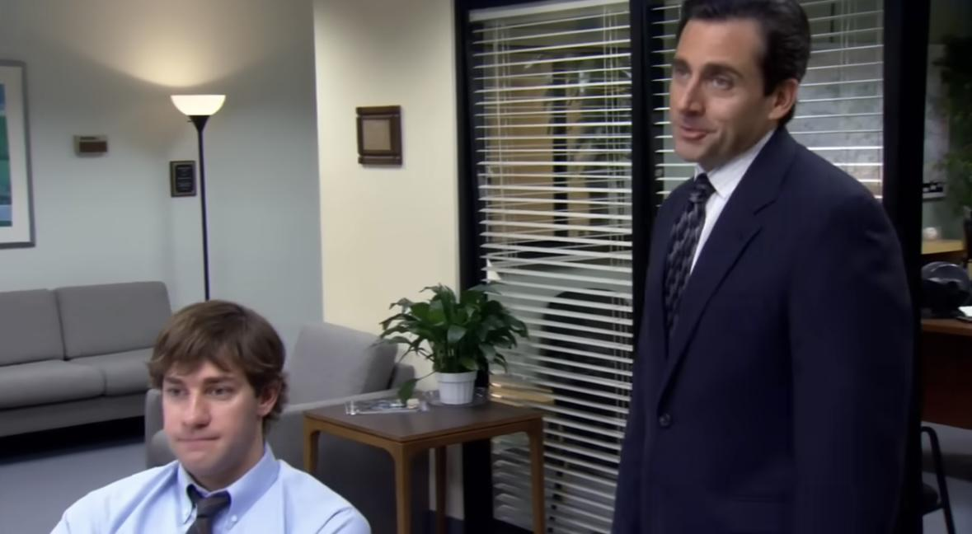
Question 1
What is Michael pretending to be here?
Michael

Slide 6
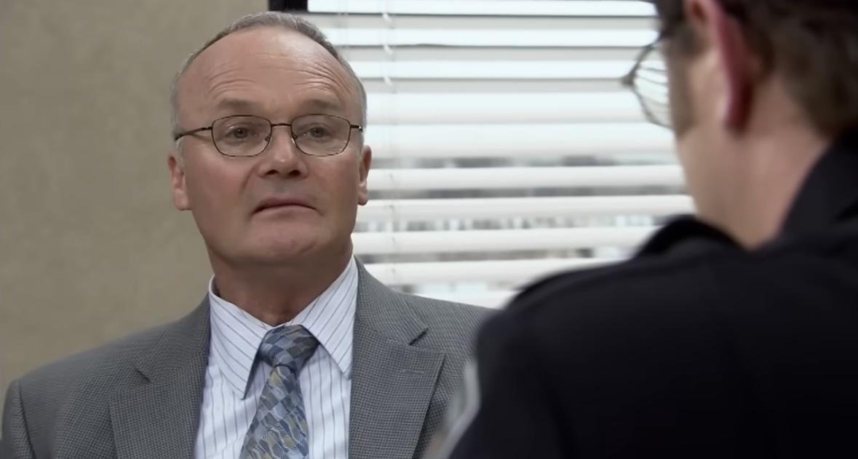
Question 2
What misunderstanding happened in this scene?
Creed
Dwight

Slide 7
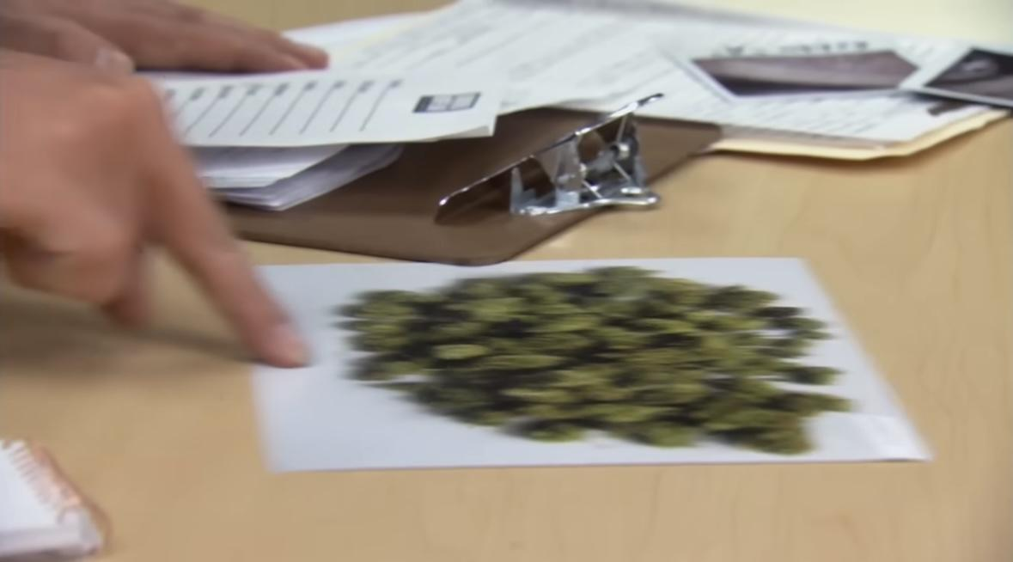
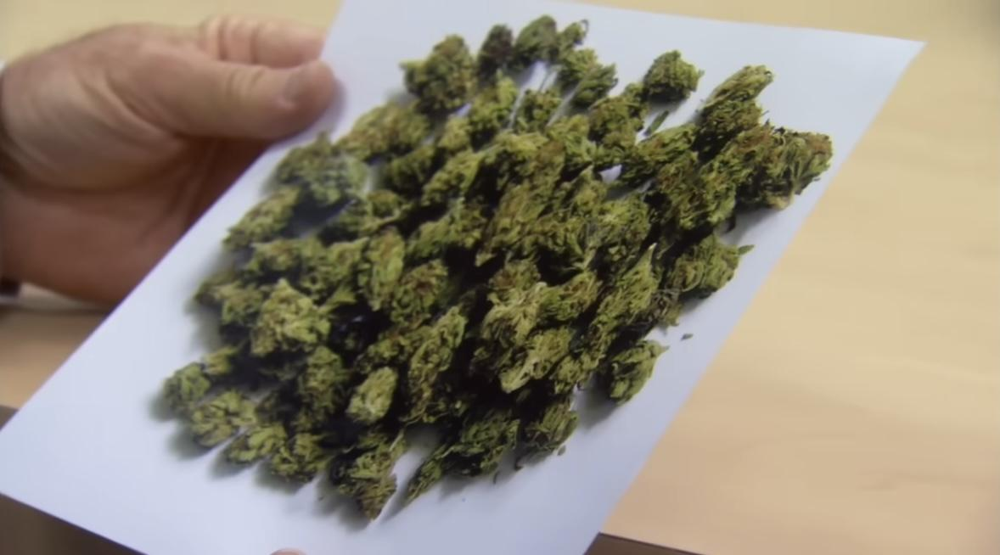
Question 3
List up all synonyms of the word drug in the whole clip:)

Slide 8
What I learned from this scene
Office can be a fun place!
This show makes you realize little moments at work can be fun depending on the way you look at it
Miscommunication
When the boss said ”Nark!” There was a miscommunication due to the word having two meanings. The boss meant “an annoying person” but Dwight understood it as a compliment with the meaning of “a police informer”
Sometimes words have two meanings!
Office style in the US
People are a lot more verbal about things. This can help people who want to work in an international environment!
You can refuse a request from your supervisor
In japan, people tend to just follow and obey what their boss says. However, this scene shows you can say No or walk away if disrespected. (know your worth!)

Slide 9
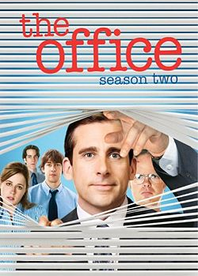
Discussion
1 What did you think of this clip?
2 Which part was the funniest to you?
3 Do you see any differences between the working culture in the US and Japan?

Slide 10
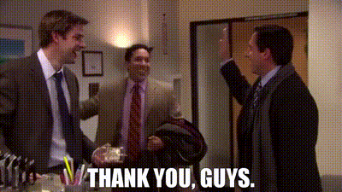

Slide 11
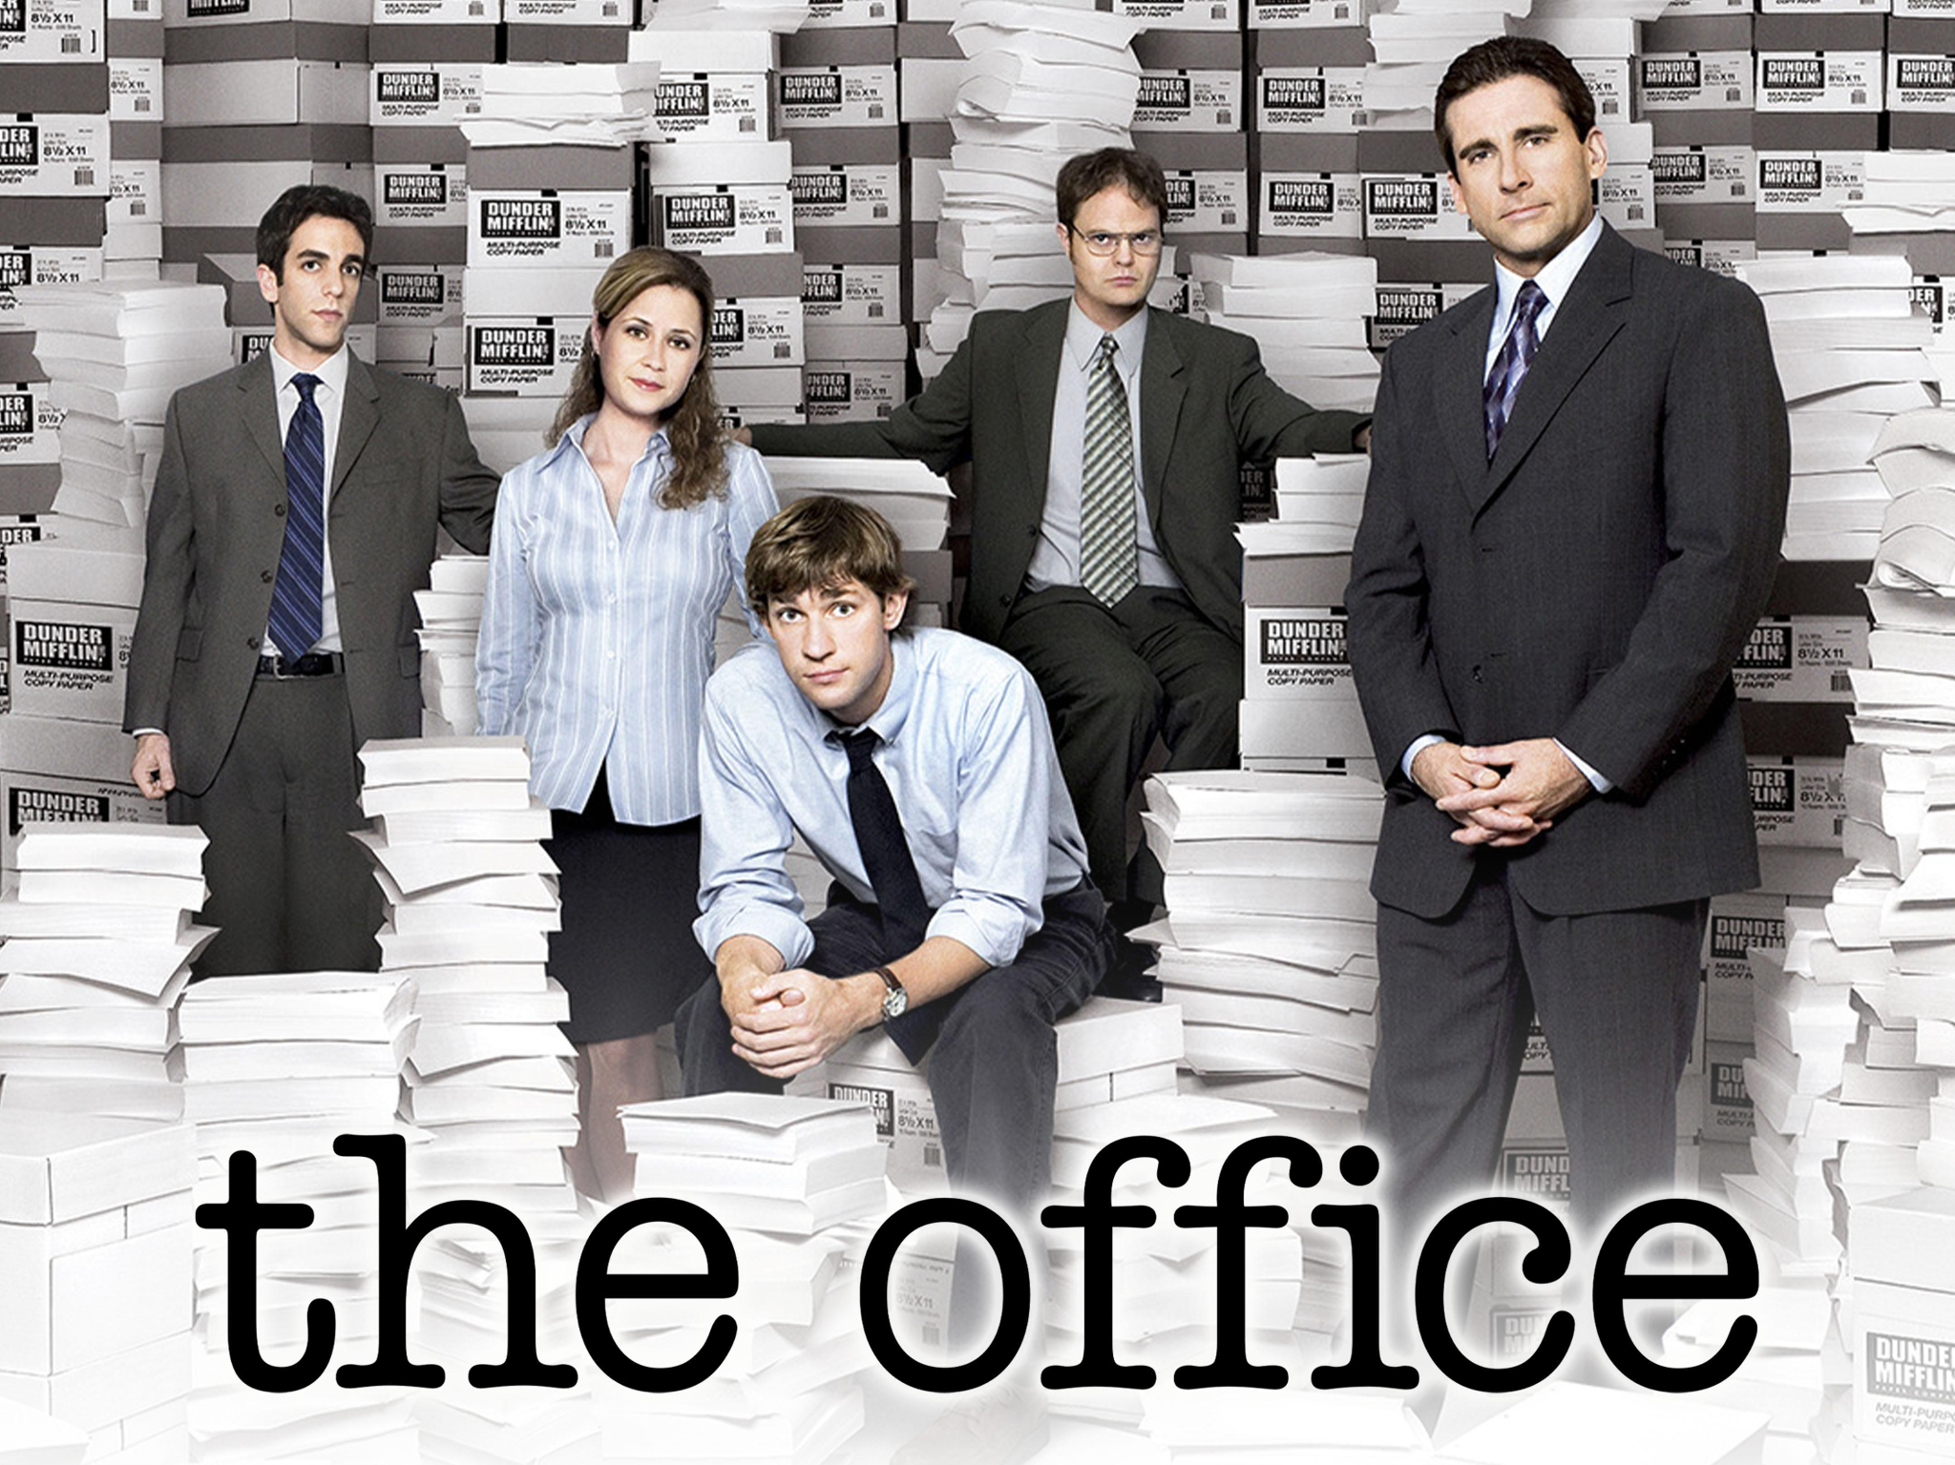
Answers
Q1 He is pretending to be high on drugs
Q2 Creed said the official name of the drug, and Dwight didn’t know that name. So Dwight misunderstood that Creed doesn’t know that it is a drug.
Q3 Marajuana, joint, dubiis, drugs, nothern lights cannabis indica, pot

Slide 12
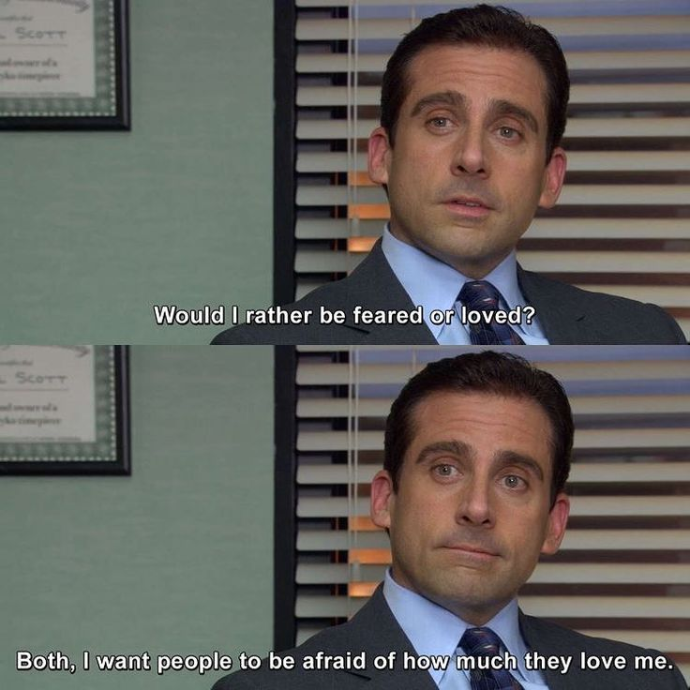
Thank you!
This is such an amazing and funny show!
If you need a little laugh, definitely give this show a watch:)
So many funny scenes from the show, like the one here haha
P.S thank you guys for a great class!

