Slide 1


The power of introverts
Source: The power of introverts | Susan Cain - YouTube

Slide 2
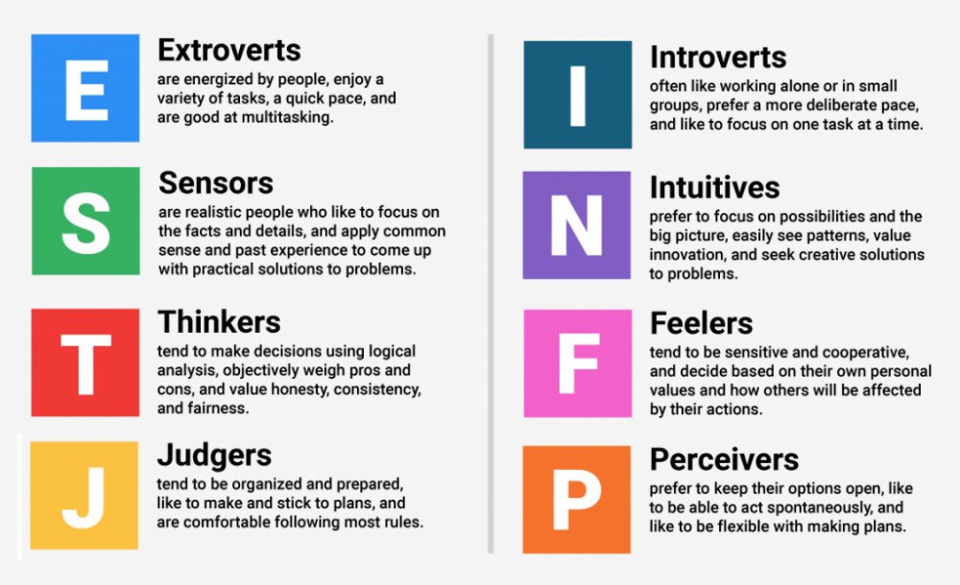
What is your mbti?
You are Introvert or Extrovert?

Slide 3

What do you think about the characteristics of introverted individuals?

Slide 4
Introverts
Distinguishing traits commonly associated with introverts on internet
restrained
Overthinking
secretive
Shy
quiet
reclusive
cool
solitary
uncommunicative

Slide 5
What is better in today's society, being an introvert or an extrovert?
People will generally cite being an extrovert as better
Most of society seems to want people who are active, super charming, and social go-getters.
=> If you don’t naturally have those traits, and are naturally more internal and dislike social situations, you’re seen as odd.

Slide 6
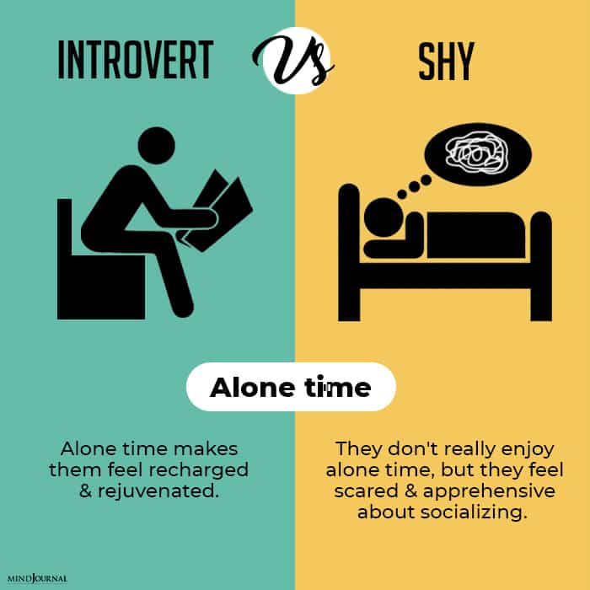
Introversion is not to be confused with shyness
Shyness is often associated with anxiety and self-consciousness in communication
While introversion relates to how a person interacts with the surrounding world and does not necessarily involve anxiety.

Slide 7
=> introverted individuals also have their own ways of contributing to societal development
Contrasting Stereotypes
Introverts are often stereotyped as shy, antisocial, or lacking in leadership skills. This topic allows you to challenge and debunk these stereotypes, showcasing the diverse strengths of introverted individuals.

Slide 8
1. Importance of Solitude and Balance
Deep Reflection
Solitude provides individuals with the opportunity for deep reflection
The quietness of solitude allows for a focused examination of one's thoughts and ideas without external distractions.
This reflective process often leads to a clearer understanding of personal values, beliefs, and creative aspirations.

Slide 9
1. Importance of Solitude and Balance
Freedom to Explore Ideas
In solitude, individuals are free to explore ideas without the influence or expectations of others.
It allows for the uninhibited generation of thoughts, enabling the exploration of unconventional or outside-the-box concepts that may not emerge in group settings.

Slide 10
1. Importance of Solitude and Balance
Reduced Social Pressure
Solitude removes the pressure to conform to social norms or expectations.
Creativity often thrives when individuals feel free to express themselves without fear of judgment, and solitude provides a space where ideas can evolve without external scrutiny.

Slide 11

2. Advocating for a Balance Between Introversion and Extroversion

Slide 12
The benefits of collaborative environments
Promoting exchanges of ideas
Encouraging casual interactions in open, shared spaces

Slide 13
Promoting exchanges of ideas
Promoting exchanges of ideas involves creating environments that encourage unplanned, spontaneous interactions among individuals.
These exchanges often lead to the discovery of new perspectives, innovative solutions, and collaborative opportunities

Slide 14

Encouraging casual interactions in open, shared spaces
Sharing casual conversations helps build stronger connections
The informal nature of these interactions encourages creative thinking and the sharing of diverse perspectives, contributing to innovation
=> A strategic approach to fostering a collaborative and communicative environment within a workplace

Slide 15
Encouraging self-reflection
constant collaboration might hinder individual creativity
Emphasizing the need for everyone, introverts and extroverts, to understand and appreciate their unique preferences

Slide 16

constant collaboration might hinder individual creativity
Collaborative environments may lead to groupthink, where individuals conform to the majority opinion to maintain harmony
Constant collaboration can create an overstimulating environment, which may distract individuals from their creative process.
In group settings, not all individuals may have an equal opportunity to contribute. Dominant voices or extroverted personalities may overshadow quieter, yet equally valuable, contributions, limiting the diversity of ideas.

Slide 17

Emphasizing the need for everyone, introverts and extroverts, to understand and appreciate their unique preferences
Understanding the preferences of introverts and extroverts helps improve communication within teams.
Introverts might contribute thoughtful, well-researched ideas, while extroverts might excel at energizing group discussions. Recognizing and valuing these contributions leads to more balanced and productive teamwork.
Introverts may excel at in-depth analysis, while extroverts may contribute dynamic and bold ideas. Recognizing these strengths leads to more well-rounded and innovative outcomes.

Slide 18
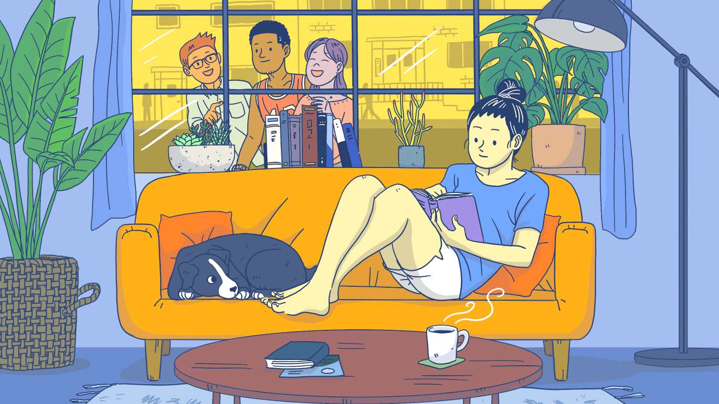
Misconception about introverts

Slide 19
Introverts are less effective leaders
WRONG

Slide 20
Introverts can be
effective leaders

Slide 21
Introverted leaders:
Let those employees run with their idea, less focused on personal recognition, introverted leaders empower and highlight the achievements of their team members.
Value diverse perspectives, creating a positive work culture where everyone feels heard and valued.
=> Introverted leaders bring valuable qualities to the table and should be recognized for their contributions.

Slide 22
To create a more inclusive and balanced environment for both introverts and extroverts
Stop the Madness for Constant Group Work
Create Spaces that Encourage Casual Interactions
Take a Good Look at What's Inside you

Slide 23

Stop the Madness for Constant Group Work
Acknowledges the importance of collaborative work but also encourages a balanced approach that values individual contributions and allows for focused, solitary work when needed.

Slide 24
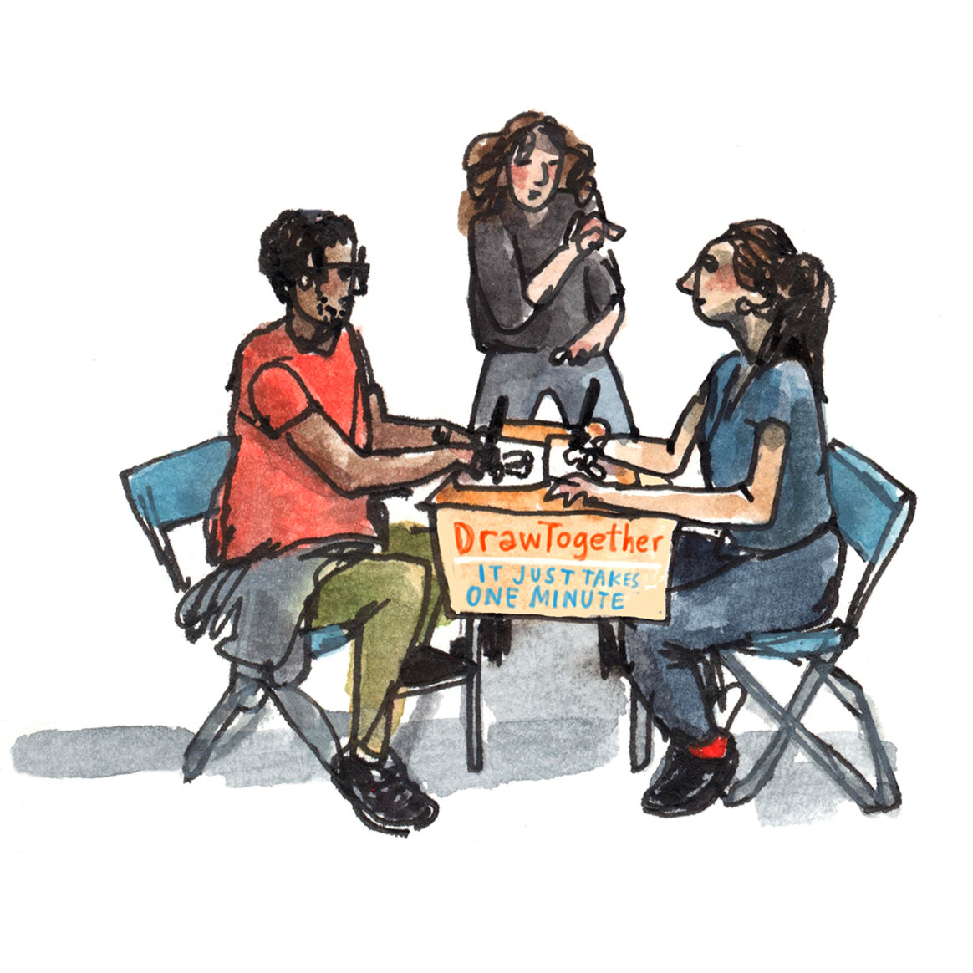
Create Spaces that Encourage Casual Interactions
Advocates for the design of workplaces and environments that support spontaneous exchanges of ideas and collaboration in a more relaxed setting.

Slide 25

Take a Good Look at What's Inside
Encourages individuals to reflect on their own preferences and understand why they make certain choices.

Slide 26
In my opinion
Introverts often bring qualities such as deep reflection, thoughtful decision-making, and a focus on individual development to the table.
While extroverts thrive in social settings and are known for their outgoing nature, introverts excel in quieter, more contemplative environments.
=> Both personality types offer unique contributions to various aspects of life, from the workplace to creative endeavors

