Slide 1


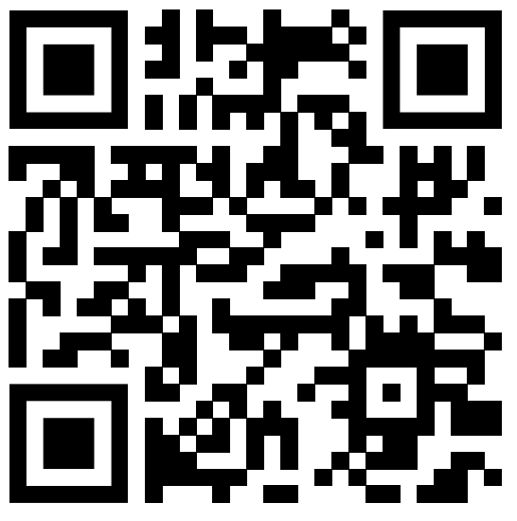

The Pursuit of Happiness

Slide 2
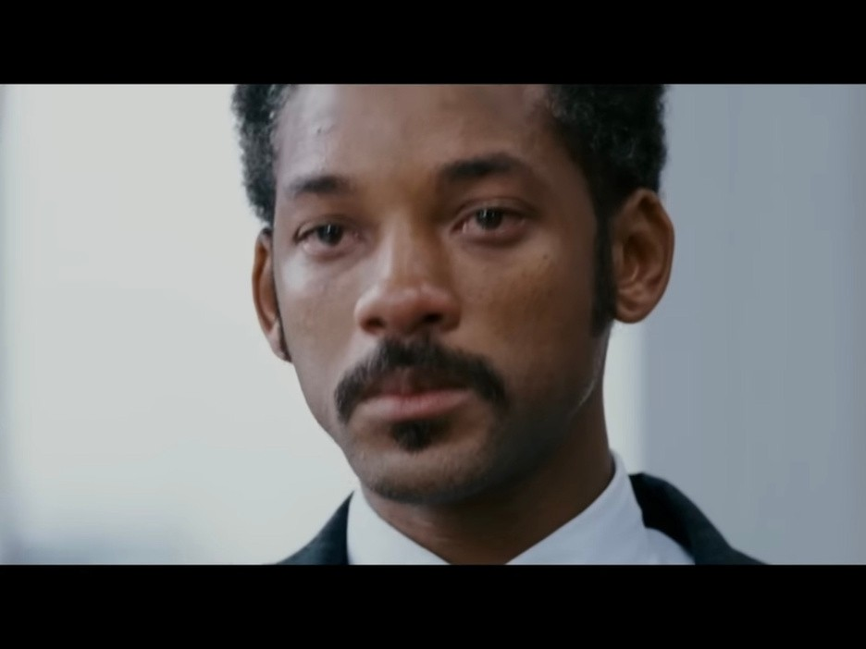
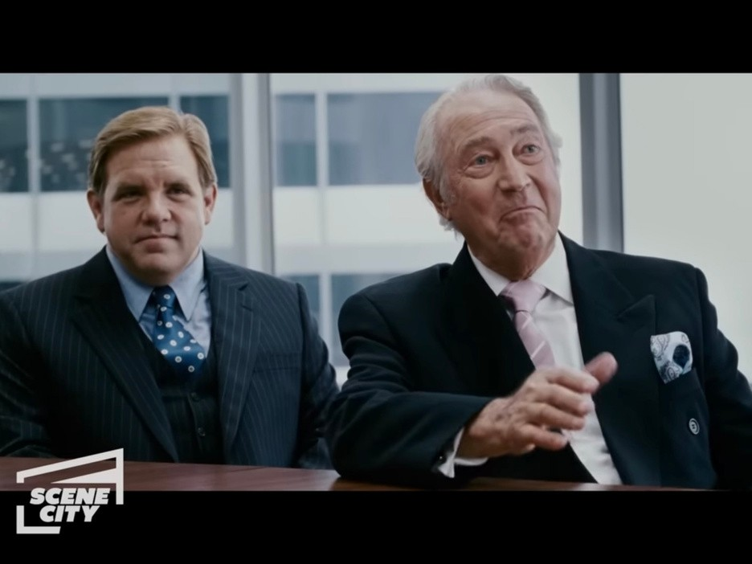
Movie Clip
URL: https://youtu.be/hKi3-5gO4uE? si=aP2aLhy-H2eA3bGn (01:10-)
About the Movie: “The Pursuit of Happiness” is based on the true story of Chris Gardner, a brave, warmhearted, hardworking man struggling with homelessness to build a better life for himself and his son.
About the Scene: This scene highlights the moment that Chris is officially offered a full- time position after completing his internship, showing how emotional he is to hear the news.

Slide 3

Why Interesting
I still remember how encouraged I felt when I first watched this film. I was completely drawn into Will Smith’s powerful performance and deeply moved by many of his memorable quotes in the film. My favorite line is, "Don't ever let somebody tell you, you can't do something." Chris truly lives by these words, and as shown in the scene I chose, he eventually earns the job through his relentless effort.
Chris’s words are always meaningful and worth thinking deeply about them. In this presentation, I would like to explore the deeper significance behind his words.

Slide 4
Officer: Chris. Come on. Frohm: Hi, Chris.
Chris: Mr. Frohm, good to see you. Frohm: Nice shirt.
Chris: Thank you, sir. Jay: Chris.
Chris: Hey, Jay. Chris: Chris.
Frohm: Chris, Sit down, please.
Chris: I thought I’d wear a shirt today. You know, being the last day and all.
Frohm: Well, thank you. Thank you. We appreciate that. But… Wear one tomorrow though, okay? Because tomorrow’s going to be your first day, if you’d like to work here as a broker. Would you like that, Chris?
Chris: Yes, sir.
Frohm: Good. We couldn’t be happier. So, welcome. Was it as easy as it looked? Chris: No, sir. No, sir, it wasn’t.
Frohm: Good luck, Chris.
Chris: Thank you. Thank you. Frohm: Oh, Chris. I almost forgot. Chris: Thank you.
Chris (Voice): This part of my life, this little part, is called happiness.
Script

Slide 5
Appreciate – “We appreciate that.”
→ Meaning: To be thankful or grateful for something.
→ Practice: Use in sentences like “I appreciate your help with this project.”
“Tomorrow’s going to be your first day.”
→ Meaning: A formal job offer.
→ Practice: Discuss job offers or formal invitations in role-play.
1
2
3
“Because tomorrow’s going to be your first day, if you’d like to work here as a broker.”
→Grammar Focus: Second conditional (polite offers).
→Practice: Create sentences like, “If you’d like to join us, please sign here.”
Vocabulary

Slide 6

Engaging Questions
Question 2
Question 1
Question 3
How did Chris’s hope and persistence lead him to this moment? Can you think of real-life examples where people had to endure hardships before achieving success?
Why do you think Chris doesn’t immediately show strong emotions in the moment he gets offer? What does this say about his journey?
Mr. Frohm asks, “Was it as easy as it looked?” Why do you think he asks this question, and how does Chris’s answer reflect his personal growth?

Slide 7
Guess the Movie Quote!
There are only 3 quotes are from the movie.
Can you guess which ones are they?
The only way to do
You want something.
Go get it!
great work is to
love what you do.
You have a dream, you go to protect it.
It is not our abilities that show what we truly are… it is our choices.
The only limit to our realization of tomorrow is our doubts of today.
There is an I in “happiness”, there is no Y in “happiness”

Slide 8
What I learned
From the scene where Chris Gardner is officially offered a full-time position, I learned the true meaning of perseverance and the importance of aligning words and actions to build trust. Despite facing extreme poverty and homelessness, Chris never gave up on his goal of providing a better life for his son. During his internship interview, Chris couldn’t even afford a shirt, which led the interviewers to doubt his abilities. However, he confidently said, “But I bet you what: I know how to find the answer, and I'll find the answer.” He didn’t rely solely on his words and worked with enthusiasm, and his supervisors recognized his dedication.
In this way, I realized that words and actions are inseparable—like a “happy set”— and both are essential for building resilience and achieving success. This lesson inspires me to not only speak with confidence but also to prove my commitment through action, just as Chris did.

Slide 9
Answers (1)
Question 2
Question 1
Question 3
Chris doesn’t show strong emotions at first because he’s endured so many hardships that receiving the job offer feels almost unreal.
Additionally, he is overwhelmed with happiness knowing that his and his son’s lives will finally become more stable and promising now that he will have a steady income.
Chris’s hope to provide his son with a stable life and to show him that dreams can come true was likely the greatest motivation behind his hard work.
Similarly, we as students must also endure the hardships of studying to achieve our goals, such as getting into our dream schools.
Mr. Frohm asks whether the work was as easy as it looked to acknowledge that success often appears effortless from the outside. Chris’s honest reply, “No, sir. No, sir, it wasn’t,” reflects his recognition of how hard he had to work.

Slide 10



Answers (2)
You want something. Go get it!
You have a dream, you go to protect it.
There is an I in “happiness”, there is no Y in “happiness”.
All of the three quotes are told by Chris to his son.

Slide 11



Thank You So Much
I hope you could enjoy this movie clip and please watch it!

