Slide 1



Active Learning Assignment: Movie Analysis
Scene from 'The Pursuit of Happyness’
https://www.youtube.com/watch?v=UUDKEbX5OQw&t=3s
This Photo by Unknown Author is licensed under CC BY-SA

Slide 2

Movie and Scene Description
The movie 'The Pursuit of Happyness' is an inspirational drama starring Will Smith. The selected scene is the job interview scene, which highlights themes of perseverance, professionalism, and resilience
This scene offers a mix of formal and informal English expressions, making it ideal for vocabulary and contextual learning.

Slide 3

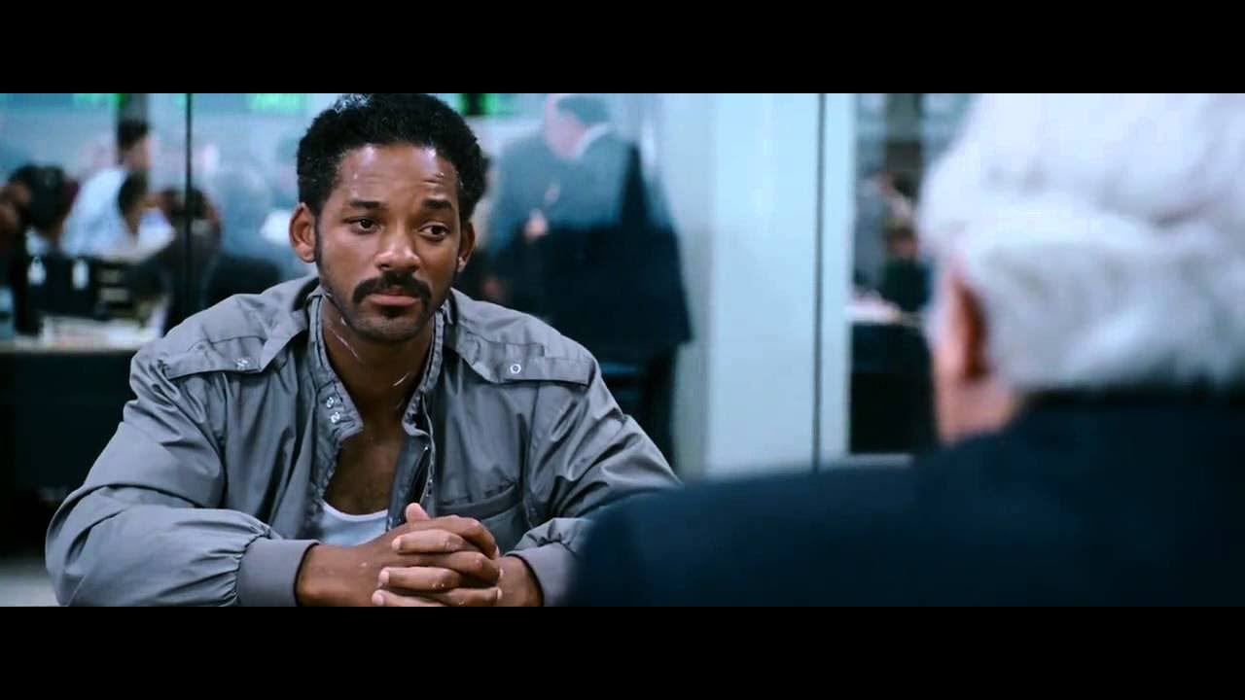
Job interview scene

Slide 4

Key Vocabulary and Grammar Highlights
1. Vocabulary:
- Perseverance
- Internship
- Confidence
- Professionalism
2. Grammar Focus:
- Use of conditionals (e.g., 'If I were given a chance...')
- Polite expressions and modal verbs (e.g., 'Could you explain...')

Slide 5

Engaging Questions
1. Why do you think the interviewer asked personal questions?
2. How does Chris Gardner show his determination in this scene?
3. Can you relate this scene to your own experiences of resilience?

Slide 6

Fun Activity
Activity: Match the phrase to its meaning
- 'Step up' -> Take responsibility
- 'Out of the blue' -> Unexpectedly
- 'Keep your head up' -> Stay positive
This activity can be done individually or in groups.

Slide 7
Post-task Reflection
From this scene, I learned the importance of staying confident and adaptable during challenging situations. It also taught me how effective communication can leave a lasting impression.
This scene exemplifies resilience and professionalism, which are valuable traits in both personal and professional settings.

Slide 8

The pursuit of happyness
https://youtu.be/IIstUiRTqfk?si=0g3ULT3QMVSVZHc2

