Slide 1
How to acquire foreign languages effectively

Slide 2
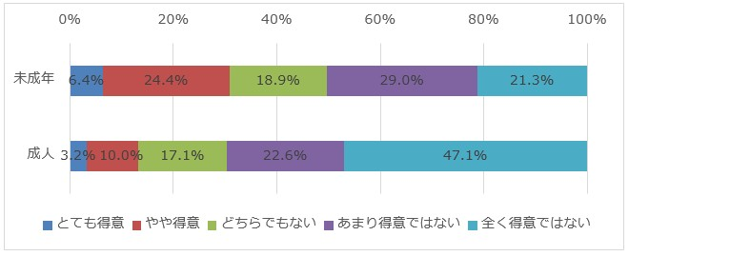
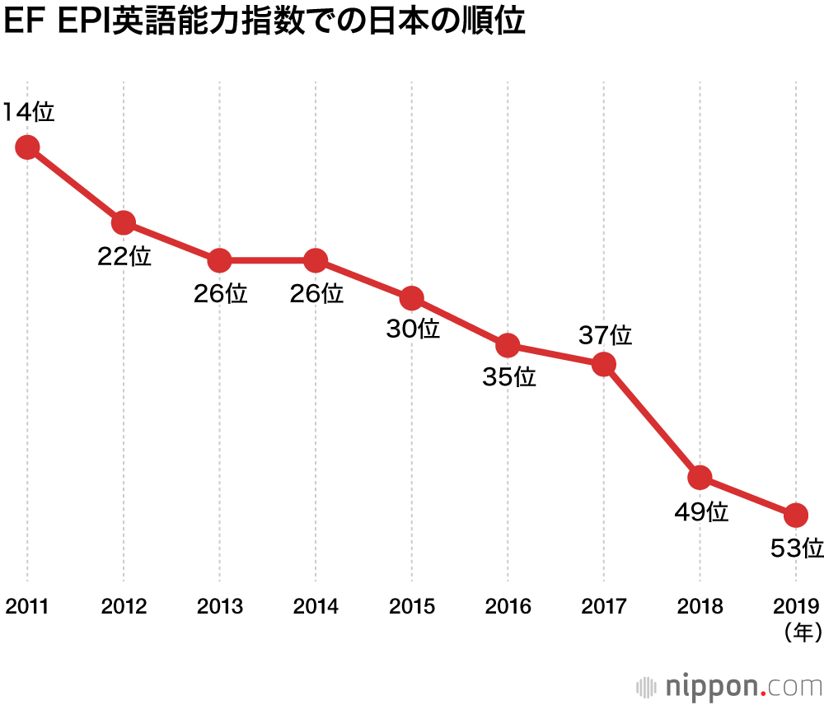
Japanese is struggling with using English

Slide 3
My question
Why cannot Japan’s education of English produce results？
Why are Japanese struggling with learning English or new language?

Slide 4
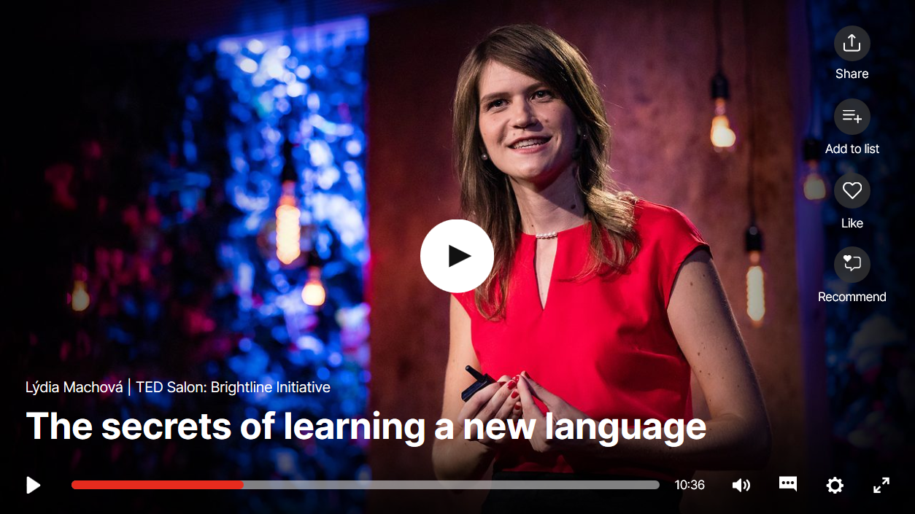
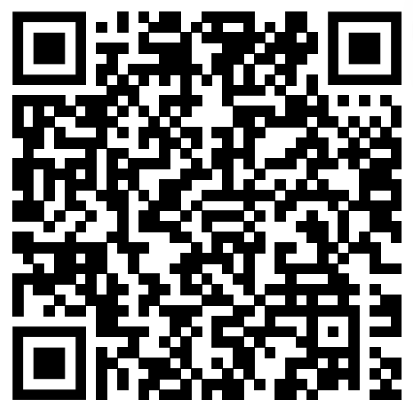
A TED video inspired me
Lýdia Machová: The secrets of learning a new language |
TED Talk
Three important things

Slide 5

To enjoy learning
You don’t have to start learning languages from grammar
Using Internet content like Youtube or TED is also good
The important thing is to enjoy learning and not to quit learning on the way!

Slide 6
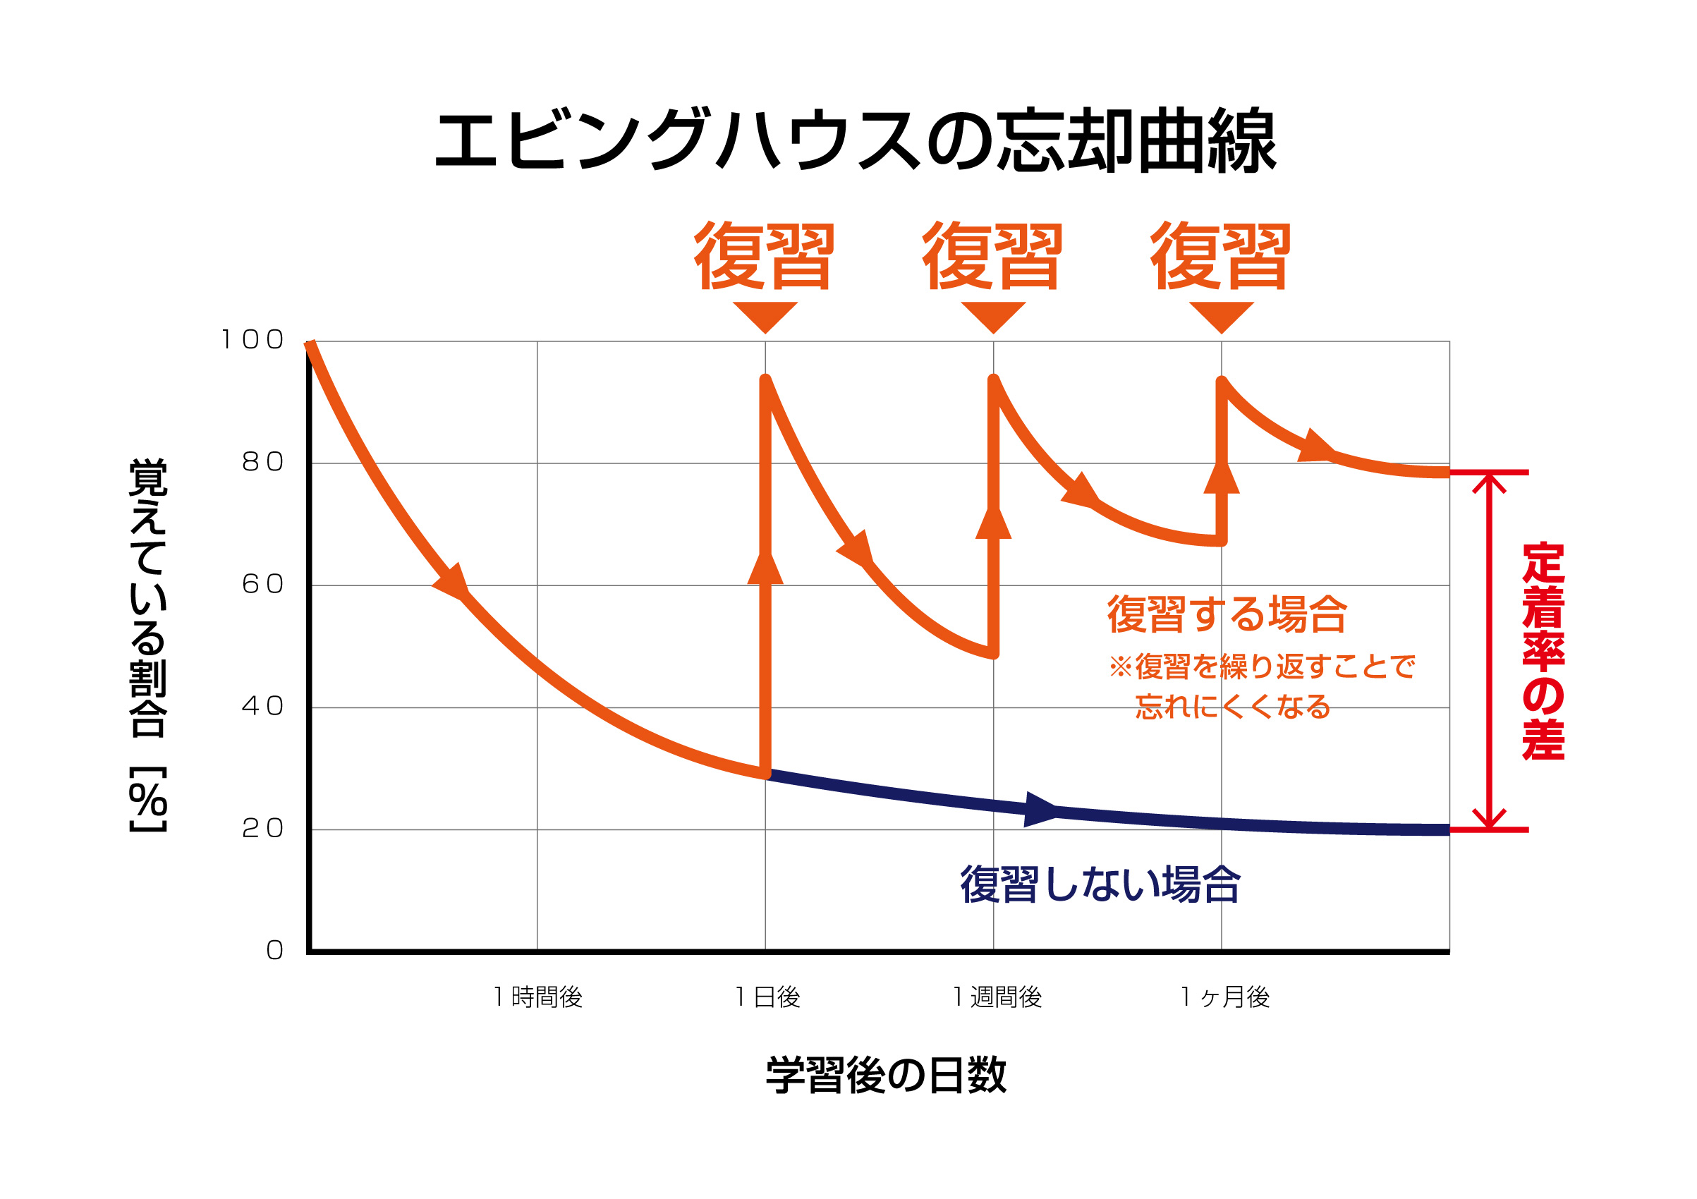
To use effective methods
Making the vocabulary or something into long-term memory is important
Using apps like Mikan,
Anki is easier

Slide 7
To plan learning
Planning makes it easier to keep learning
Planning helps us to make time when we are busy
Even in 15 minutes, you can revise some of what we studied or listen to podcast
Once we start carrying out the plan, we can easily keep learning

Slide 8
Make your plan!
Make your learning plan and maximize effectiveness of your language learning
  What material to use
  How long one cycle is
  What your goal is
  etc
Write down on paper, Word file or something and start learning now!

Slide 9
To keep learning
To keep learning is the easiest way to get improved
Even polyglots cannot master foreign languages in one month
We need a little bit patience to get basic ability
One month is enough to get visible improvement

Slide 10
My answer to the question
1.Japan’s education of English is placing too much weight on grammar and vocabulary
  It deprives motivation from students
2. Usually students have no plan of learning English
  It makes learning so inefficient

Slide 11
References
日本人の英語力、非英語圏で53位に後退：スイスの教育機関調査 | nippon.com
https://www.nippon.com/ja/japan-data/h00594/
「英語に関する意識調査」を未成年・成人計10,000名に調査 | GMOインターネット株式会社
https://www.gmo.jp/news/article/5792/
Lýdia Machová: The secrets of learning a new language | TED Talk
https://www.ted.com/talks/lydia_machova_the_secrets_of_learning_a_new_language

Slide 12
Thank you for listening!

