Slide 1
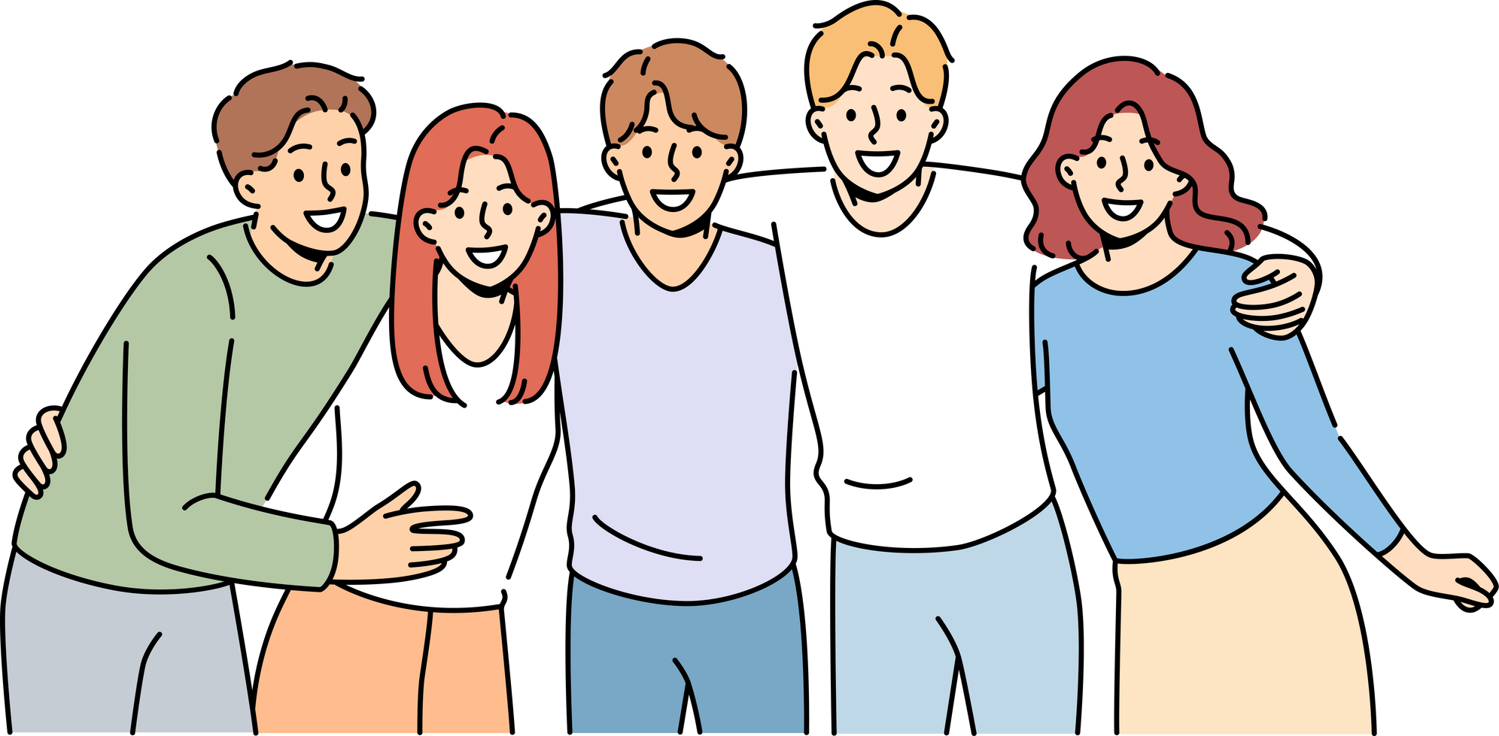
The secrets of learning a new language
Riki hayashi

Slide 2


Background
I grew up in a multicultural environment, so I have always been interested in different languages. Also, I’m interested in a different culture.
I know language connects with people that is power of language.
I want to learn French and Chinese!!
<Source>
https://youtu.be/o_XVt5rdpFY?si=xlABUxvKLoiyXirK

Slide 3
Summary
Machová said we don’t need any special talent to learn a new language. The important thing is the right way, such as enjoying the learning process and introducing an effective way into your daily life.
Implementing those things leads to picking up a new language.

Slide 4
Why do we learn a new language?
Culture understanding
Learning a language is not only about memorizing the words and grammar.
It helps you to expand your ability and get a new perspective from others.

Slide 5

Connect with people
If you speak a different language, you can join another community. Most of us grew up in a certain community and interact with the same kinds of people.
Language can change your life and future.

Slide 6

We don’t need to study for a long time in a day, just do what
We can do.
Listing podcast on the train, and watching a movie in a target language.
Text in a different language, etc.
How do we learn?

Slide 7

In my case
I’m learning Burmese with a podcast and Facebook. Minor language, hard to find a resource as you get to an advanced level.
So, you need to be wise; textbooks never teach us real language.

Slide 8

Fun activity
NO.1
Remender these words
Bus, Cat, Bread,
Clock, Rain,Bag
Compare 1 and 2, a couple of days later, which types that you still remember?

Slide 9
Fun activity
NO.2
Story with those words
“This morning, I rushed to catch the bus in the rain.
Suddenly, a cat jumped out of my bag and started eating my bread. Just then, the clock rang, and I woke up. It was all a dream.”

Slide 10
Activity Explanation
This activity demonstrates how our memory works better when information is given meaning or context.
Remember, a story is much better to understand than to just memorize unrelated words when it comes to putting into long-term memory.

Slide 11
Conclushion
The thing is, we don’t need to learn like another subject; always study at the desk.
The important thing is how we learn, find a suitable method, and enjoy the process of learning that you can bring into your life.

Slide 12
Thank you!!

