Slide 1
Communicate in the language that is not your native language

Slide 2
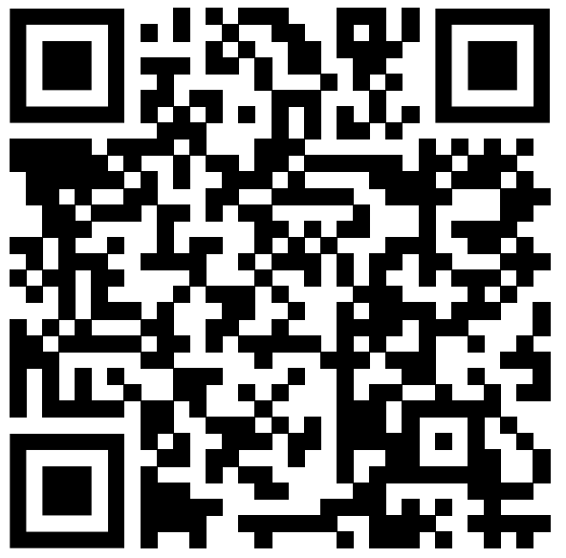
the MOVIE clip
URL:https://www.youtube.com/watch?v=O_9UWQLfBUk&list=LL&index=1
Title：The Terminal(2004)

Slide 3
Why I chose this Video
I found this movie clip while searching for videos.
In this scene, the main character “Navorski” is looking for a job in the airport.
“Navorski” is not good at talking in English, so there are some inconsistencies in comunication. I found that this scene to be interesting as it expresses this descrepancy.

Slide 4
Vocabulary
particular about : very careful about choosing exactly what you like and not easuly satisfied
punctual : arriving, happening, or being done at exactly the time that has been arranged
mailing address : the address to which a person’s mail should be sent
someplace : somewhere

Slide 5
Questions
When Navorki was asked his phone number, what he did?
1. He tells his phone number.
2. He tells a fictional phone number.
3. He tells the phone number of pay phone.
At the last of this movie clip, Navorski can _______.
1. go to bed
2. not get a job
3. not go to the bathroom

Slide 6
Discussion
When you have a conversation with foreigners, what do you try to do to understand what they are saying?
What would you do if you were unable to leave a foreign country? Do you try to get a job in the country like Navorski?
Have you ever feel unconfortable when you talk with people whose native language is different from yours? Please share your experience.

Slide 7
The answers
When Navorki was asked his phone number, what he did?
3. He tells the phone number of pay phone.
At the last of this movie clip, Navorski can 2. not get a job

