Slide 1
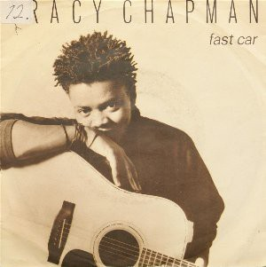

Fast Car
Tracy chapmen

Slide 2

About the singer
African American singer
Tracy Chapmen
Interested in social issues
58 years old

Slide 3
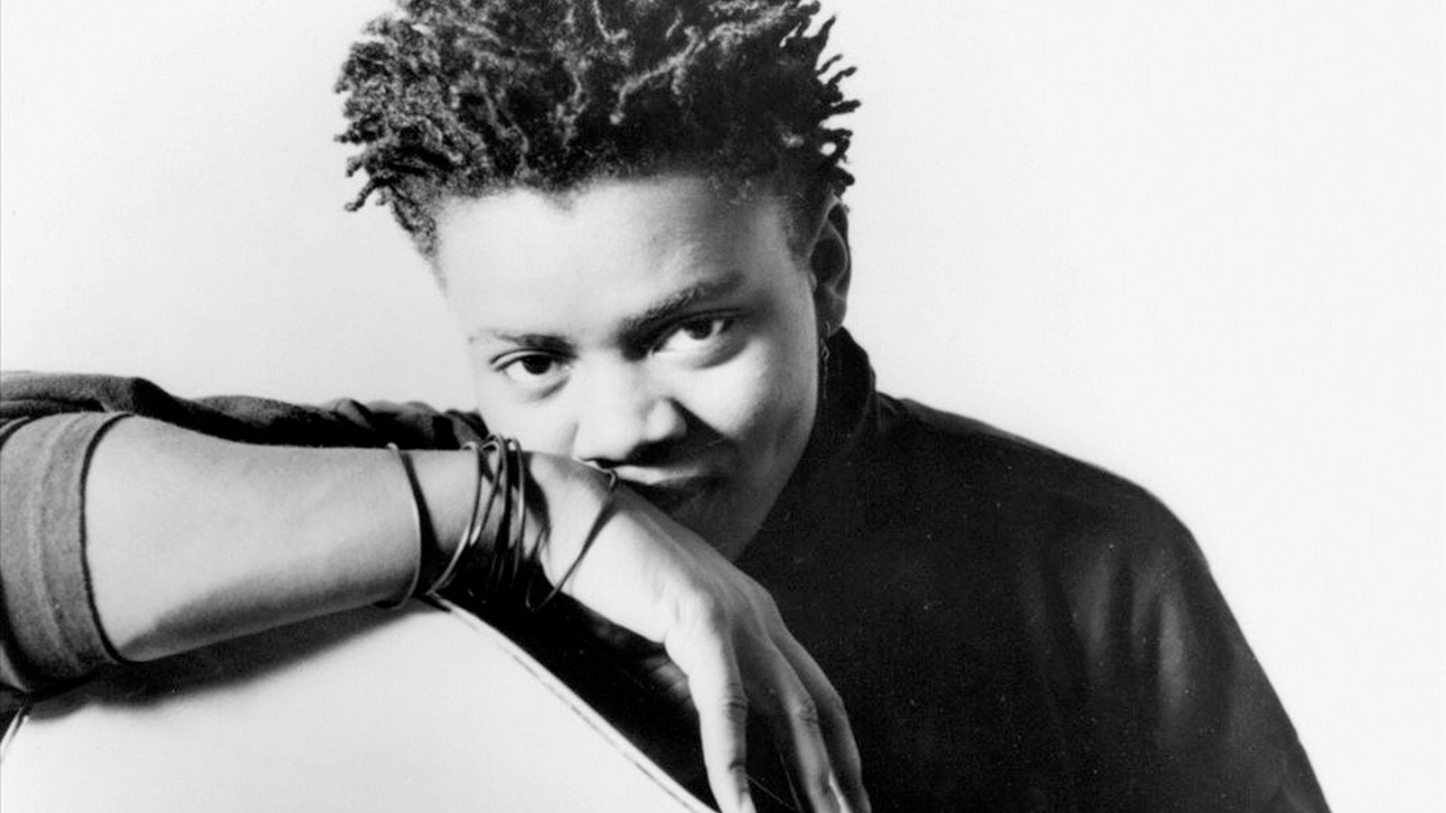
・From state of Ohio
・Growing up with music
・Joining social movements

Slide 4

Social Background
from 1960’s to 1980’s

Slide 5
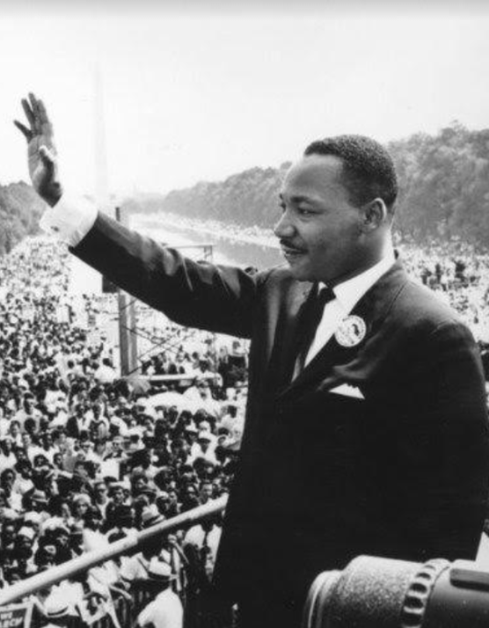
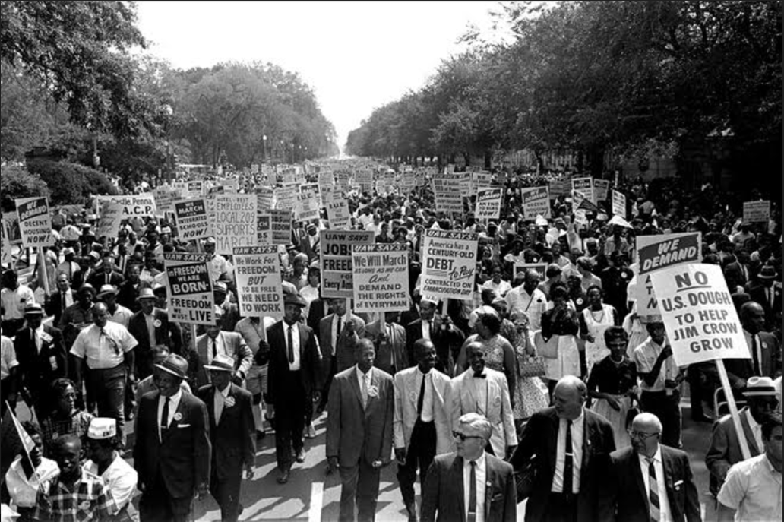
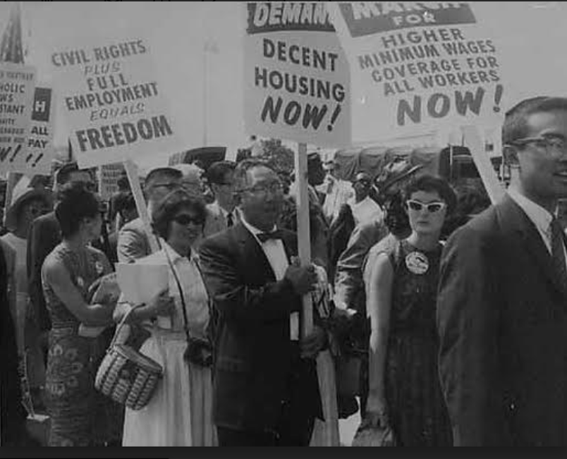
Civil Rights Movement

Slide 6
Yearly Income of BLACK FAMILY
61% of income of White Family

Slide 7
Important things for Americans
their own efforts
and
their own capacity

Slide 8


But …
They do NOT HAVE
HIGH QUALITY of EDUCATION
HIGH ECONOMICAL and SOCIAL STATUS

Slide 9
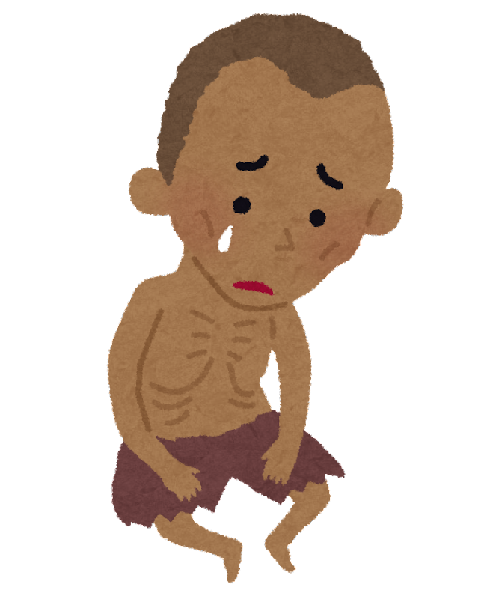
STILL．．．
POOR

Slide 10
THEME of THIS SONG
Endless Poverty

Slide 11
Click here and listen to it !!
https://www.youtube.com/watch?v=AIOAlaACuv4

Slide 12
[Verse 1]
You got a fast car
I want a ticket to anywhere
Maybe we make a deal
Maybe together, we can get somewhere
Any place is better
Starting from zero, got nothing to lose
Maybe we'll make something
Me, myself, I got nothing to prove

Slide 13
[Verse 2]
You got a fast car
I got a plan to get us outta here
I been working at the convenience store
Managed to save just a little bit of money
Won't have to drive too far
Just ‘cross the border and into the city
You and I can both get jobs
Finally see what it means to be living

Slide 14
[Verse 3]
See, my old man‘s got a promlem
He lives with a bottle, that's the way it is
He says his body‘s too old for working
His body's too young to look like his
When mama went off and left him
She wanted more from life than he could give
I said, “Somebody‘s gotta take care of him"
So I quit school, and that's what I did

Slide 15
[Refrain]
You got a fast car
Is it fast enough so we can fly away?
We gotta make a decision
Leave tonight, or live and die this way

Slide 16
[Chorus]
So I remember when we were driving
Driving in your car
Speed so fast, it felt like I was drunk
City lights lay out before us
And your arm felt nice wrapped ‘round my shoulder
And I-I had a feeling that I belonged
I-I had a feeling I could be someone, be someone, be someone

Slide 17
[Verse 4]
You got a fast car
We go cruising, entertain ourselves
You still ain't got a job
And I work in a market as a checkout
I know things will get better
You'll find work and I'll get promoted
We‘ll move out of the shelter
Buy a bigger and live in the suburbs
[Chorus]

Slide 18
[Verse 5]
You got a fast car
I got a job that pays all our bills
You stay out drinkin‘ late at the bar
See more of your friends than you do of your kids
I'd always hoped for better
Thought maybe together, you and me'd find it
I got no plans, I ain't going nowhere
So take your fast car and keep on driving
[Chorus] [Refrain]

Slide 19
Quiz!
1. The singer of this song, Tracy Chapman is...
A. Male
B. Female
C. neither

Slide 20
Quiz!
2. When was this song released?
A. 1979
B. 1988
C. 1994

Slide 21
3. How many awards did his first album, “Tracy Chapman”, win in the 31st Grammy awards ?
Quiz!
A. 5
B. 1
C. 3

