Slide 1

What is the hidden power of sad songs and rainy days?

Slide 2
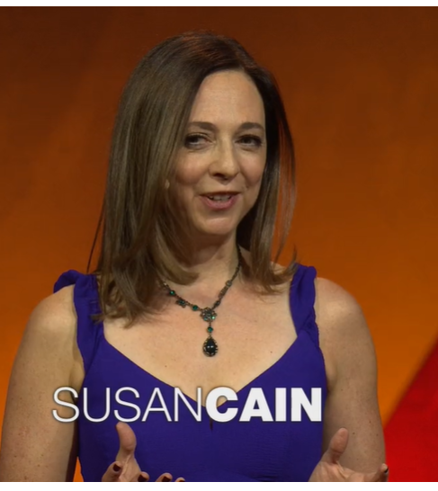
I’ve watched this TED-talk
https://www.ted.com/talks/susan_cain_and_min_kym_the_hidden_power_of_sad_songs_and_rainy_days

Slide 3



Why did I choose this topic?
Have you ever been hooked for …?
Tragedy love drama
Heart-broken song
Atmosphere of a rainy day
Why do we WELCOME SWAROOW in these works or situation??
Aren’t they something we‘d like to avoid?
Listening to this TED-talk we can know why we love them
And the power of them! Don’t you think it interesting?

Slide 4
Let’s check out some vocabularies!
on the verge of sth
Very near to the moment when sb does sth happens
fall to sb
To become the duty or responsibility of sb
hooked
Enjoying very much,
So that you want to do it, see it, etc.
lullaby
A soft gentle song sung to make a child go to sleep
exquisite
Extremely beautiful or carefully made
stubborn
Determined not to change your opinion or attitude
orphan
A child whose parents are dead
siege
A military operation in which an army tries to capture a town by surrounding it

Slide 5
Quiz : What do they mean?
Moonshots
It not only mean
The paradox of tragedy
Moonshots
The paradox of tragedy

Slide 6
Answer : What do they mean?
Moonshots
It not only mean
The paradox of tragedy
Moonshots
While 'moonshot' originally meant
"long shot,"
it's increasingly being used to describe a monumental effort and a lofty goal—in other words,
a "giant leap."
The paradox of tragedy
The paradox of tragedy is a paradox of deriving pleasure from something that would only bring misery and sorrow if it happened to us in real life.
We voluntarily make ourselves feel overwhelming negative emotions by engaging with tragic, pitiful, or appalling pieces of art.

Slide 7

Fun activity①
Do you come up with something that tell very sad contents or work or situation etc., but makes you kind of joy?
Write them as much as you can!
And think about how they influenced to your life?

Slide 8
What did you write?
Shakespeare’s Romeo and Juliet
Titanic

Slide 9
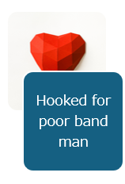
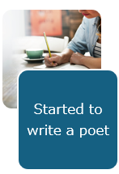
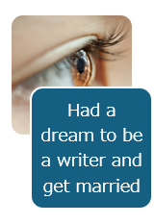
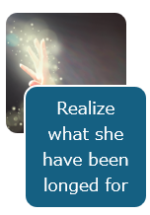
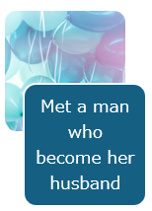
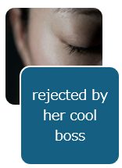
Fun activity② puzzle
Let’s organize
the story of Susan,
the speaker of this TED-talk by rearranging these objects!

Slide 10
Answer of the puzzle
Had a dream to be a writer and get married
Started to write a poet
Met a man who become her husband
Hooked for poor band man
Realize what she have been longed for
rejected by her cool boss
This is what she have experienced!

Slide 11
The answer of the first question!
From her experience, Susan realized
If we welcome sorrow, it help you find your longing.
Longing is actually the deep source of all our moonshots and our loves.
These are the hidden power of sad songs and rainy days!

