Slide 1

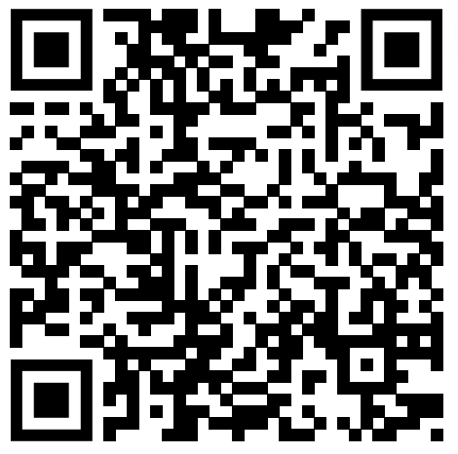
What ping-pong taught me about life
-Pico Iyer

Slide 2

Why I chose this TED talk
The title was very interesting
↪︎It is fun to play ping-pong, but I never had a life advise or quote for my life
I suspected that it might be a little exaggerated
↪︎I thought it would be difficult to learn life from a
ping-pong match

Slide 3

Newly learned words
Disconsolate
↪︎Of a person: lacking consolation or comfort
Resurgence
↪︎The action or an act of rising again
Exult
↪︎To rejoice exceedingly
Choir
↪︎A company of singers

Slide 4
Engaging questions
If there is no winning, what is there to rejoice in?
Was it Japan or table tennis that taught me about life?
Are there any teachings in Japan like the ones Pico learned?

Slide 5
Quiz Activity(connect them)
Q.1 What sport is raised as a subject in this story?
A.①○○○-①○○○
Q.2 During Victorian times what did we hit instead of balls?
A.○②○○ ○○○○○
Q.3 What is best followed by watching ping-pong?
A.○○○③○○○○○○○
Q.4 Winning against stronger player than yourself is called?
A.○○○④○ victory

Slide 6

Quiz Answer
A1. ping-pong
A2. wine corks
A3. geopolitics
A4. upset
Final Answer
↪︎PIPE

