Slide 1
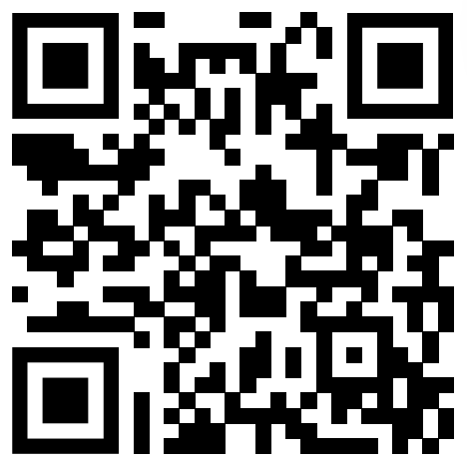
What’s Your Leadership Language?

Slide 2
Why I choose this topic
I wanted to see if there is something beyond language itself that is necessary for communication.
Also, knowing what kind of leadership language would enable me to communicate with people from various sectors.

Slide 3
New vocabulary
Jargon
special words or expressions used by a profession or group that are difficult for others to understand:
Advocacy
public support for or recommendation of a particular cause or policy:
Resonate
produce or be filled with a deep, full, reverberating sound:
Philanthropy
the desire to promote the welfare of others, expressed especially by the generous donation of money to good causes:

Slide 4
Overview of Leadership Language
It emphasizes the importance of being conversant in the diverse communication styles and jargon used across various sectors.
It goes beyond traditional leadership styles, advocating for adaptability and personalization of leadership to suit different situational needs and cultural contexts.
Successful leaders should be capable of effectively communicating and translating among different groups and disciplines to foster collaboration and achieve common goals.
This approach to leadership focuses on understanding and integrating the unique vernacular of each community and culture, rather than adhering to a single leadership style.

Slide 5

Fun activity
Match the cycles in which the following three sectors operate to achieve their goals.
Private sector
Public sector
Nonprofit and philanthropic sectors
Multi-year election cycle
15 years or a generation cycle
Quarterly accounting cycle

Slide 6
Engazing questions
Can you think of a situation where a leader might need to switch between different leadership languages? How would they approach this change?
Reflect on a time you encountered a situation that required different communication styles. How did you adapt your approach, and what was the outcome?
Do you agree that being multilingual in leadership language is more effective than having a strong, singular leadership style? Why or why not?
Imagine you are a leader in an organization that operates internationally. How would you apply the concept of leadership language to effectively manage your team?
How can understanding and integrating the vernacular of different communities and cultures lead to more inclusive and effective leadership?
Discuss the ethical considerations a leader must keep in mind when adapting their leadership language to different cultural or organizational contexts.

