Slide 1
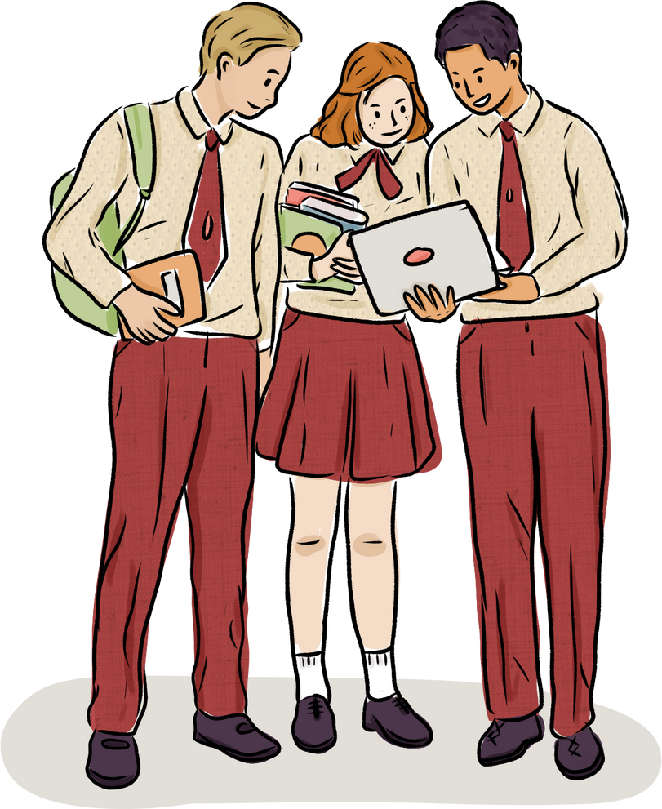
2025
Ted talk
Material
1

Slide 2
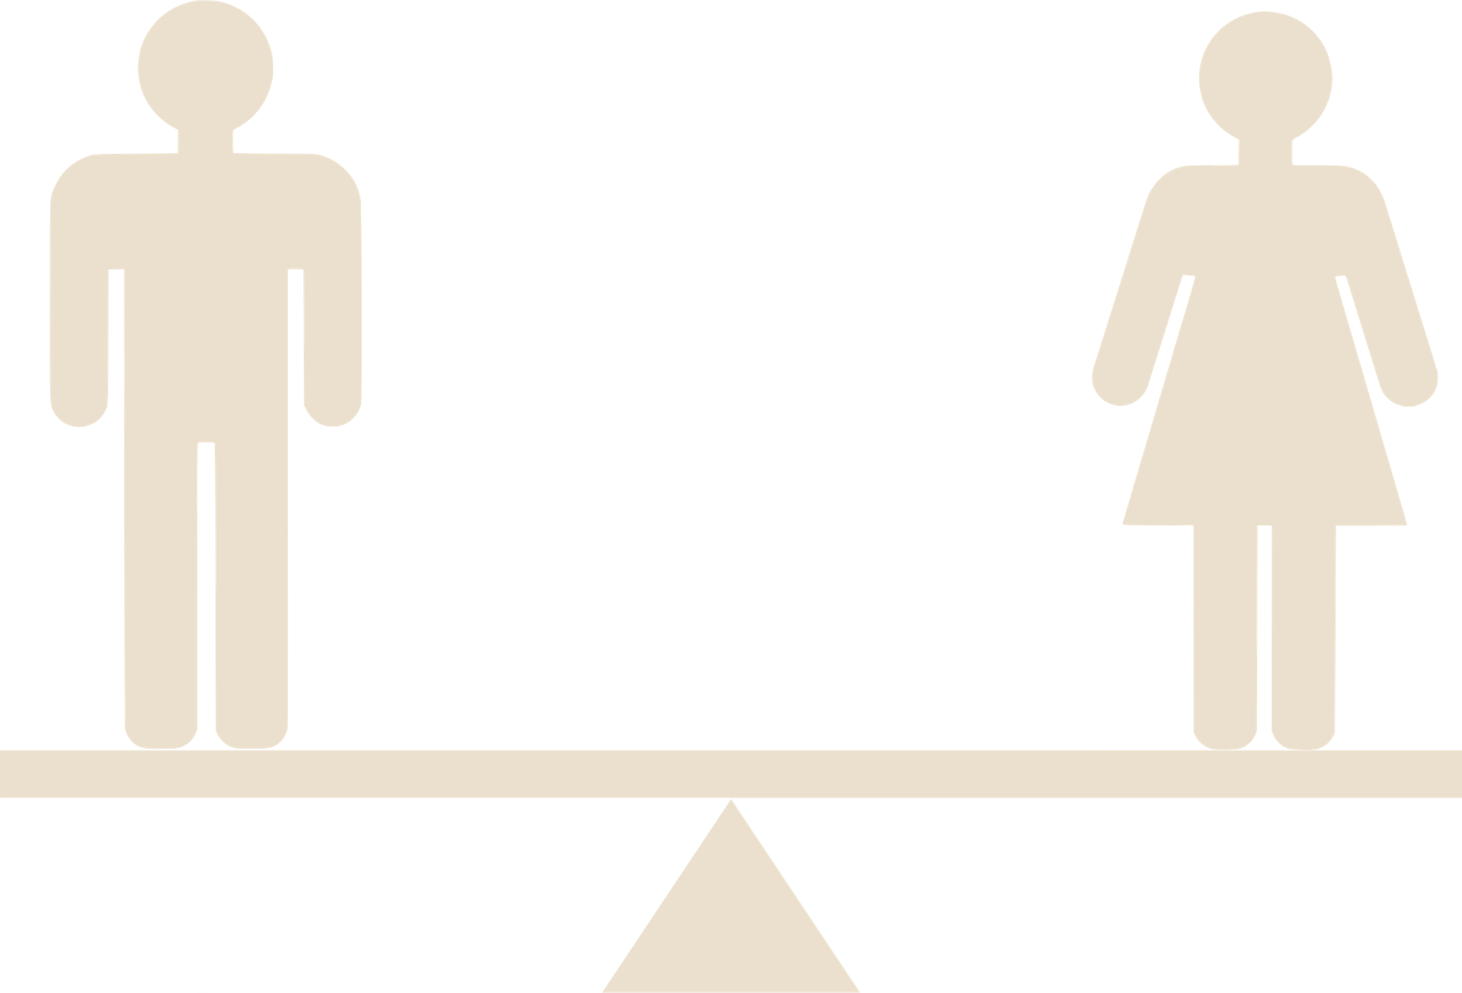
Topic: Why Gender Equality Is Good for Everyone — Men Included
By Michael Kimmel
https://youtu.be/7n9IOH0NvyY?si=Zlb2L69eJ0etGRYG
2

Slide 3
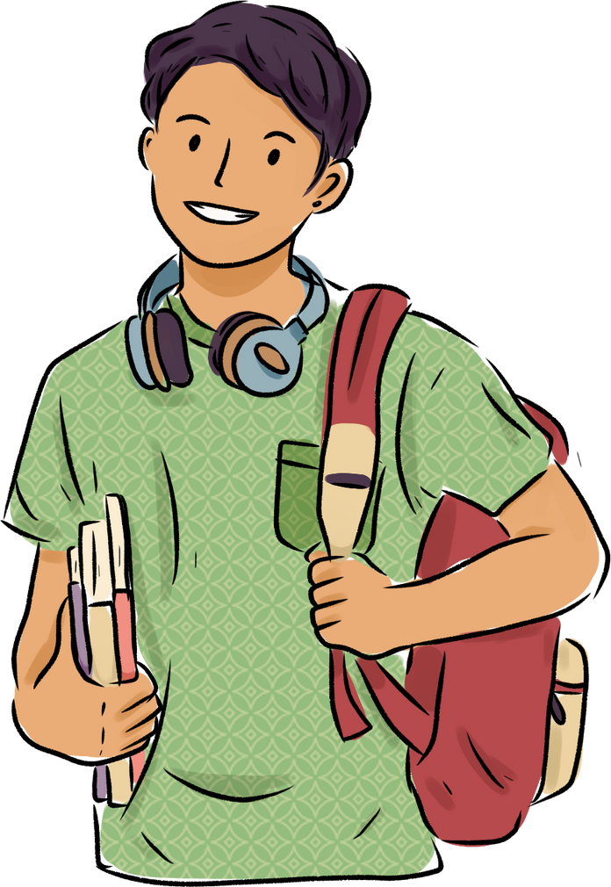
Why I chose this topic
  I am interested in gender problems and want more people to consider this topic.
  People tend to think gender equality is for women, but it is not true. This TED TALK explains this with a funny story.
  The content is not only about gender but also teaches how we should identify ourselves
  The way he talks includes difficult terms, but the content is easy to understand.
3

Slide 4
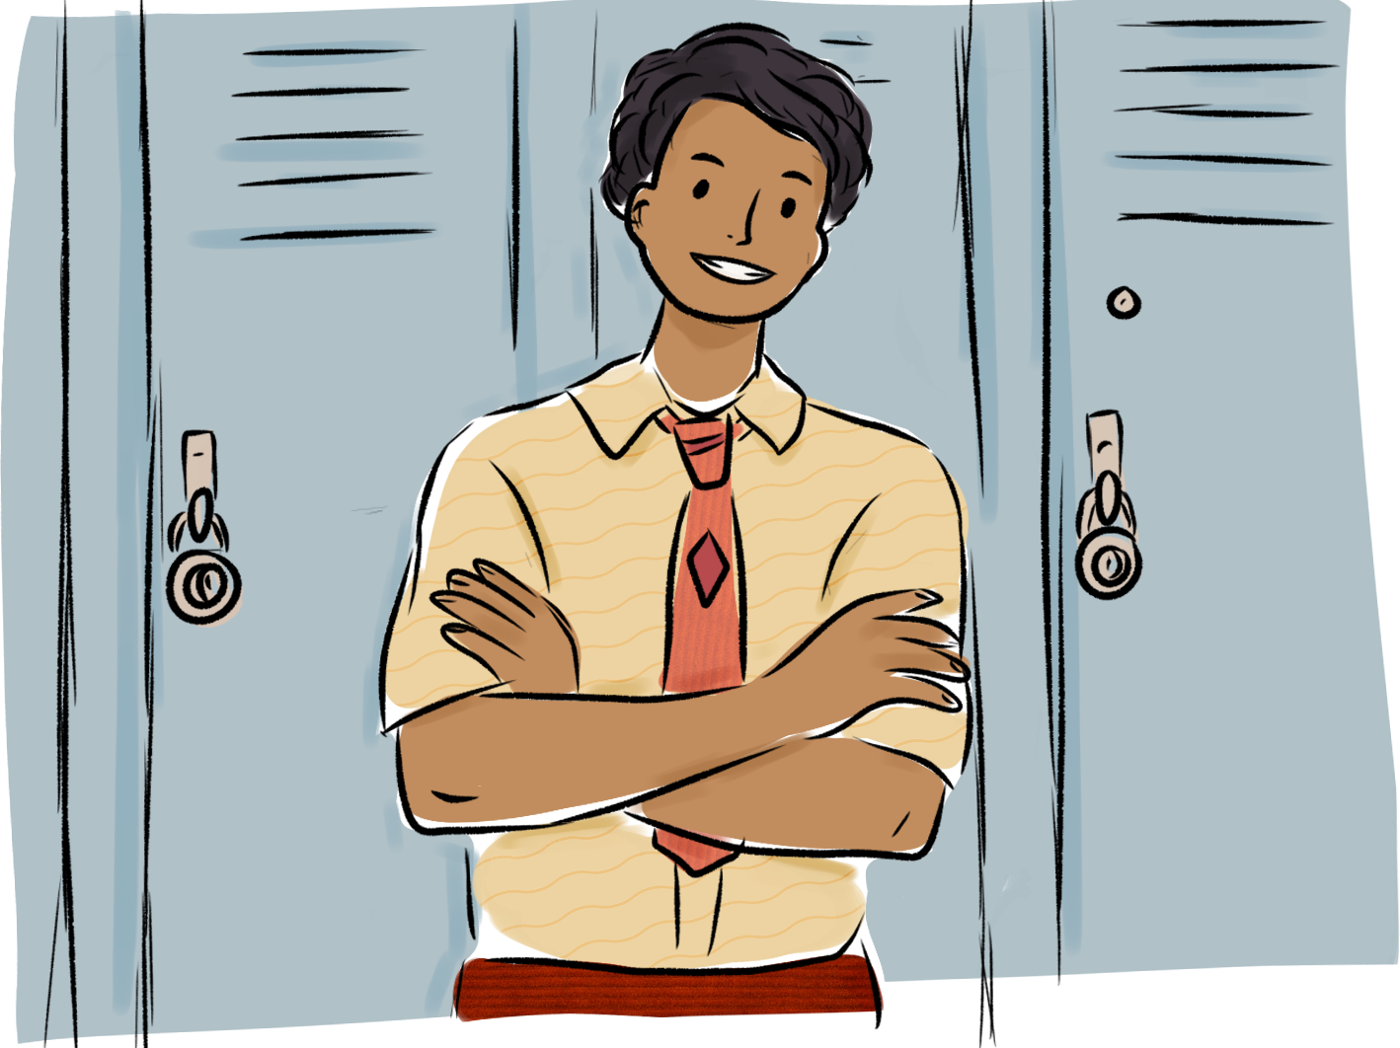
Before Listening to TED TALK
Let’s think about the following question:
Who are you?
What is gender equality for?
What is Feminism？
Let's check with your classmates how your answers have changed after watching the video.
4

Slide 5
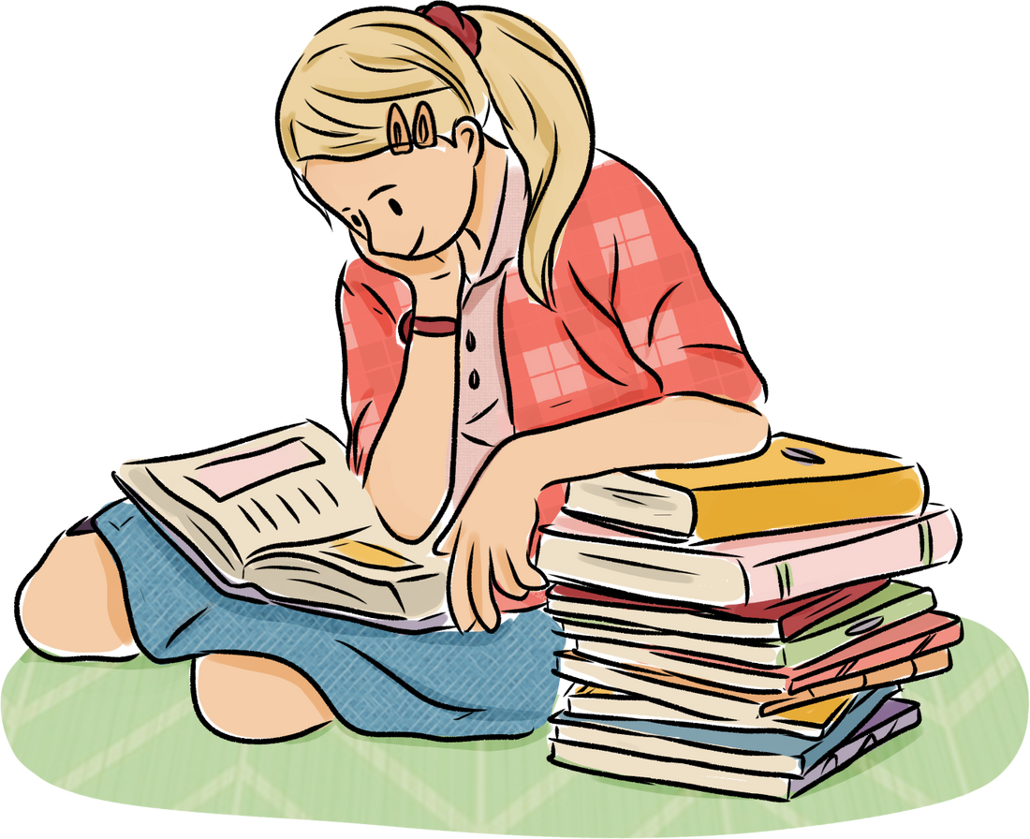
Here are important terms in the video. Let's check them before watching.
Vocabulary
5

Slide 6
a
Privilege
・
A situation where both partners in a relationship have their own careers.
b
The philosophical idea that the mind and body are separate entities, often associated with René Descartes.
Mind-body dualism
・
c
To identify a problem or illness by examining the symptoms or situation.
Dual-career
・
d
A special advantage that some people have, often unearned, based on factors like wealth, race, or gender.
Exposition
Mansplain
・
When a man explains something to a woman in a condescending way, assuming she lacks knowledge on the subject.
Diagnose
・
e
6

Slide 7
f
・
Feeling very confused or unsure about what to do.
Anachronistic
g
Something that doesn’t belong to its time, either being outdated or placed in the wrong historical period.
Flummoxed
・
h
・
A symbol or image that represents an idea, especially in the study of signs and meanings.
Intuitive
i
Exposition
・
A system where men hold most of the power in society, often at the expense of women.
Signifier
j
Patriarchy
・
Something understood naturally, without needing detailed thought or reasoning.
7

Slide 8
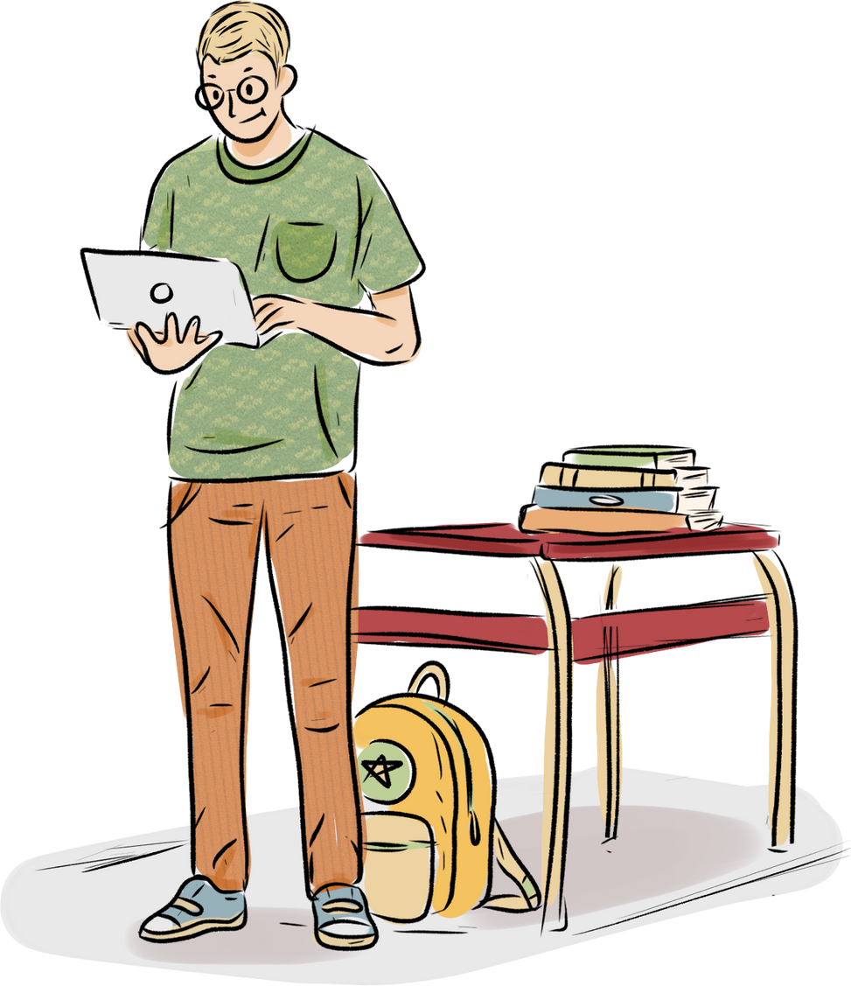
2025
Questions
Listen to TED TALK and answer the following question!
8

Slide 9
01
02
According to his speech,
what is the first step to engaging men to support gender equality?
How did the Black woman he mentioned in his speech define privilege?
01
01
01
03
Answer the 5 words that he mentioned as people or thing that benefit from gender equality.
04
9

Slide 10
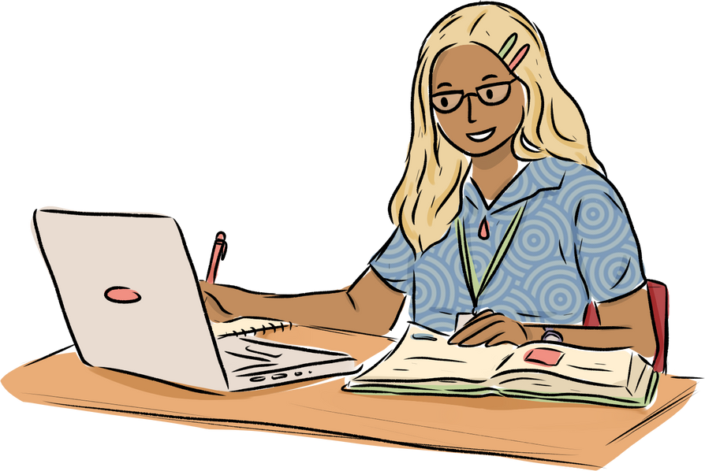
DICTATION
10
01
02
According to his speech,
what is the first step to engaging men to support gender equality?
1. 2:27
It is a (1 word), I will say to the white people sitting in this room, not to have to think about race e (3 words) of our lives.
01
01
2. 5:39
They see supporting gender equality something a (4 words), like,
"Thanks very much for b (5 words), ladies, we'll take it from here."This results in a syndrome that I like to call ' p (2 words).'
03
3. 13:27
They are less likely to go to the (1 word), but more like to go to a doctor for
(2 words).They are less likely to see a therapist, less likely to be
d (3 words),less likely to be
taking (2 words)
04

Slide 11
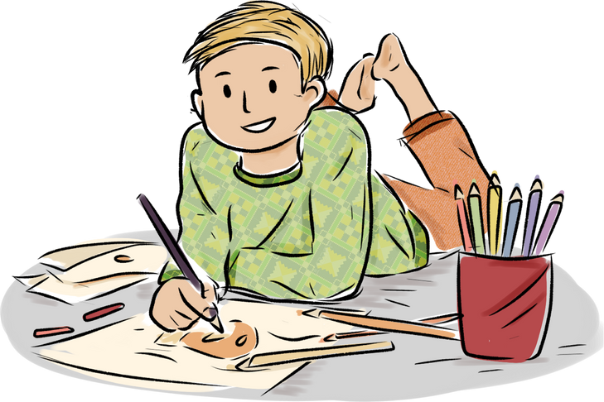
Let’s think further!
11
  Have you ever experienced some disadvantages due to gender inequality?
  What aspects of gender inequality do you think can be observed in Japan?
  What is the current state of gender equality in the region you are specializing in? And try to think of the differences and similarities compared to the situation in Japan.

Slide 12
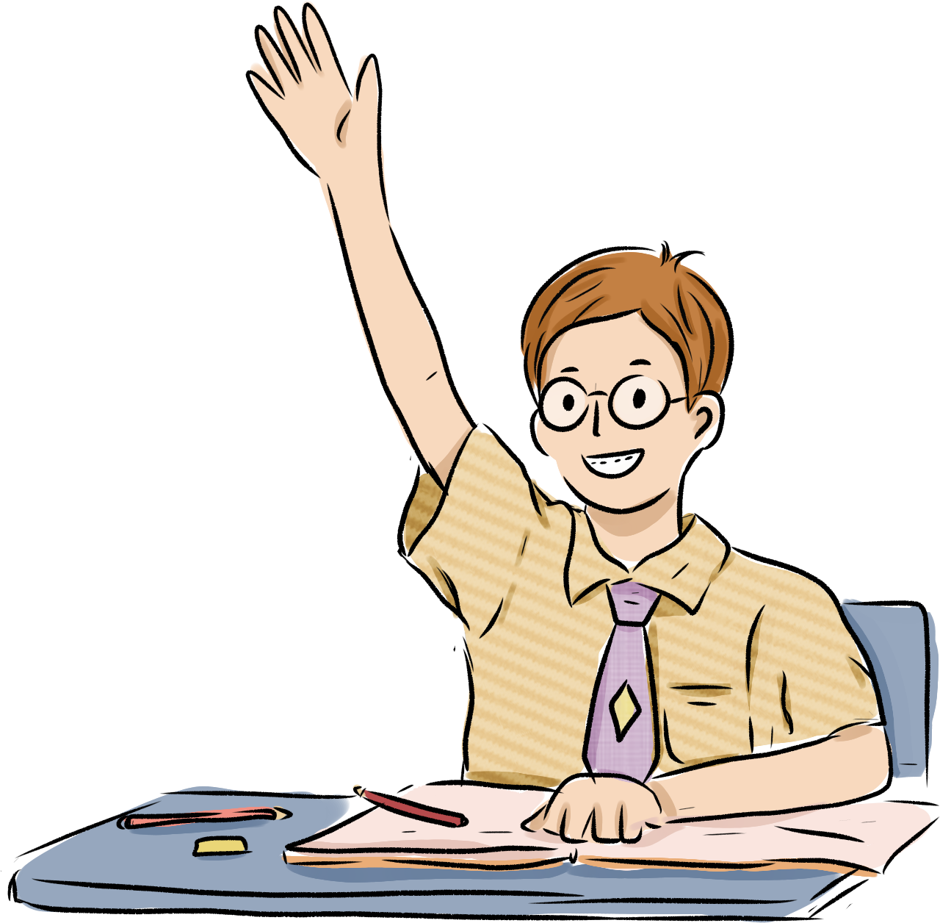
2025
Fun Activity
12

Slide 13
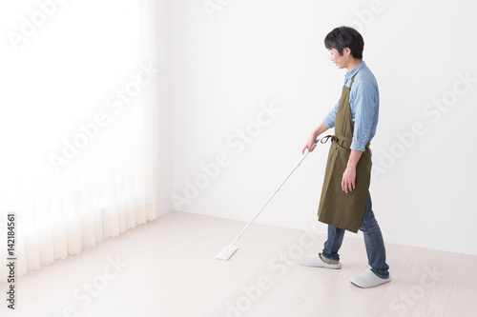

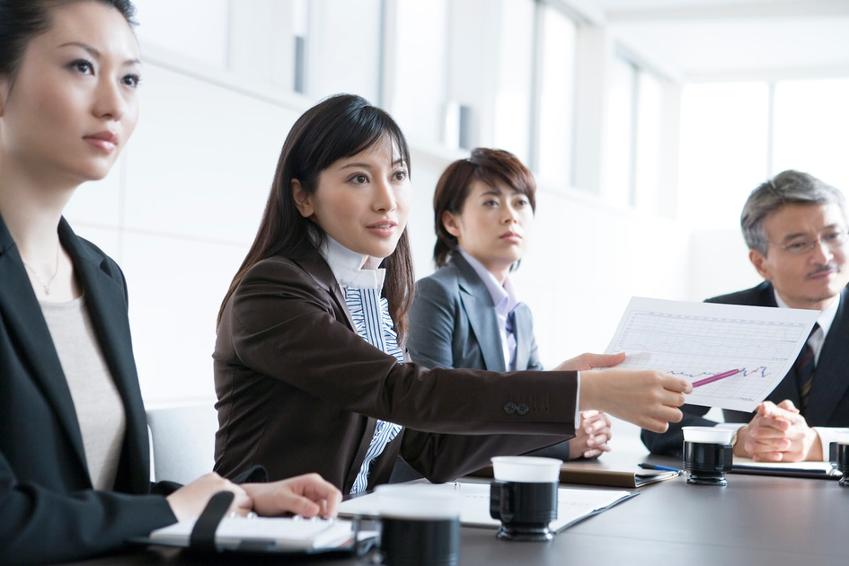
Breaking Gender Stereotypes:
Role-Reversal Challenge
13
Purpose
01
01
  Raise awareness of unconscious gender biases through a fun activity.
  Encourage reflection on how stereotypes influence daily decisions.
  Promote gender equality by challenging traditional gender roles.

Slide 14
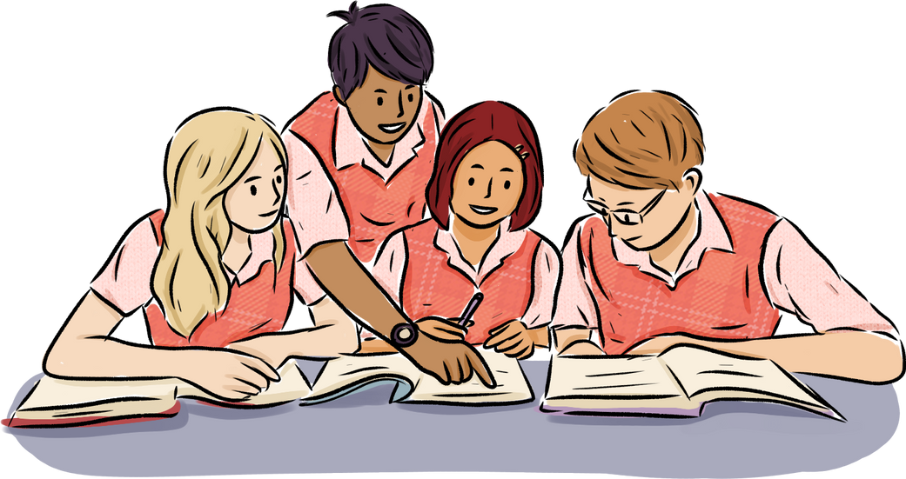
How to Play
1. Choose a Scenario
Examples:
Someone needs to cook dinner for the family.
2. Switch Genders
Imagine yourself as the opposite gender.
3. Act and Decide
Decide how your "new gender" would act in the scenario.
4. Reflect Together
Share how you felt during the role.
Discuss if your decisions were influenced by stereotypes.
14

Slide 15
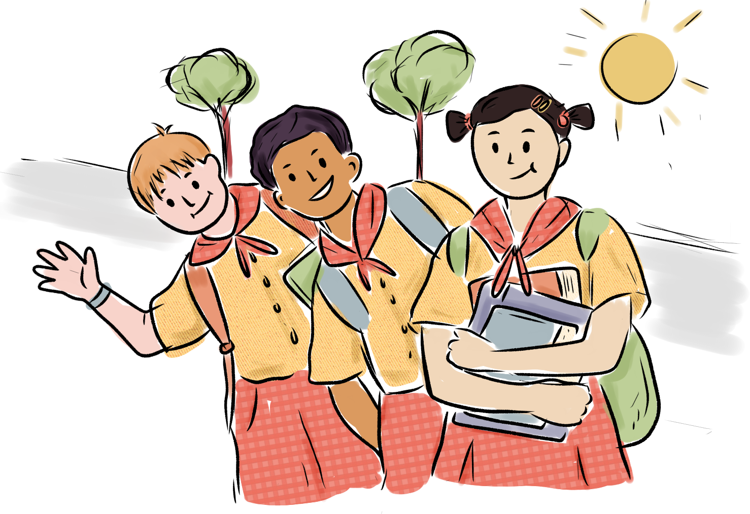
I hope that through this activity, you will gain a better understanding of gender equality.
15
Thank you!

