Slide 1





Why social health is key to happiness and longevity.

Slide 2
Outline
The reason why I chose this topic
The vocabulary and the contents of the video
Engaging questions
Fun activity

Slide 3
The reason why I chose this topic.
This video’s title says social health is highly related to happiness and longevity. I get really interested in this topic.
I would like to learn about social health.
I try to stay healthy every day, so I care about physical hearth and mental health.
However, I did not care about social health because I had not heard about it.
I was sure that watching this video can be useful for our lives.

Slide 4
The vocabulary
cherish: to love sb/sth very much and want to protect them or it.
tether: a rope or chain used to tie an animal to sth.
recurrent: that happens again and again.
bolster: to improve sth or make it stronger.
proactive: controlling a situation by making things happen rather than waiting for things to happen and then reacting to them.
ingrained: that has existed for a long time and is therefore difficult to change.

Slide 5
The contents of this video
犬のトリミングサロンで
トリマーとして働いています！
犬や猫だけでなく動物が昔から
大好きです！
A lot of people go weeks at a time without talking to a single friend or family member. One in four people feel lonely.
Disconnection trigger stress in the body even if you care about physical and mental health.

Slide 6
The contents of this video
犬のトリミングサロンで
トリマーとして働いています！
犬や猫だけでなく動物が昔から
大好きです！
The concept of social health is the cue in solving this problem.
The video shows the importance of social health and introduce how to build up social health.

Slide 7
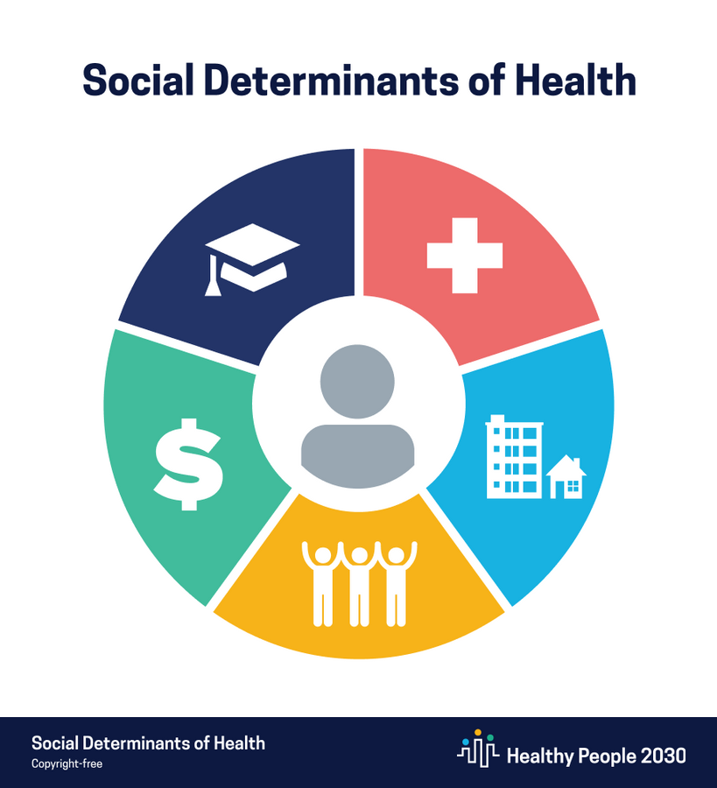
what is
Social health?
・Having a close relationships with your family, your friends, your partner, yourself.
・Having a regular interaction with your coworkers, your neighbors.
・Feeling like you belong to a community.

Slide 8
Method for social health
5-3-1guideline
To strengthen at least 3 close relationships overall
To interact with 5 different people each week
To spend 1 hour a day connecting

Slide 9
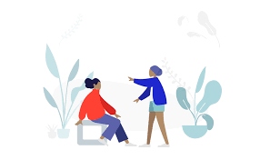
To interact with 5 different people each week
Interacting with a variety of people is more rewarding.
Your five include
・close loved ones
・casual acquaintances
・complete strangers
For example
making eye contact, or chit-chatting with barista.

Slide 10

To strengthen at least 3 close relationships overall
Step1
Writing a to-love list.
Write those who matter most to you, who can you be yourself with.
Step2
Scheduling regular time together,
showing a genuine interest in their lives,
and opening up about the experiences that you are going through.
*Face-to-face is ideal but texting is ok

Slide 11

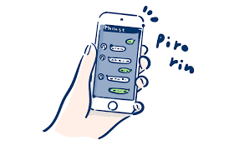

To spend 1 hour a day connecting
Spend one hour a day on meaning ful connection
Instead of
scrolling on social media⇨text a friend.
listening a podcast⇨call a family member.
reading news headlines⇨write a thank-you card.

Slide 12
Engaging questioons
1.Have you ever felt stress caused by the lack of social health?
2.How important are the friendships for maintaining good health?
3.To build up social health, which guideline do you want to try?

Slide 13

Fun activity
Make the best choices to build social health!
Imagine yourself in the following situations.
And think about what actions you could take to improve your social health!

Slide 14
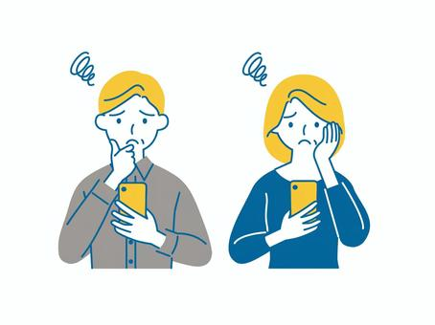
When you see your friend’s fun Instagram story and feel self-loathing
1.Glancing the story.
2.Trying to go out with someone.
3.Responding to the story and contacting the friend.

Slide 15

You are at the cash register paying for your purchase.
What do you do when the clerk gives you your change and the item?
1.Just receiving them.
2.Giving a slight bow.
3.Saying thank you while looking the clerk in the eye.

Slide 16

When you are studying in a classroom, busy with a test or assignment, and your friends come into the classroom
1.Saying hello to them.
2.Keeping studying without saying anything.
3.Having a light chat.

Slide 17
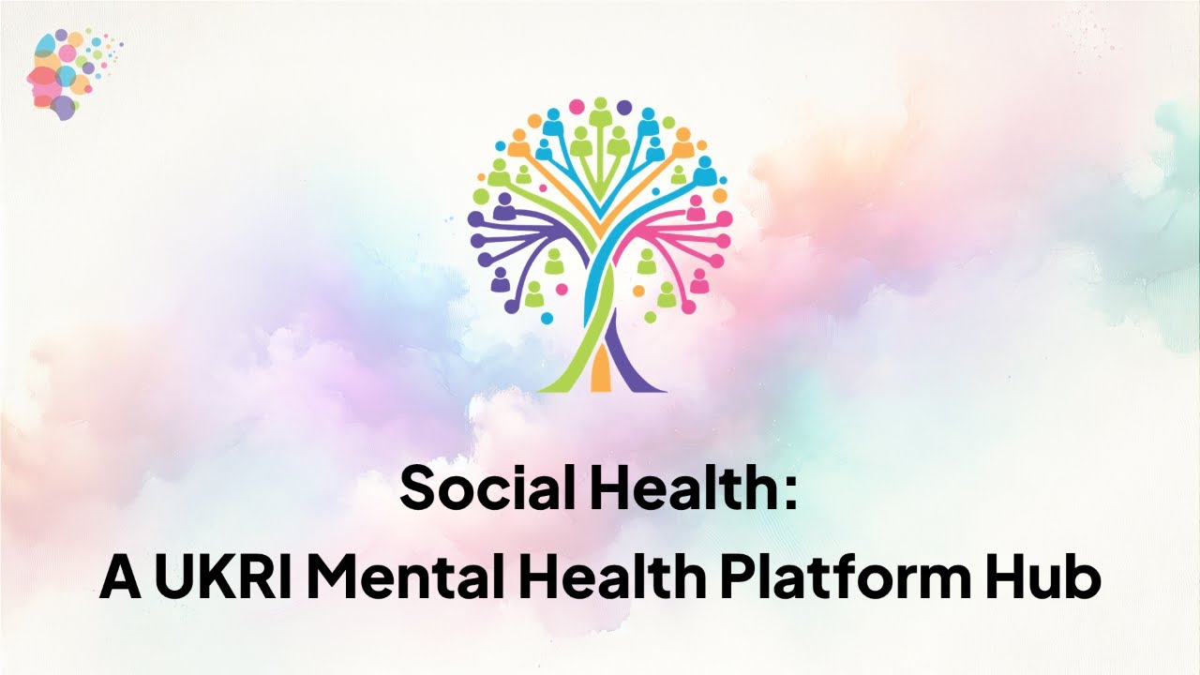

Did you make the best choices?
Small things like interacting with others can improve your social health.
Try to keep them in mind every day!

Slide 18
My answer
1.Have you ever felt stress caused by the lack of social health?
Yes, I have.
When I have a lot of things like assignment and part-time jobs, I cannot spend time to communicate with my family and friends. In such cases, I fell stress, and I get little depressed. I do not want to do anything like going to school or even talking with my family. Also, I feel restless and cannot sleep well.
To relieve stress, I eat too much food and snacks. After that I regret having done such a things.

Slide 19
My answer
2.How important are the friendships for maintaining good health?
I think friendships has an effect to reduces stress and loneliness, and it is highly connected to social health.
This is because when you spend time with your friends, you feel supported and understood.
As for me, when I have enough time to communicate with my friends, I think my life is fulfilling and I feel very positive. So, I can try various kinds of things like starting to learn new languages or doing some exercises. Friendships has an impact to physical health and mental health.

Slide 20
My answer
3.To build up social health, which guideline do you want to try?
I want to try “To spend 1 hour a day connecting”.
At first, I think one hour is too long and I do not have enough time to do so.
However, I realize that I spend about an hour watching YouTube or listening to music when I am on the train or after eating dinner. Instead of doing such a things, I will try to interact with people rather than enjoying my free time alone.
Even just talking a little can help me to change my mood, For example, I will chat with my friend on LINE or react to Instagram stories.

Slide 21
Thank you so much
Thank you for listening.
Source of information
Title: Why social health is key to happiness and longevity
Speaker: Kasley Killam
Link:
https://www.ted.com/talks/kasley_killam_why_social_health_is_key_to_happiness_and_longevity?utm_campaign=tedspread&utm_medium=referral&utm_source=tedcomshare

