Slide 1

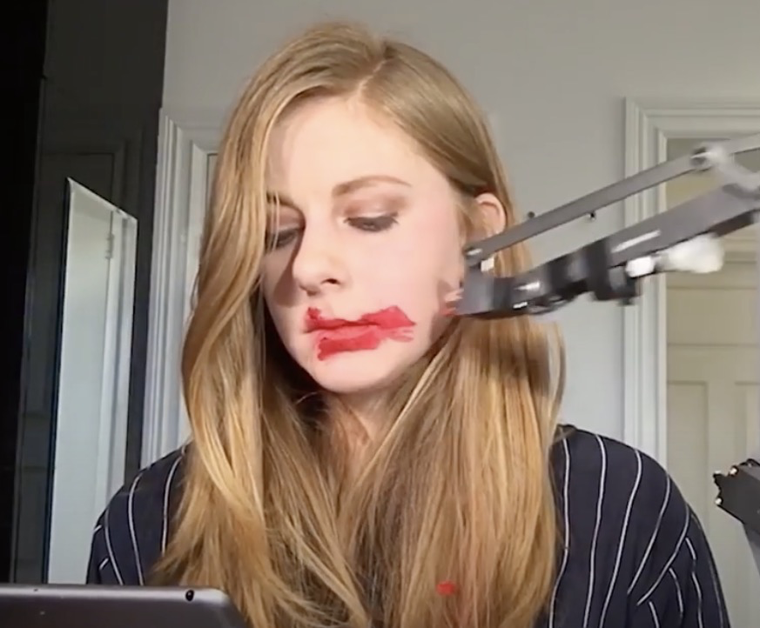
Why you should make useless things?

Slide 2



TED Talk
URL:
https://www.ted.com/talks/simone_giertz_why_you_should_make_useless_things?referrer=playlist-surprisingly_fun_ted_talks&autoplay=true&subtitle=en
Speaker:
Simone Giertz
Title:
Why you should make useless things?

Slide 3
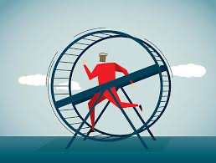
Why did I choose this topic ?
In our efficiency-focused society, “wasted” time and “useless” things are often cut out. But I think taking detours can actually bring relaxation, new discoveries, and broaden our perspectives. I chose this topic to explore the speaker’s views on this idea and see if I could resonate with them.

Slide 4
Vocabulary
Carved out
＝generate,create
Detours
＝a roundabout way
Mindfulness
＝awareness · realization · recognition
Performance anxiety
＝nervousnes
Puberty
＝adolescence
Dare to
＝risk doing
Mesmerizing
＝fascinate
Slapstick
＝comedy

Slide 5
Questions provided
What is the speaker's profession?
a) Scientist
b) Author
c) Entrepreneur
d) YouTuber
What did the speaker invent?
a) Toothbrush Helmet
b) Cutting hair with drones
c) A device that wakes you up
d) Vegetable cutting machine
Was every invention of his successful?
a) Yes
b) No

Slide 6
Questions provided
What is the speaker's profession?
a) Scientist
b) Author
c) Entrepreneur
d) YouTuber
What did the speaker invent?
a) Toothbrush Helmet
b) Cutting hair with drones
c) A device that wakes you up
d) Vegetable cutting machine
Was every invention of his successful?
a) Yes
b) No

Slide 7
Questions provided
1.What is the speaker's profession?
a) Scientist
b) Author
c) Entrepreneur
d) YouTuber
2.What did the speaker invent?
a) Toothbrush Helmet
b) Cutting hair with drones
c) A device that wakes you up
d) Vegetable cutting machine
3.Was every invention of her successful?
a) Yes
b) No

Slide 8
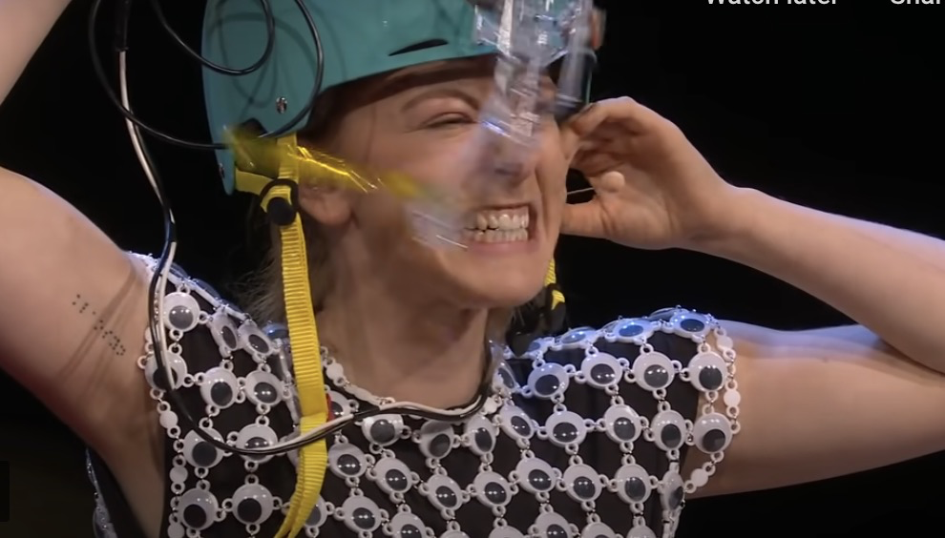
2.What did the speaker invent?
https://digitalcast.jp/v/26343/
(2:04〜 3:24〜3:58)
a) Toothbrush Helmet
b) Cutting hair with drones
c) A device that wakes you up
d) Vegetable cutting machine

Slide 9
Questions provided
What is the speaker's profession?
a) Scientist
b) Author
c) Entrepreneur
d) YouTuber
What did the speaker invent?
a) Toothbrush Helmet
b) Cutting hair with drones
c) A device that wakes you up
d) Vegetable cutting machine
Was every invention of his successful?
a) Yes
b) No

Slide 10
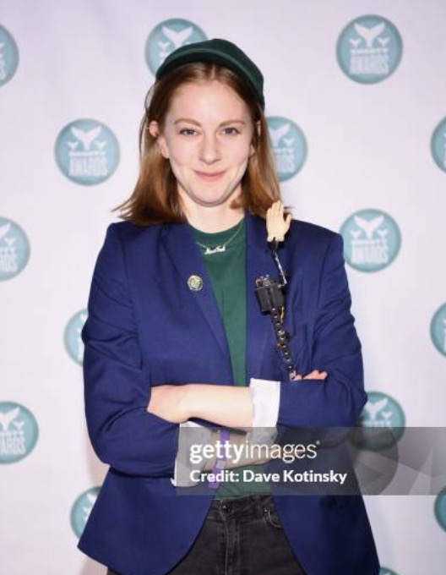
The speaker’s perspective:
When she started creating something meaningless, as soon as she removed the pressure and expectations she had for herself, and she was able to purely enjoy it. In a way, she is creating her work from making things that are not useful, which was not planned at all. It’s simply the result of being absorbed in what she was doing and sharing that enthusiasm with others. That’s the wonderful thing about making something useless—recognizing that you don’t always know what the best answer is.

Slide 11

Discussion time:
Let’s think more about “wasting” and “useless.”

Slide 12
Discussion part
⑴How do you feel that "detours" or "wasting time" contribute to your life?
⑵In an era of high stress, what do you think about intentionally creating wasted time? Include your reasons for agreeing or disagreeing.
⑶What do you think are the disadvantages of focusing too much on efficiency?

Slide 13

Thank you for your listening!

