Slide 1



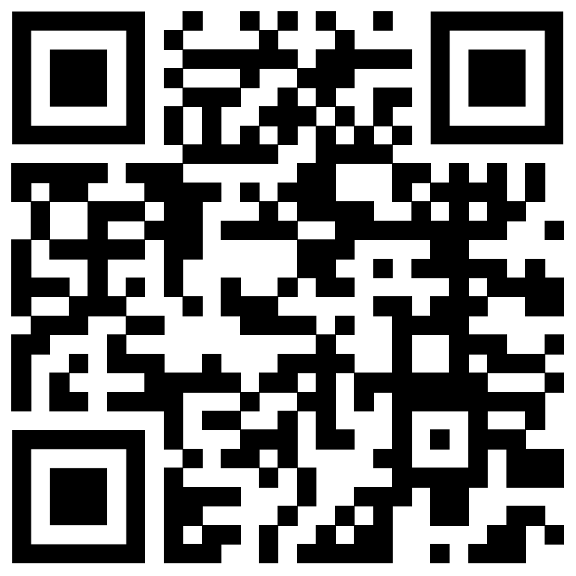


film
wonder
(2017)
film link: https://www.youtube.com/watch?v=5go9i8NYrKw&t=1603s

Slide 2


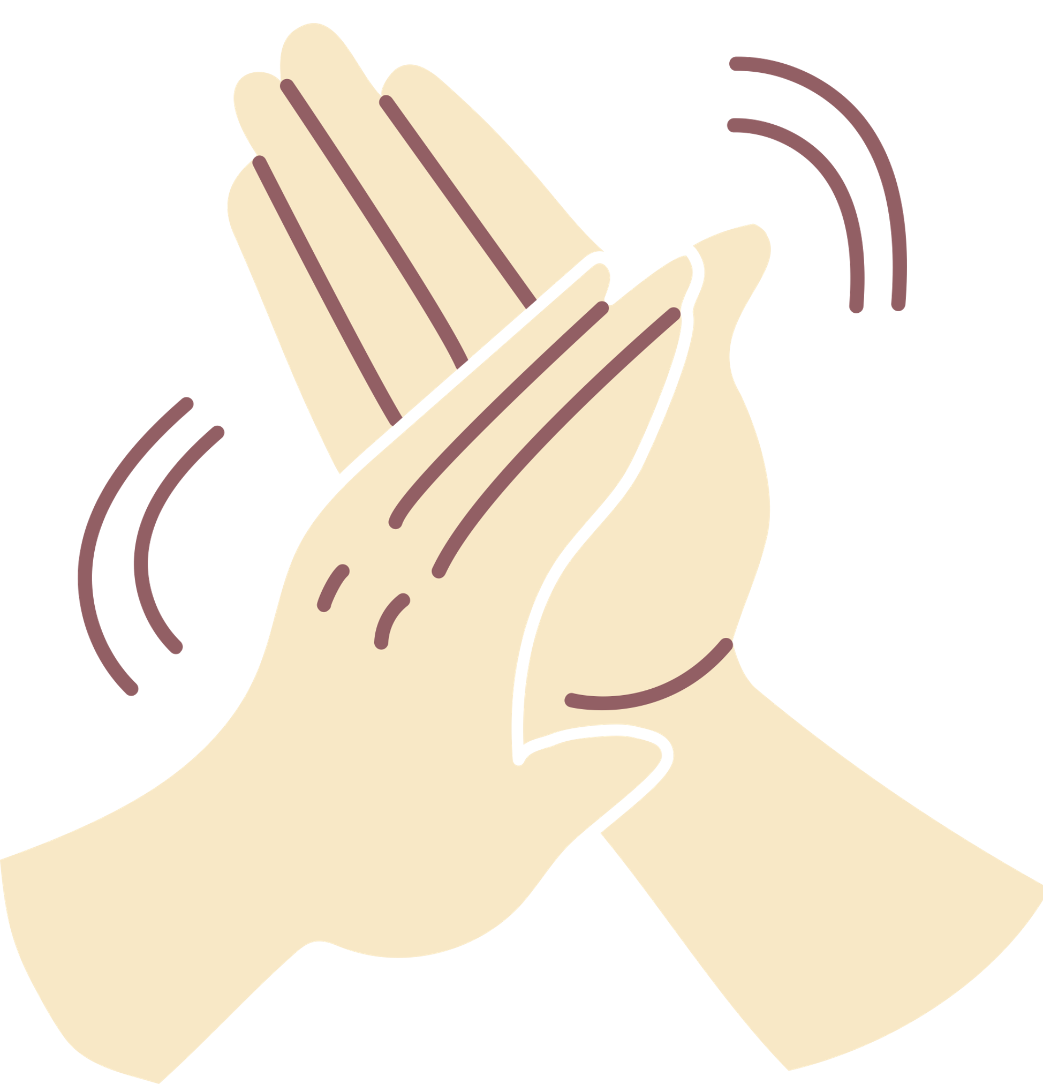

Slide 3

why I choose it
1
2
explores family and friendship dynamics
teaches empathy and kindness
3
addresses bullying and peer pressure
offers relatable life life lessons
4

Slide 4





transcript
Scene: Auggie and Via talk after an argument
Auggie: (enters Via’s room hesitantly) Can I come in?
Via: (sighs, closing her book) What do you want, Auggie?
Auggie: (nervous) I… I just wanted to say I’m sorry
Via: (looks surprised) Sorry for what?
Auggie: For… I don’t know. For being me. For taking all of Mom and Dad’s attention.
Via: (sits up) Auggie, don’t say that. It’s not your fault.
Auggie: But it is. You were happy before I was born.
Via: (pauses, softens her tone) That’s not true. You know what I was thinking when Mom and Dad told me you were coming home for the first time?
Auggie: What?
Via: (smiles) I couldn’t wait to meet you. I told all my friends I was getting a baby brother. I didn’t know what you’d look like, and I didn’t care.
Auggie: (tearing up) Really?
Via: (nods) Really. You’re not a burden, Auggie. Yeah, sometimes it’s hard. But you make us better—our whole family.
Auggie: (smiles faintly) Thanks, Via.
Via: (playfully) Just don’t touch my stuff, okay?
Auggie: Deal.

Slide 5



what did i learn from this scene?
This scene not only teaches emotional intelligence but also provides a template for resolving conflicts and building resilience in real life.
In terms of movie:The movie has clear positive messages about choosing kindness, appreciating everyone for who they are (rather than what they look like), and true friendship; empathy, compassion, and perseverance are also strong themes. There's some fighting among tweens/young teens and sad moments involving a loss.

Slide 6
vocabulary
1
2
Courage- The ability to do something difficult or face danger without fear.
Humble- Modest; not overly proud or boastful
burden- something worrisome
3
4
Precept-A rule or principle that guides behavior or action
Peer pressure- Influence from people in your age group to behave in a certain way.

Slide 7

questions provided
1
Why does Auggie apologize tp Via?
2
How does Via respond when Auggie says he’s sorry?
3
What do you think the relationship between Auggie and Via shows us about family?
4
Why do you think about Auggie feels like he’s burden?

Slide 8

How to Negotiate Miscommunication and Build Resilience
1. Acknowledge and Express Feelings: • Like Auggie, share how you feel honestly, even if it’s hard. This builds trust. • Example: “I feel like I’m taking too much attention, and it’s making me feel bad.”
2. Listen Actively: • Via listens without interrupting, showing patience and empathy. When resolving miscommunication, prioritize understanding over reacting. • Example: “Can you tell me how you feel? I want to understand better.”
3. Reframe the Situation: • Via helps Auggie see his value, turning his guilt into pride. This is a powerful resilience-building strategy. • Example: “Yes, it’s tough, but think about how much we’ve grown because of you.”
4. Compromise and Humor: • Ending the conversation with humor (“Don’t touch my stuff”) lightens the mood, showing how positivity strengthens bonds. Stretching Learning into Your Life

Slide 9

match the words with descriptions
fun activity
descriptions
words
A. The feeling you have when you believe you have done something wrong.
B. A strong, positive quality that helps you bounce back from difficult situations.
C. The ability to understand and share the feelings of others. D. What Auggie feels like, thinking he is causing stress for his family
E. The word that describes brothers and sisters.
F. A phrase used to show you regret something you said or did.
G. A way of seeing things that helps us understand the experiences of others.
H. The act of being friendly, generous, and considerate toward others
  SORRY
  GUILT
  BURDEN
  SIBLINGS
  LENS
  RESILIENCE
  EMPATHY
  KINDNESS

Slide 10

viewing
time
Grab the popcorn!

Slide 11
Answer: 1-F , 2-A , 3-D , 4-E , 5-G , 6-B , 7-C , 8-C

