Slide 1
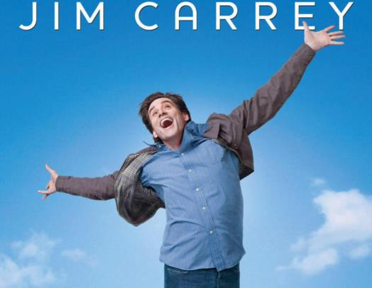
M O V I E
“ Y e s M a n ”

Slide 2
Basic Information
Release Year: 2008
Genre: Comedy
Director: Peyton Reed
Starring: Jim Carrey
Country of Production: USA, UK
Based on: Danny Wallace's book Yes Man (2005)

Slide 3
Basic Information
Story Summary
Carl, the protagonist, leads a closed-off life, saying "NO" to everything. After attending a seminar about saying "YES," he decides to embrace a life where he says "YES" to every opportunity, leading to dramatic changes in his life.

Slide 4




Why I choose this movie?
This movie made me reflect on the following keywords:
Self-Transformation:
Personal growth through
saying "YES”
Relationships:
How a positive approach expands personal connections

Slide 5
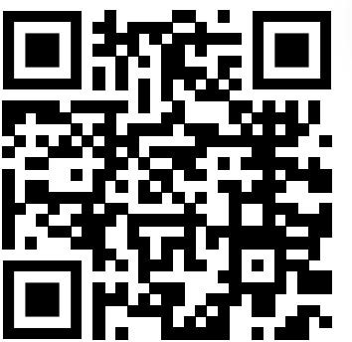

Slide 6
1.Basic Information
2.Why I choose this movie?
OUTLINE
3.Vocabulary
Question Provided
Discussion Part

Slide 7
Vocabulary
cut ties with
＝to end communication or a relationship
Dicey
＝unpredictable and potentially dangerous.
shipshape
＝n good order; trim and neat.
Airtight
＝preventing the entrance or escape of air or gas
ballsy
＝aggressively bold
Covenant
＝an agreement.

Slide 8
Vocabulary
Worrywart
＝a person who is inclined to worry unduly
Sever
＝divide by cutting, especially suddenly and forcibly.
Sync
＝synchronization
Smother
＝kill (someone) by covering their nose and mouth
Palpable
＝so intense as to seem almost tangible.
Pending
＝not yet decided : being in continuance.

Slide 9
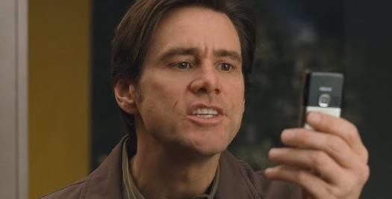


Question Provided
１.Why does Carl keep saying "no"?
Because he lacks confidence
Because he wanted to avoid new challenges
Because he was busy with work

Slide 10
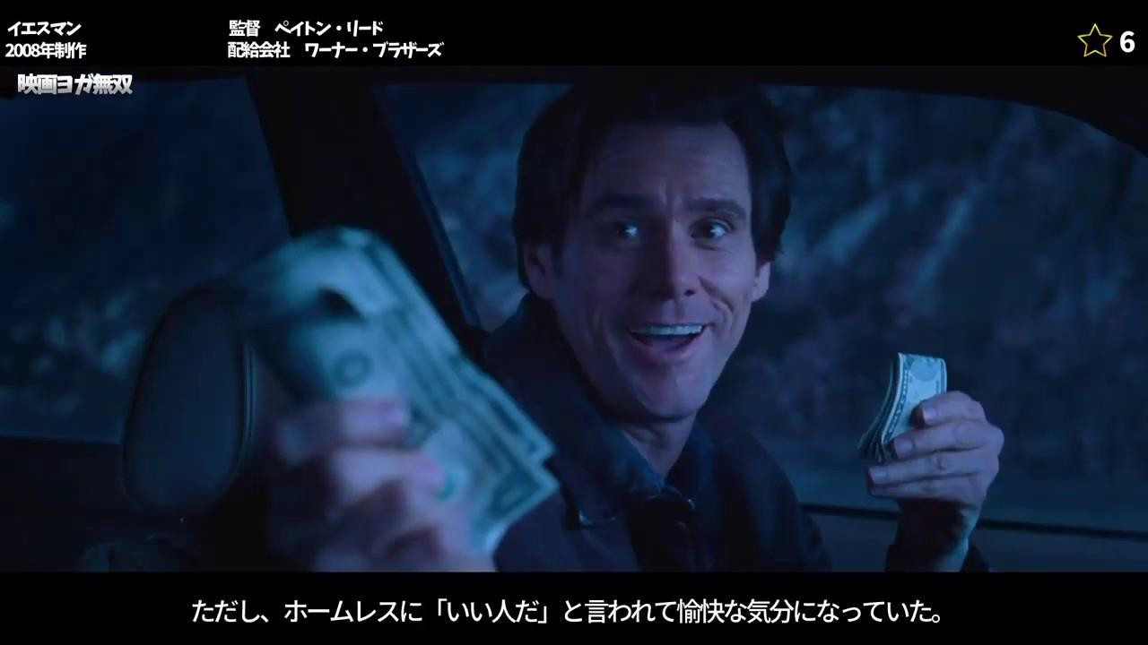
Question Provided
What does Carl gain by saying "yes" throughout the movie?
  New friends
  A new perspective on his life
  Money and material things

Slide 11
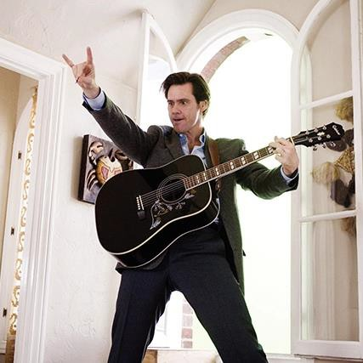




Question Provided
What was the most moving moment for Carl when he chose "yes"?
  Meeting new friends
  Succeeding in love
  Overcoming a challenging personal limit

Slide 12
Discussion Part
01
①Is there something you consciously focus on in your daily life?
02
②Are you a "Yes man" or a "No man"? Why?
03
③Have you ever experienced something good by saying "Yes"?

Slide 13
THANK YOU！

