Slide 1

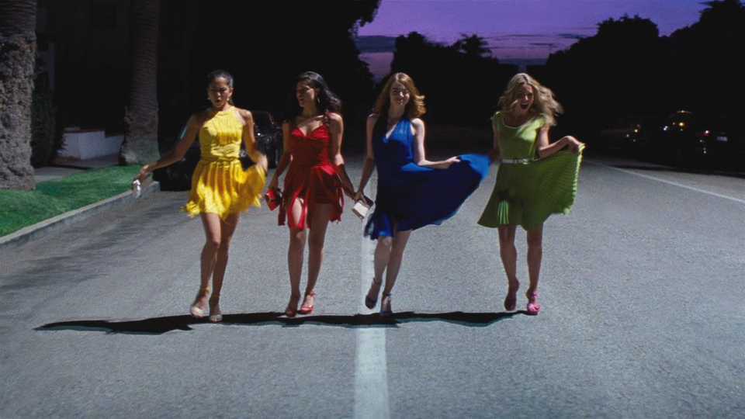
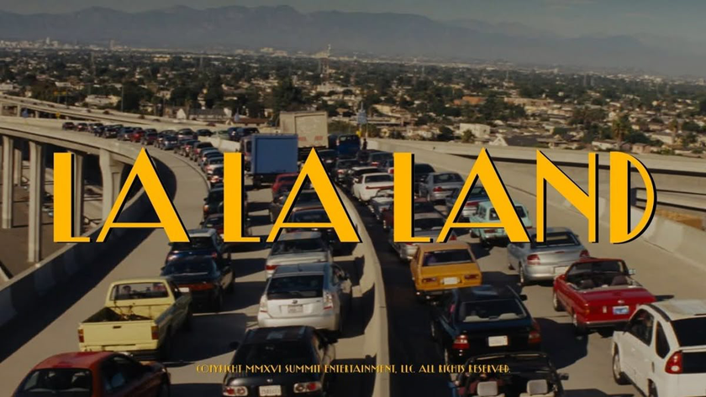
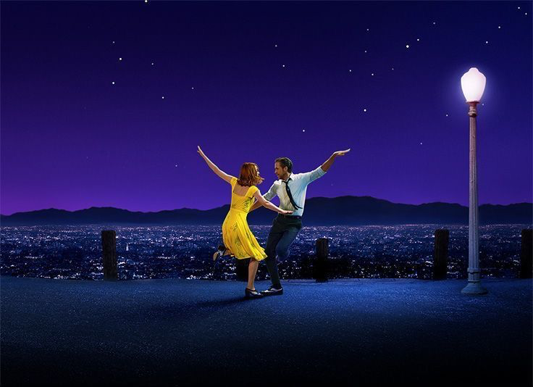

ANOTHER DAY OF SUN
FROM LA LALAND

Slide 2
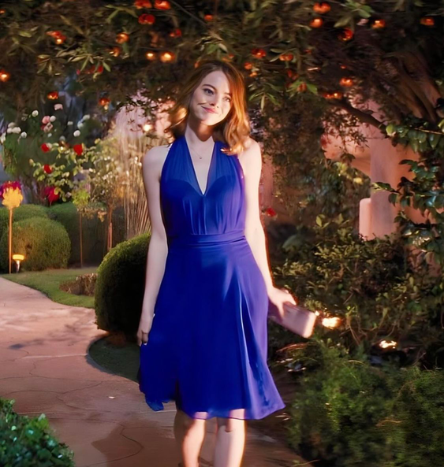
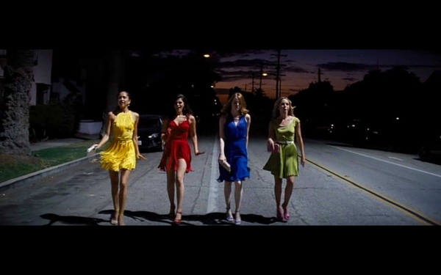
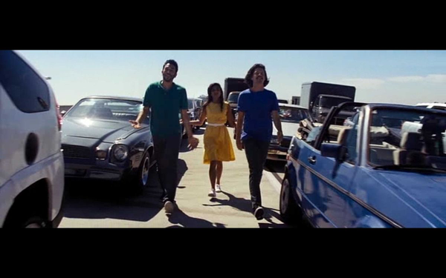
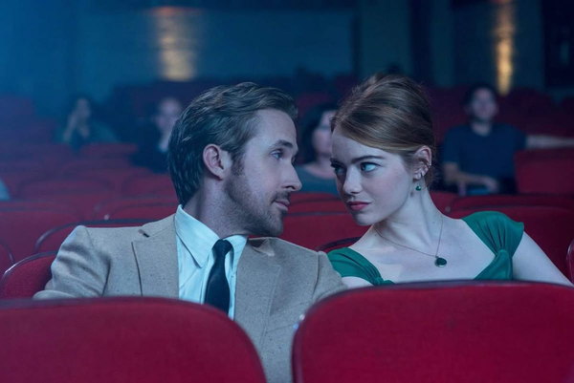
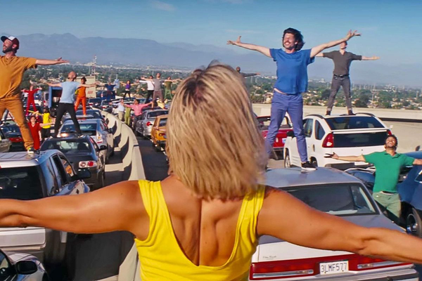
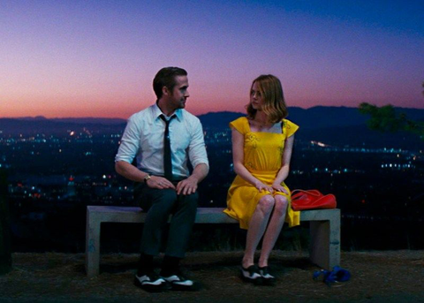
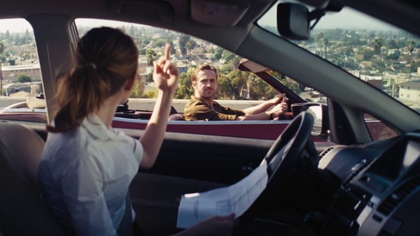
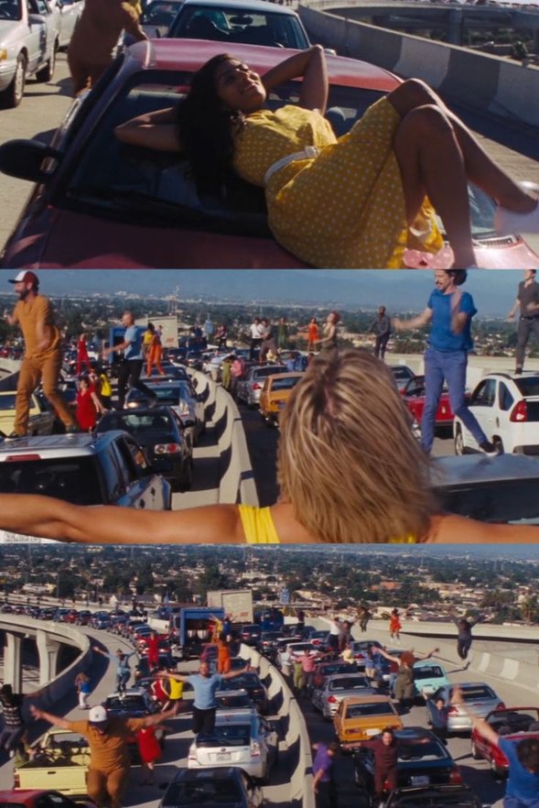
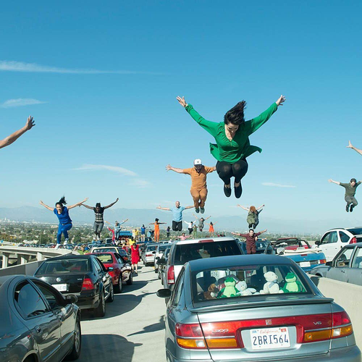
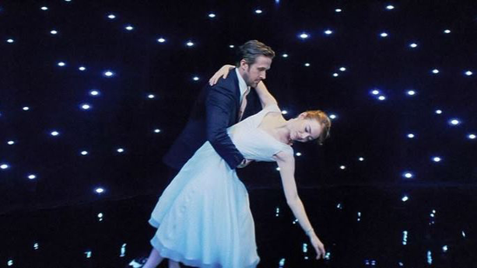
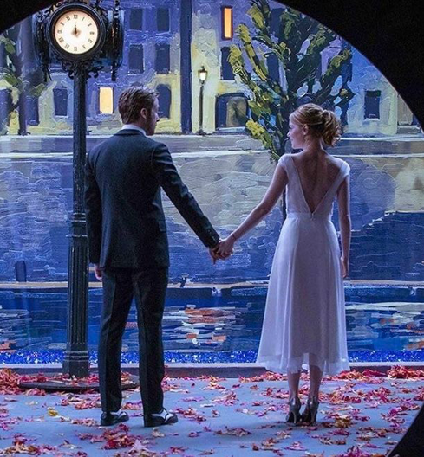
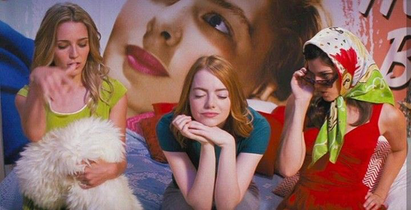
Another day of sun is
from La La Land
This song is about people
in Los Angeles
who dream of becoming
actor or musician.
ABOUT
THIS SONG

Slide 3
released in 2016
Composer: Justin Hurwitz
Lyricists: Benj Pasek and Justin Paul
Genre: musical
This song tells us to keep following our dreams

Slide 4

Click here

Slide 5

ANSWER
1 SEVENTEEN
2 SCREEN
3 BRAVE
4 SLEEPY
5 SHINE
6 RHYTHMS
7 SOMEDAY
8 ROLLS AROUND
9 BEGUN

Slide 6
VOCABULARY
Without a nickel to my name
→I have no money at all
nickel :5cents

Slide 7
VOCABULARY
Climb these hills I'm reaching for the heights
→ I will overcome difficulties to achieve my big dream
hills: Hallywood Hills/Challenges

Slide 8
MAIN MESSAGE
Keep following your dreams
Even if you fail today, the sun will rise again tomorrow
(Mixed feelings of joy hope and dremas but also frastration, emptiness)

Slide 9














LYRICS-IRONY-
Cause morning rolls around and it's another day of sun
For dreamers, sun is a symbol of hope
For those who give up, sun is a cruel reality
No matter what happen to you, the sun shines just as brightly as yerterday

Slide 10
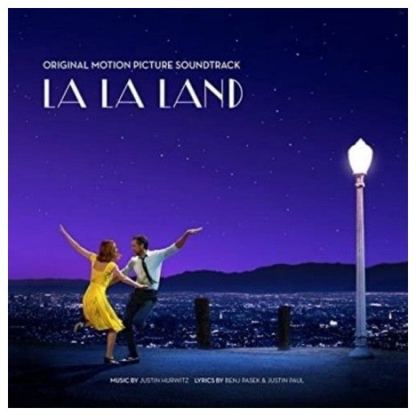
RHYME
Without a nickel to my name
Hopped a bus, here I came
Could be brave or just insane
Notes:
this song has some rhymes in the lyrics.
The rhyme make the song sound catchy and fun to listen to.
For example name came insane or town down how

Slide 11
RHYTHM
・
・
・
・
Climb these hills I'm reaching for the heights
And chasing all the lights that shine
・
・
・
・
・
・
・
・
・

Slide 12
REASON
Bright and energetic melody.
It makes me feel happy and positive
Message of the song encourages us to follow our dreams.
Notes:
I chose this song because I like its bright and energetic melody.
It makes me feel happy and positive when I listen to it.
I also like the message of the song because it encourages us to follow our dreams.

Slide 13
QUIZ
1.When was the song released?
A 2016
2.What is the meaning of nickel?
A 5 cents
Notes:
I chose this song because I like its bright and energetic melody.
It makes me feel happy and positive when I listen to it.
I also like the message of the song because it encourages us to follow our dreams.

Slide 14
THANK YOU

