Slide 1




Studio Shodwe
Gossip
maneskin
Genre : hard rock

Slide 2
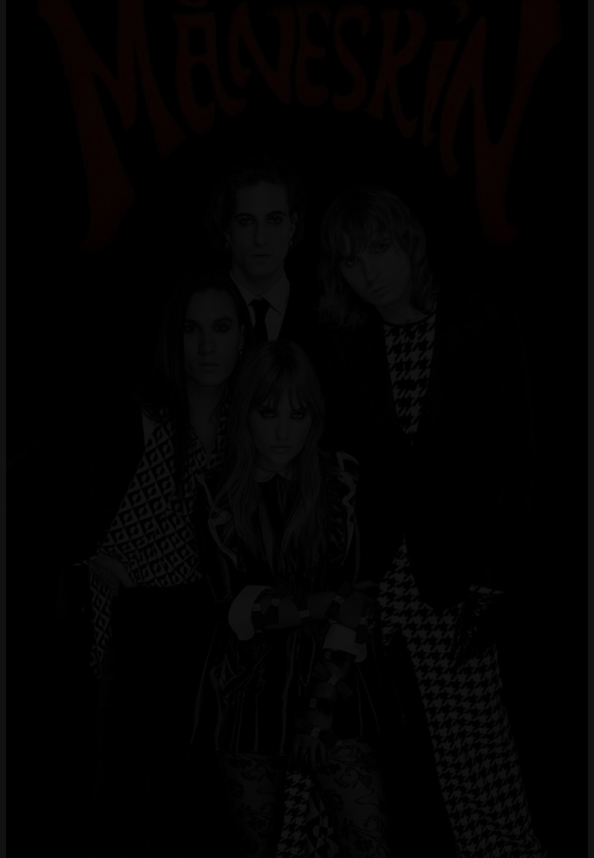
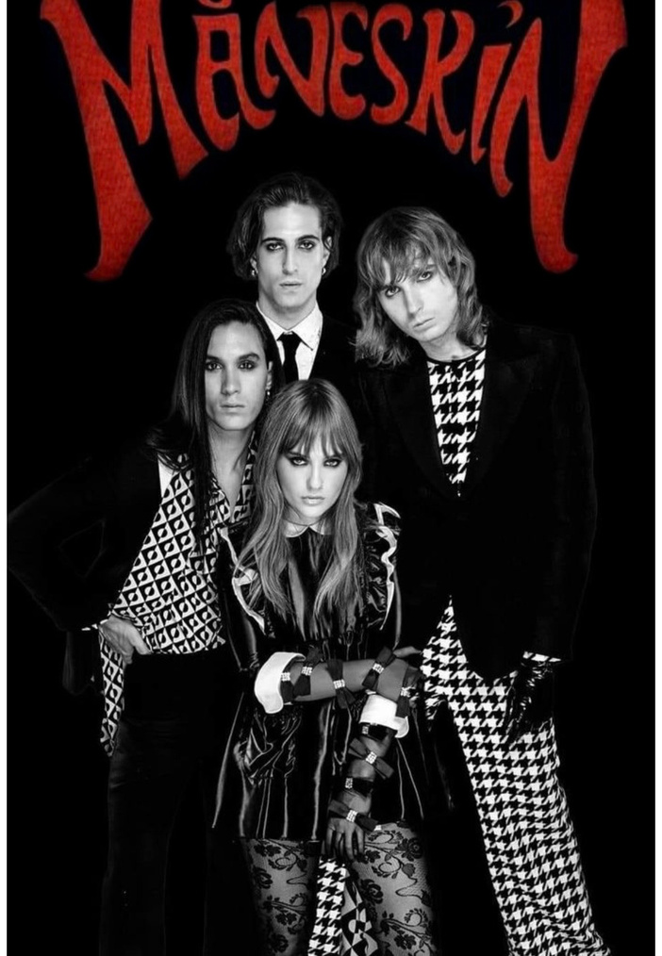
Studio Shodwe
Introduction
We love rock style songs!!
Strong energy
wipe out stress!!!
Powerful impression

Slide 3
Quiz
No.1 Where was the band formed?
No.2 When was “Gossip” released?
No.3 In this song , what does
people influenced by fashion
become finally?

Slide 4
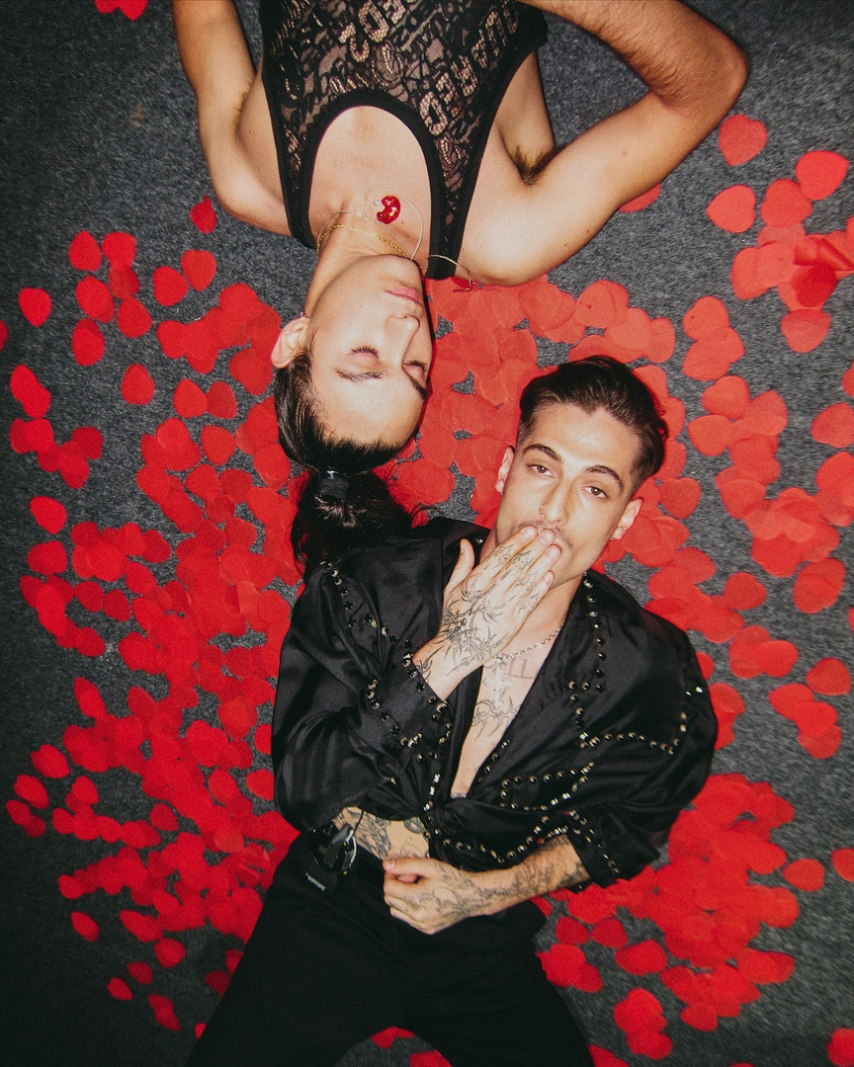

Studio Shodwe
INTRODUCE VOCB
01
Gossip
Rumors, trends, and media messages
Iconic
02
Extremely famous, unique, or representative of a particular style or culture
Sip
03
To drink something slowly

Slide 5
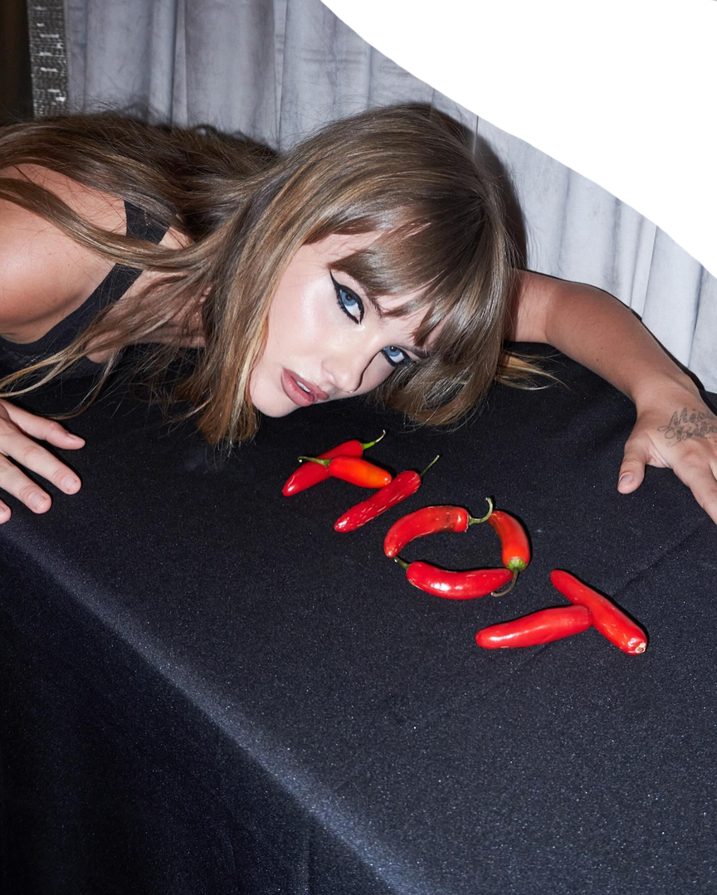

FILL IN THE BLANKS

Slide 6
ANSWER
1 price 2 movie star 3 plastic
4 surface 5 faking 6 gossip
7 iconic 8 acting 9 gloomy
10 taste

Slide 7
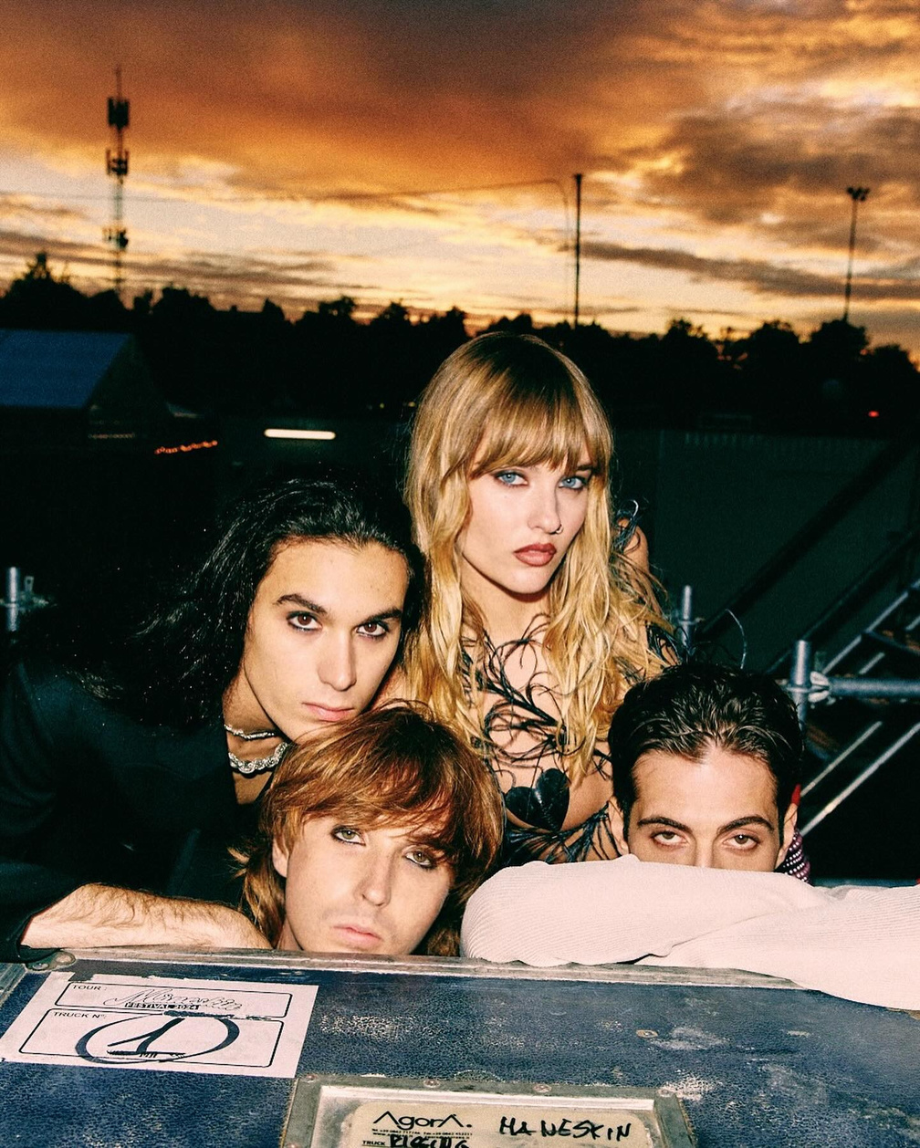
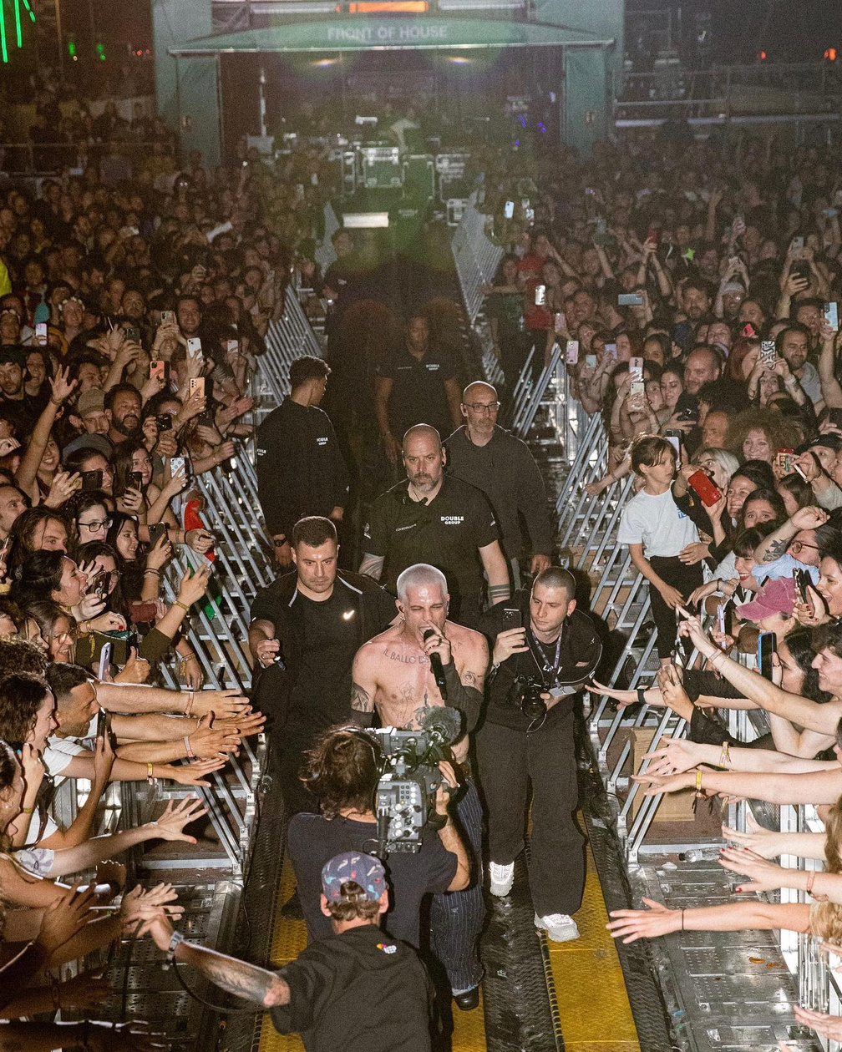
Studio Shodwe
Background and Main Theme
01
Social Pressure
02
Value by Appearance
03
Manufactured Uniqueness

Slide 8
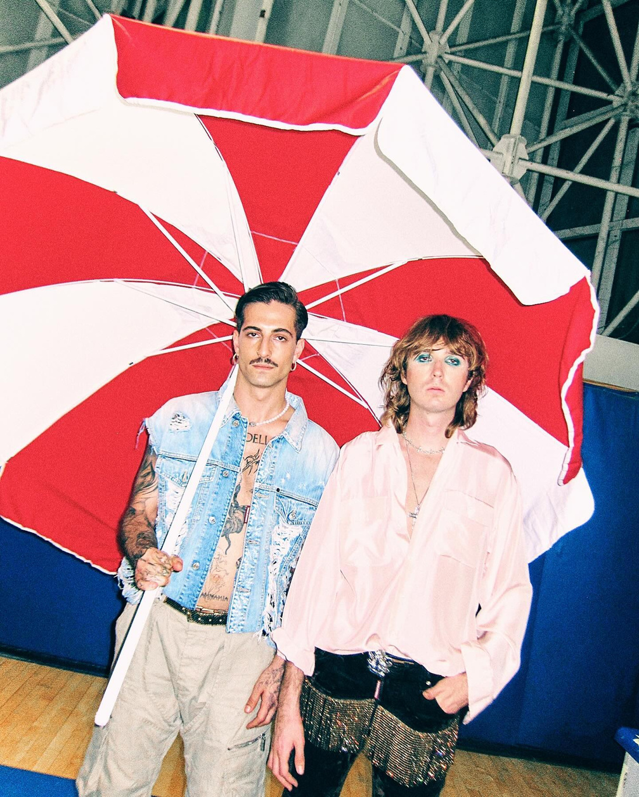

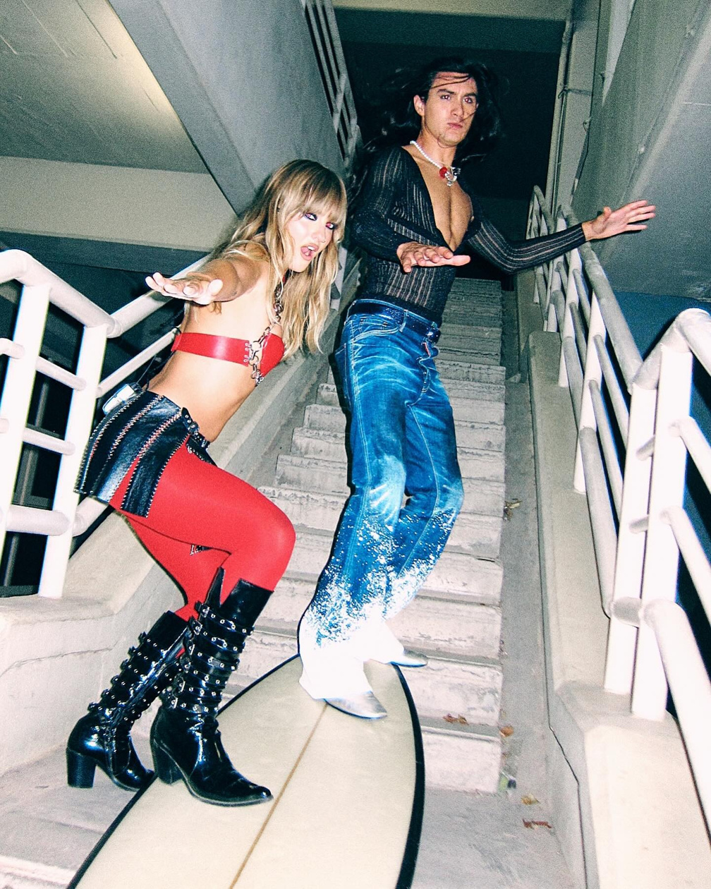

Studio Shodwe
People…
01
Consume rumors
02
Conform
03
Lose IDENTITY

Slide 9



Studio Shodwe
History And Award
・Formed in Rome in 2016
・Got secnond place in Italien
music contest in 2017
・4 albums and 13 singles topped Italian and
European music charts
・received their first Grammy nomination at the
2023 Grammy Awards.
Ethan, Victoria, David, Thomas

Slide 10
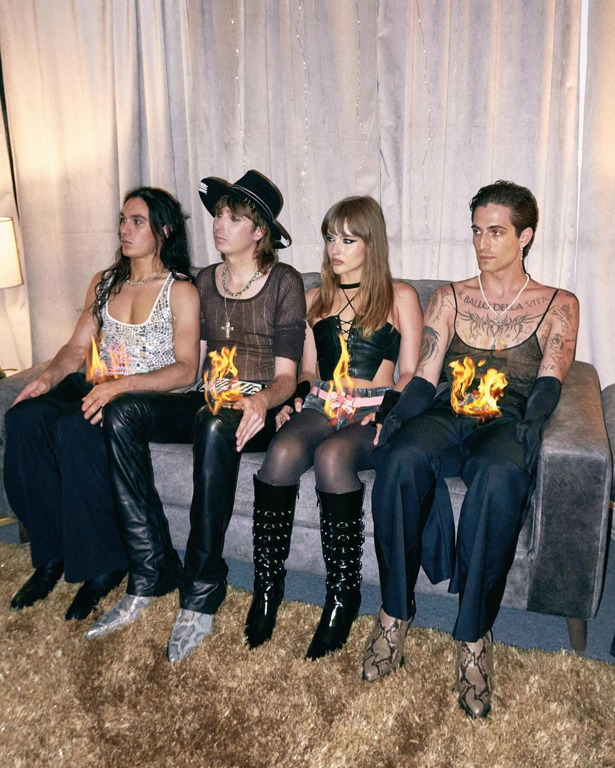

PRONOUCIATION
01
Elision
When consonants occur together, sounds such as /t/ or /d/ may be weakened, reduced, or omitted altogether.
04
Assimilating
02
Intrusion
A sound changes its place or manner of articulation because of the influence of a neighboring sound.
A final consonant is linked directly to the vowel sound at the beginning of the next word.
05
The shwa
03
Catenation
Unstressed function words such as articles, pronouns, and auxiliaries are often pronounced with the weak vowel sound /ə/.
A linking sound such as /j/ or /w/ is inserted between two vowel sounds to make pronunciation smoother.

Slide 11
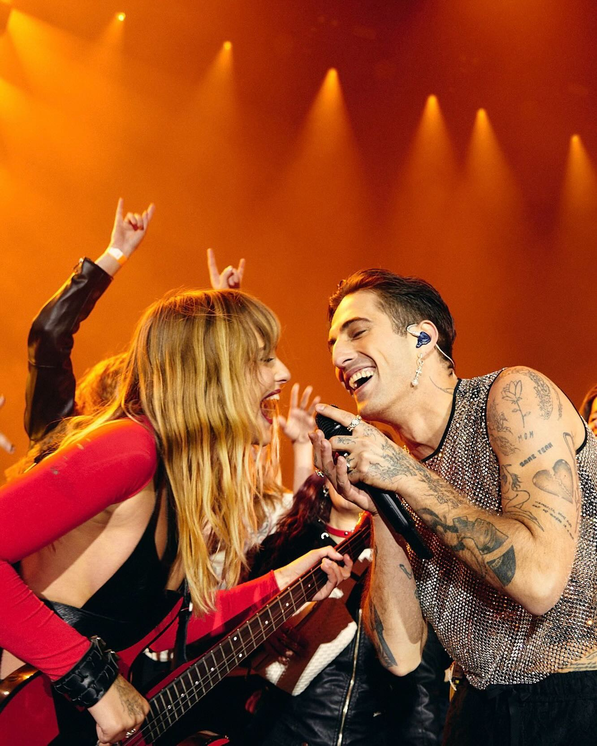
PRACTICE

Slide 12
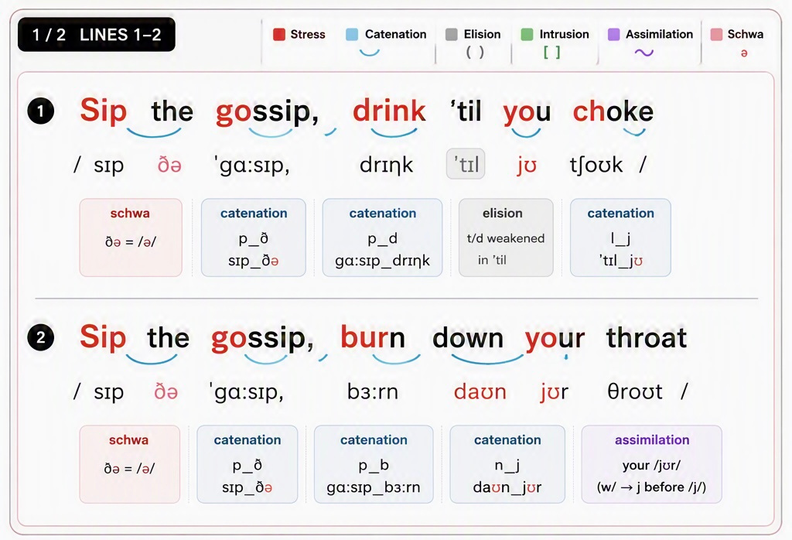

Slide 13
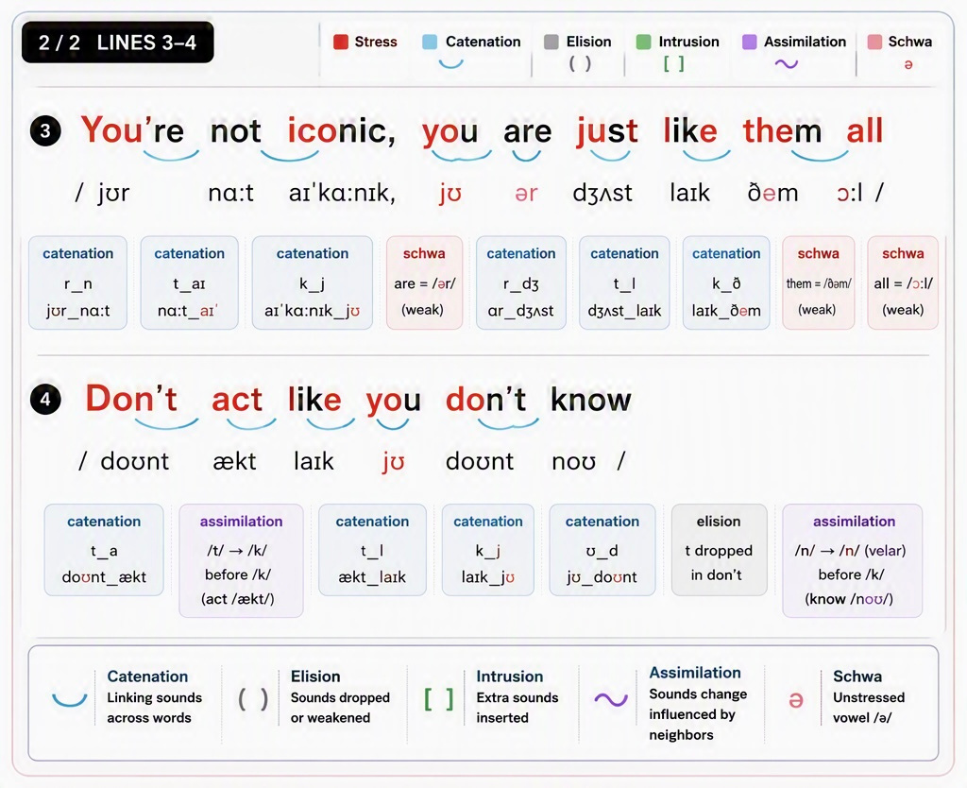

Slide 14
rythm and intensity
Sip the gossip, drink 'til you cho - ke
Sip the gossip, burn down your thro - at

Slide 15
rythm and intensity
You're not iconic, you are just like them all
Don't act like you don't kn-ow,

Slide 16
Studio Shodwe
Answer of the Quiz
No.1 Where was the band formed?
A. Rome in Italy
No.2 When was “Gossip” released?
A. 2023
No.3 In this song , what does
people influenced by fashion become finally?
A. Lose identity

Slide 17
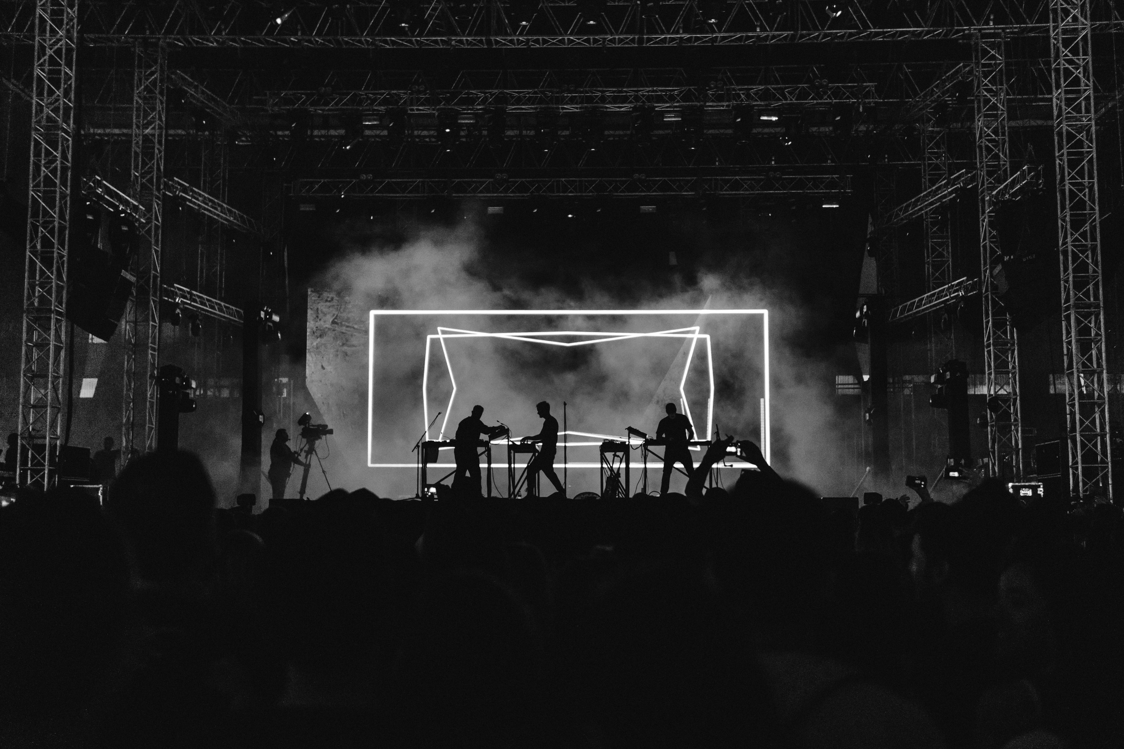
Studio Shodwe
Thank You

