Slide 1

Diva
All I Want For Christmas Is You

Slide 2
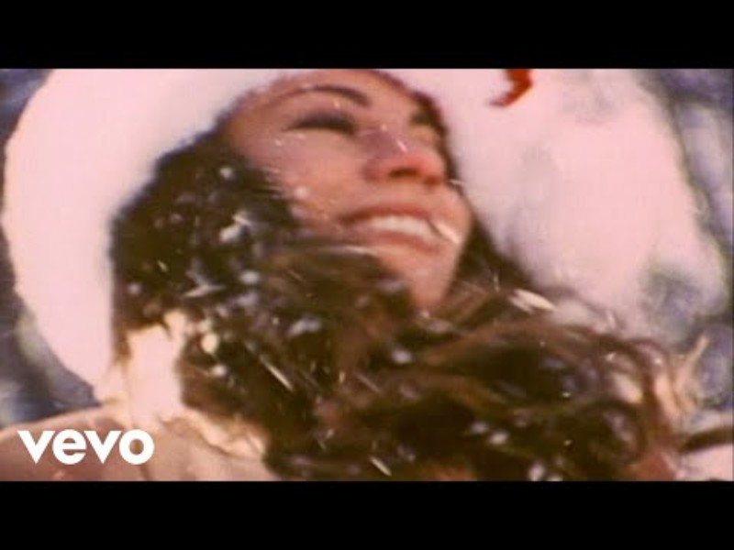

Slide 3
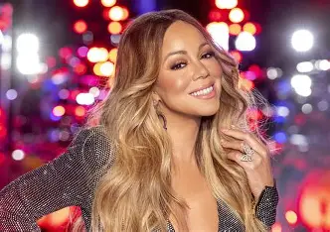

Mariah Carey
  Born:１９６９
  From：New York,USA
  Debut:１９９０（２１years old）
  Genre:Diva
Famous for her powerful voice
  has won 5 Grammy Awards

Slide 4
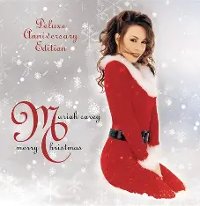
All I Want For Christmas Is You
  Christmas memories
  Makes us feel happy
  A song We hear every year

Slide 5

Song Information
  Released ：１９９４
  Album：Merry Christmas
  Theme : Love & Christmas

Slide 6


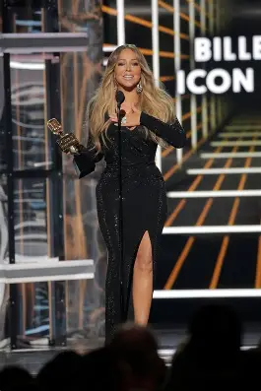
Awards & Records
  RIAA Diamond Award（２０２１）
  Billboard Hot 100＃１in ２０１９
  Vews : ８４０million on Youtube

Slide 7

The message
She doesn’t want presents.
She only wants the person she loves.

Slide 8


The Story
Behind the Song
  written in about １５minites!
  Recorded in August
- in the middle of summer!

Slide 9


What Makes It a “diva” song?
  Powerful vocals
  High notes
  wide vocal range
  Emotional singing
  Confident performance

Slide 10
Important Word
① presents
things that you give to someone as a gift

Slide 11
Important Word
② underneath
⇨under something

Slide 12
Important Word
③ fireplace
a place in a house where you make a fire

Slide 13
Let's try singing

Slide 14
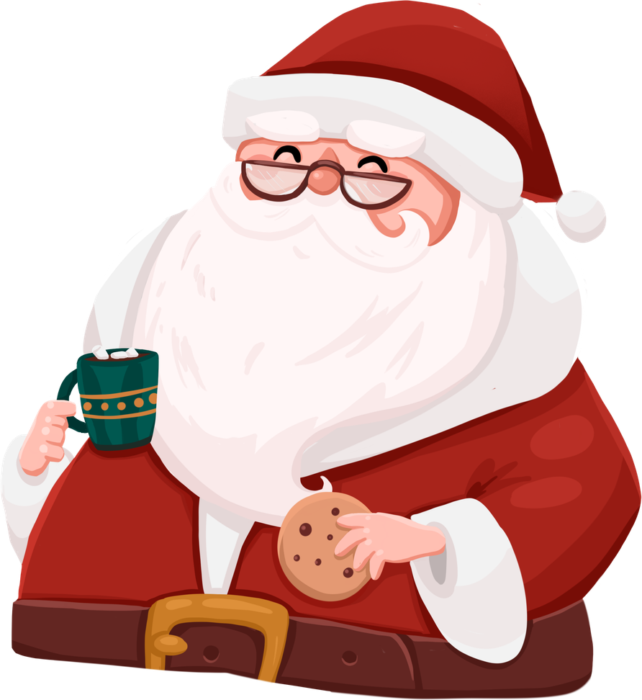
pronunciation
①I just want you for my own
→(I jus wan-choo for my own)
②More than you could ever know
→(More than yoo cou-de-ver know)
③Make my wish come true
→(Make my wish come troo)
④All I want for Christmas is you
→(Aw-ly wan-for Christ-ma-siz you)

Slide 15
Let's try singing
Lyrics
I just want you for my own
Beats
1
2
3
4
1
2
3
4
Lyrics
More than you could e-ver know
Beats
1
2
3
4
1
2
3
4

Slide 16
Let's try singing
Lyrics
make my wish come tr--ue
Beats
1
2
3
4
1
2
3
4
Lyrics
All I want for Christ--mas with you
Beats
1
2
3
4
1
2
3
4
1

Slide 17
Let's quiz

Slide 18
No.1 When was she born?
No.2 What does “underneath” mean?
No.3 When was this song released?
No.4 What is the theme of this song?
→Christmas and ____

Slide 19




Let’s check the answers!

Slide 20
No.1 1969
No.2 under something
No.3 1994
No.4 Christmas and love

Slide 21

Thank You
It might still feel like Christmas is a long way off, but Christmas will be here after just 15 more Sundays!
Christmas is coming soon…

