Slide 1


HOW DEEP?

Slide 2
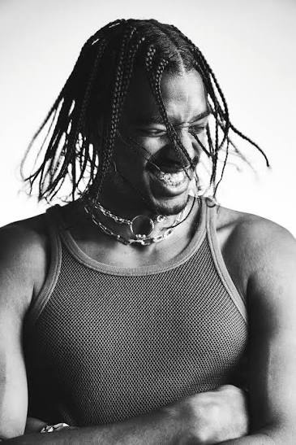
TAI VERDES
Who is
【Profile】
BORN: 1995
Nationality: US
GENRE:R & B, Pop
Influenced by: Kenye West
Hit:A-O-K, Stuck in the middle

Slide 3
Remember : What is R&B ?
Roots in Blues, Jazz & Gospel
Focusing on Romance & Everyday LIfe
A Groovy Beat & Emotional Vocal

Slide 4
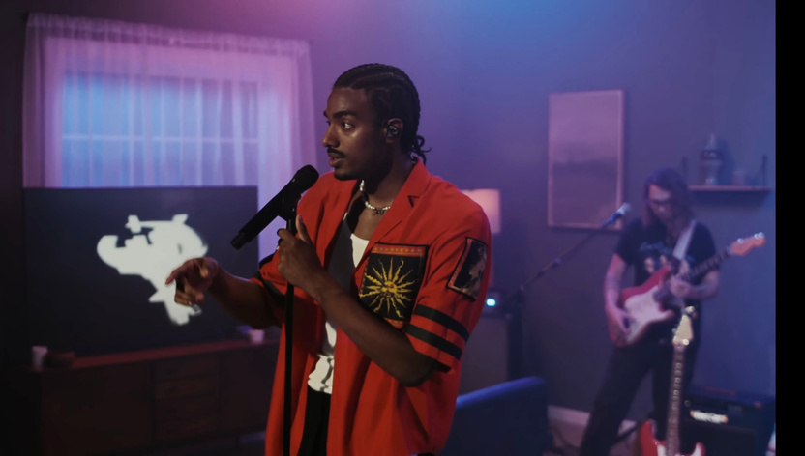
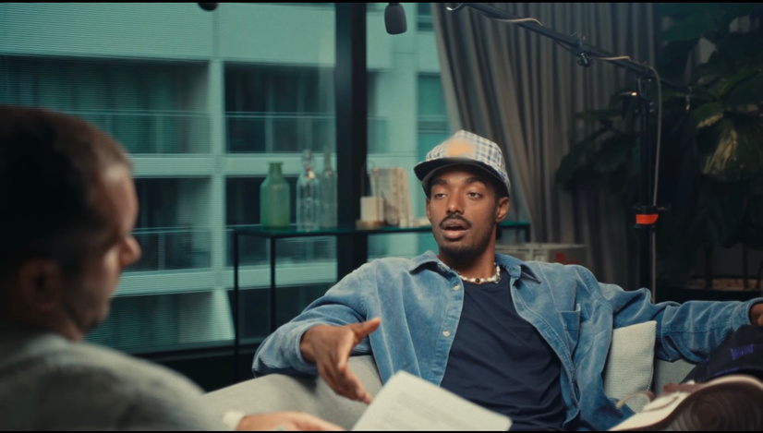
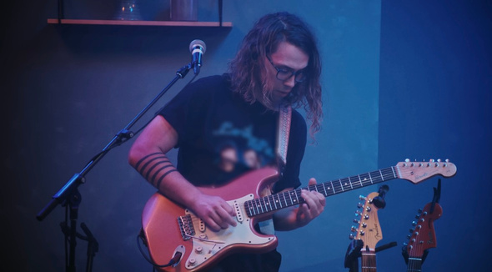
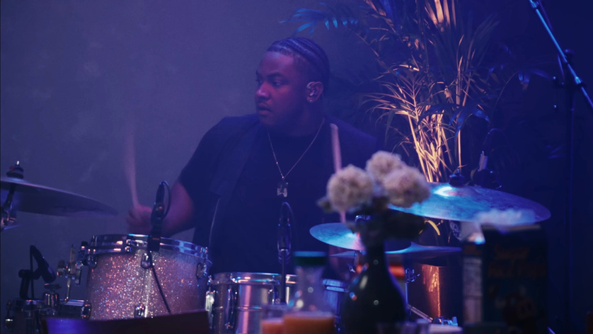
Why is the song R&B ?
Smooth Vocals
Relaxed Groove
Guitar × Drums

Slide 5
Let’s listen to the song!!
https://youtu.be/RqBA1JaOQ78?si=75JNbepJ0yHkTkYK
Click on “C” to see the lyrics

Slide 6
Answers to the Fill-in-the-Blank Lyrics
  Hey
  my fault
  my place
  my heart
  how deep
  love me forever

Slide 7


Let's
Understand the song

Slide 8
The theme of this song
unexpectedly falling in love and not knowing
how deep those feelings will become

Slide 9



Opening Lines
It always starts with a "Hey"
Turns into "How was your day?"
Turns into "Meet at my place"
Turns into you and me drinking rosé
Turns into "How did you sleep?"
Turns into "It′s been a week"
Turns into gave you a key
Turns into conversations talking 'bout what are we?

Slide 10


Let's
Learn important phrase

Slide 11
① How I'm ′posed to know how deep?
② make my heart skip beats
③ Didn’t mean to take that leap

Slide 12

「am I supposed」
① How I'm ′posed to know how deep?
→I never imagined that I would fall this deeply in love.
② make my heart skip beats
→She makes his heart beat faster.
「take a risk and try something new」
③ Didn't mean to take that leap
→I didn’t plan to take a big step and fall in love.

Slide 13
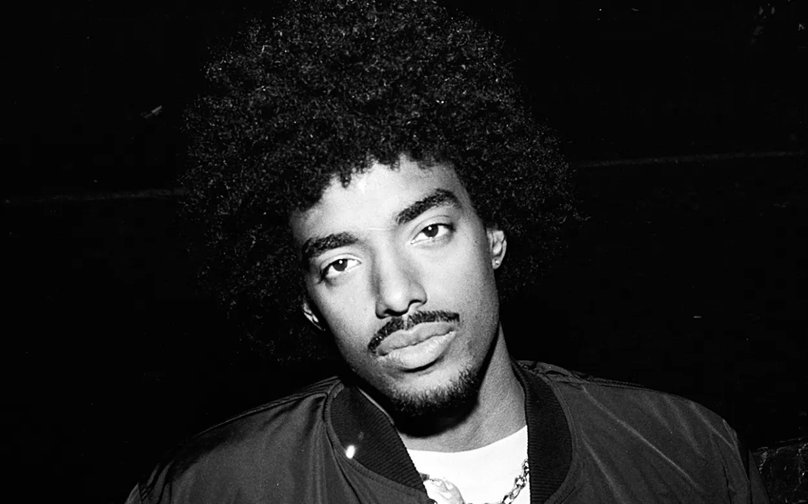
Let's
Sing together !

Slide 14
How I'm ′posed to
know how
deep?
How I'm ′posed to
know how
deep?
I'd fall
How'd you make my
heart skip
beats
Didn′t mean to
take that
leap
My fault

Slide 15
How-im-pos-to-
know-how
deep?
How-im-pos-to-
know-how
deep?
id fall
Hou-juh make my
har-skip
beats
Didn′ mean tuh
take-tha
leap
My fault

Slide 16

Review QUIZ !
① Who sings “how deep?” ?
② What is the theme of “how deep?”
③What dose I'm ′posed mean?

Slide 17


The answer is...
① Tai Verdes
② How deep is feelings when you fall in love
③ I’m supposed or
I am expected to do something

Slide 18

THANK YOU FOR LISTENING !

