Slide 1


Diva
We are Never Ever Getting Back together
Taylar Swift

Slide 2


We Are Never Ever Getting Back Together

Slide 3
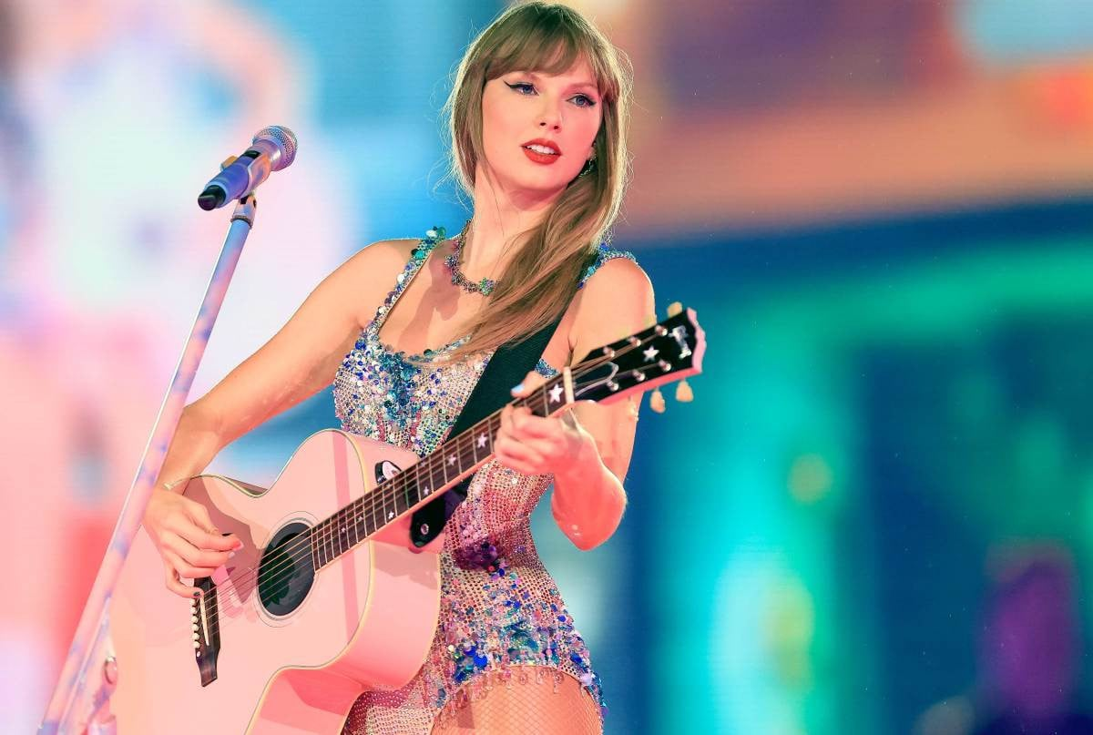

Taylor Swift
  Born : １９８９
  From : USA
  Debut : ２００６（１６yaers old）
  Genre : Diva
Known for writing songs about her
personal experiences

Slide 4
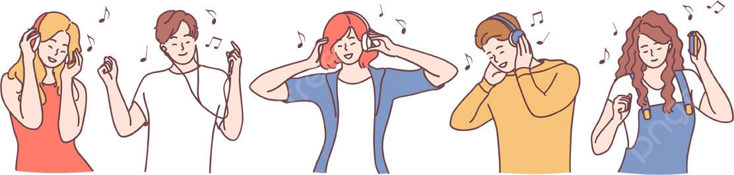
Why did we Choose This Song
One of the first Talor Swift songs we Knew
The title caught our attention
The contrast between the theme and the mood is interesting

Slide 5




What to listen for
  Rhythm
  Repetition especially the title
  Pronunciation & intonation

Slide 6
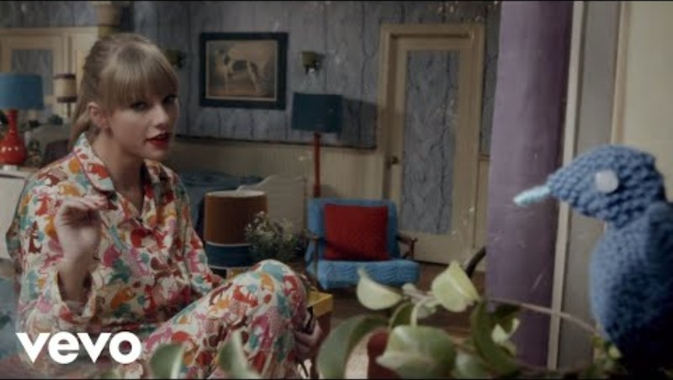
動画

Slide 7
♪the answers for the blanks♪
①enough ②space ③change
④off ⑤together ⑥flights
⑦mind ⑧mine

Slide 8



Song Information
  released : 2012
  Album : Red
  Theme: An on-and-off relationship

Slide 9

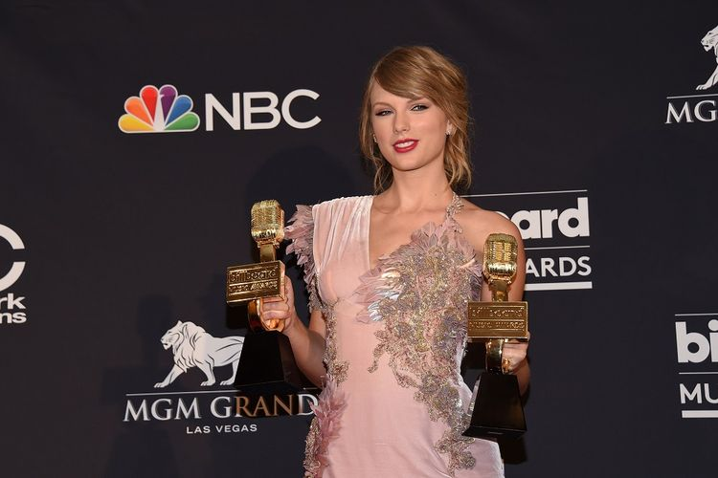

Awards & records
Teen choice Award – Choice single :
Female（２０１３）
No.１on the billboard Hot １００
６✕Platinum certified in the U.S.
Over ８００ million streams on Spotify

Slide 10

The message
" I've had enough, and I'm moving on"
Sometimes, the best choice is to
move on and stop the same relationship.

Slide 11
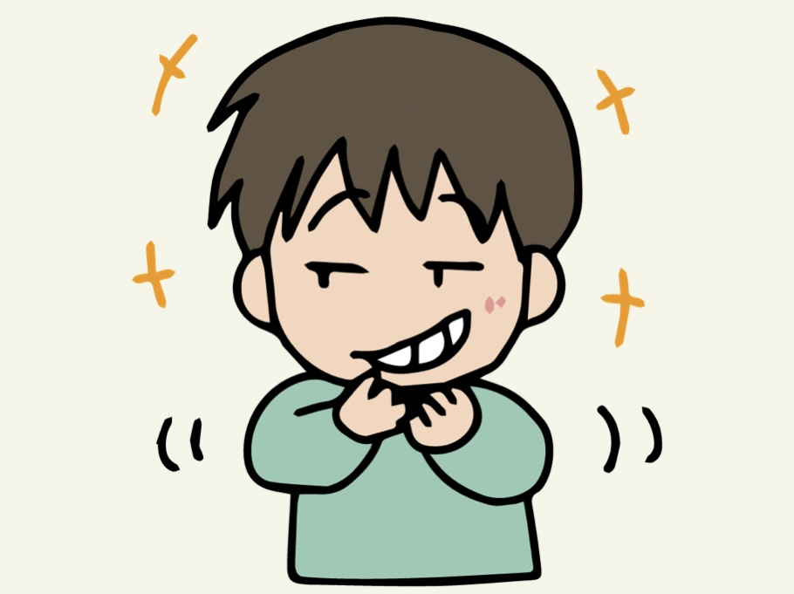

Fun Facts - Background Story
①Talor’s ex-boyfriend’s friend visited the studio
②ex-boyfriend’s friend :〝You might get back together”
③Talor: ‶Never Ever！”
This phrase became the main idea of the song!

Slide 12


Why is this a ‶Diva” song?
  Strong attitude
  Powerful message
  Catchy & energetic
  Confident female image
Strong + Confident + Empowering = Diva

Slide 13
Important Word
♪Chorus♪
We are never ever ever.... getting back together
You go talk to your friends, talk to my friends, talk to me
But we are never ever ever ever... getting back together

Slide 14
Important Word
⭐️never ever
⇨“not at any time.”

Slide 15
Important Word
⭐️get back together (with ~)
⇨“start a relationship again after breaking up
”

Slide 16
Important Word
⭐️talk to
⇨“Start a conversation”

Slide 17

Let's Practice Pronunciation and Sing

Slide 18
Pronunciation
1. Word Linking & Glides
We are never ever getting back together
"getting back": Drop the sharp "t" in getting to make a soft "d" sound (flap T), and blend it right into back: "ged-ding-back".
Full phrase flow: "ged-ding-back tu-ge-ther"
You go talk to your friends
Blend "talk to" into "tawk-tu" rather than pausing between the words.

Slide 19
Pronunciation
2. Conversational Dropping (Reductions)
Taylor sings this track almost like she is talking animatedly to a friend. Soften trailing consonants to keep up with the fast tempo:
Like, ever ➞Pronounce as "Li-ke-ver" in one quick motion.
Used to say ➞Soften the d into a light s: "yoo-stu-say".
With a hate like yours ➞Connect hate and like: "hayt-like-yors".

Slide 20
Let's try singing
Lyrics
We are never, ever, ever getting back together
Beats
1
2
3
4
1
2
3
4
Lyrics
We are never, ever, ever getting back together
Beats
1
2
3
4
1
2
3
4

Slide 21
Let's try singing
Lyrics
You go talk to your friends, talk to my friends, talk to me
Beats
1
2
3
4
1
2
3
4
Lyrics
But
we are never, ever, ever, ever getting back together
Beats
1
2
3
4
1
2
3
4
1

Slide 22

Let’s quiz

Slide 23
No.1 When was Taylor Swift born?
No.2 When was this song released?
No.3 Why is this a Diva song?
？？ + ？？ + ？？ = Diva

Slide 24

Let's check the answers

Slide 25
No.1： 1989
No.2 ：2021
No.3 ：Strong + Confident + Empowering
= Diva

Slide 26
Thank you!

