Slide 1

Rewrite the stars
From The Greatest Showman

Slide 2
About this song
‘
‘’ Rewrite the Stars’’ is a famous song from musical movie‘’ The Greatest Showman’’.
This movie was made in2017 and this song was released in the same year.
The song was sung by Zac Efron and Zendaya.
Notes:
‘’ Rewrite the Stars’’ is a famous song from musical movie‘’ The Greatest Showman’’. This movie was made in2017 and this song was released in the same year. The song was sung by Zac Efron and Zendaya.
In the movie Zac Efron plays Philip and Zendaya plays Anne.
They love each other, but there are many differences between them. Because of their social backgrounds and other people’s opinions, it is difficult for them to be together.

Slide 3

Anne
Philip
A performer of the Barnum`s Circus
Lower social class
Black Woman
poor background
Barnum's business partner
Upper class
White man
rich background
Notes:
In the movie Zac Efron plays Philip and Zendaya plays Anne.
They love each other, but there are many differences between them. Because of their social backgrounds and other people’s opinions, it is difficult for them to be together.
The title “Rewrite the Stars” means changing their destiny. Philip believes that they can change their future and be together if they really want to. Anne also has feelings for him, but she knows that it is not easy to overcome the problems between them.
In the song, they sing about their feelings and their wish to change their future.
I think this song is not only about love. It also has a message that we should choose our own future instead of letting other people decide it for us. That is why I think “Rewrite the Stars” is such a meaningful and beautiful song.

Slide 4

Click here

Slide 5
Answer
1 secret
2 tied
3 in the cards
4 destiny
5 rewrite the stars
6 Nothing
7 easy
8 mountains
9 doors
10 hopeless
11 Everything
12 fly
13 fall
14 impossible
15 possible
16 bound

Slide 6
Vocabulary
“You claim it's not in the cards”
be in the cards = likely to happen
“What if rewrite the stars?”
What if -? =used to ask about something that could happen in the future
We’re bound to break and my hands are tied
be bound to = something is certain to happen

Slide 7
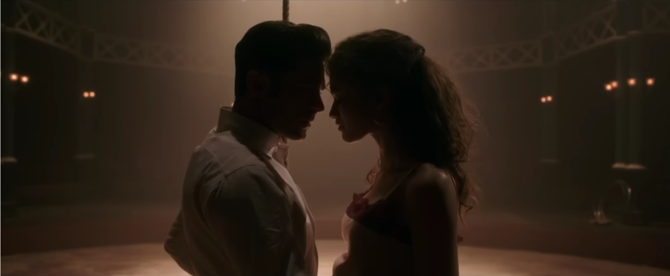
Theme
A love divided by social class
Defying destiny

Slide 8
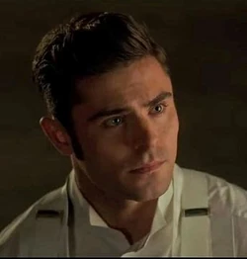
Lyrics -contrast-
Phillip (man)
“Nothing could keep us apart”
“So who can stop me if I decide that’s your my destiny”
“Maybe the world could be ours”
→ He strongly bellieves they can fight against thier destiny

Slide 9
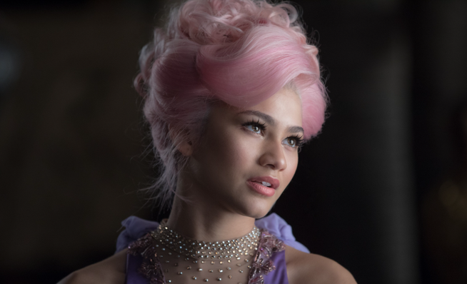
Lyrics -contrast-
Anne (woman)
“Everything keeps us apart”
“You're gonna wake up and see that it was hopeless after all”
“No one can rewrite the stars”
→She loves him but she is facing the reality of thier social differences

Slide 10
The overall message
A deep conflict between ideals and reality
Can we rewrite the distiny?

Slide 11
Review Quiz
1.When is this song released?
2.What is the meaning of rewrite the stars?
The Answer
1.2017
2.change their destiny

Slide 12
Rhythm
What if we rewrite the stars?
Say you were made to be mine.

Slide 13
Thank You

